Slide 1


Augmented Reality Implementation Framework
Example Pack
May 2022
Kristen Phan
MSc Business Information Technology
Supervisor: Ilia Shakitko
January 2023

Slide 2

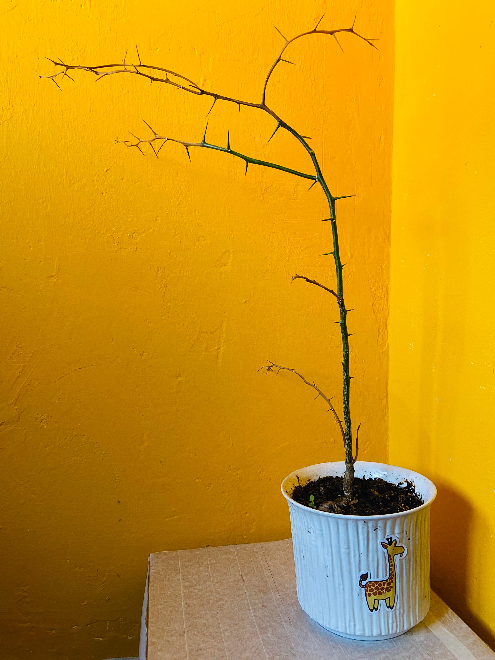
Introduction
AR 101
WebAR Prototype
AR Implementation Framework
Key Takeaways
What Can We Do About Kristen’s Green Thumb Problem?
Before
Now

Slide 3
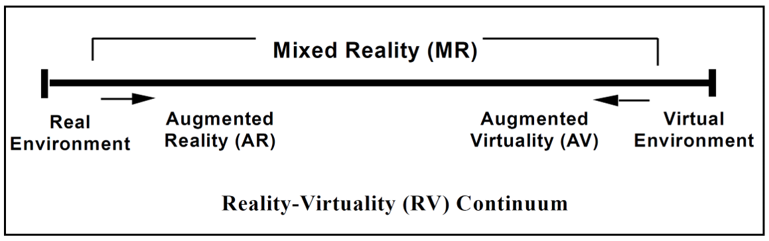

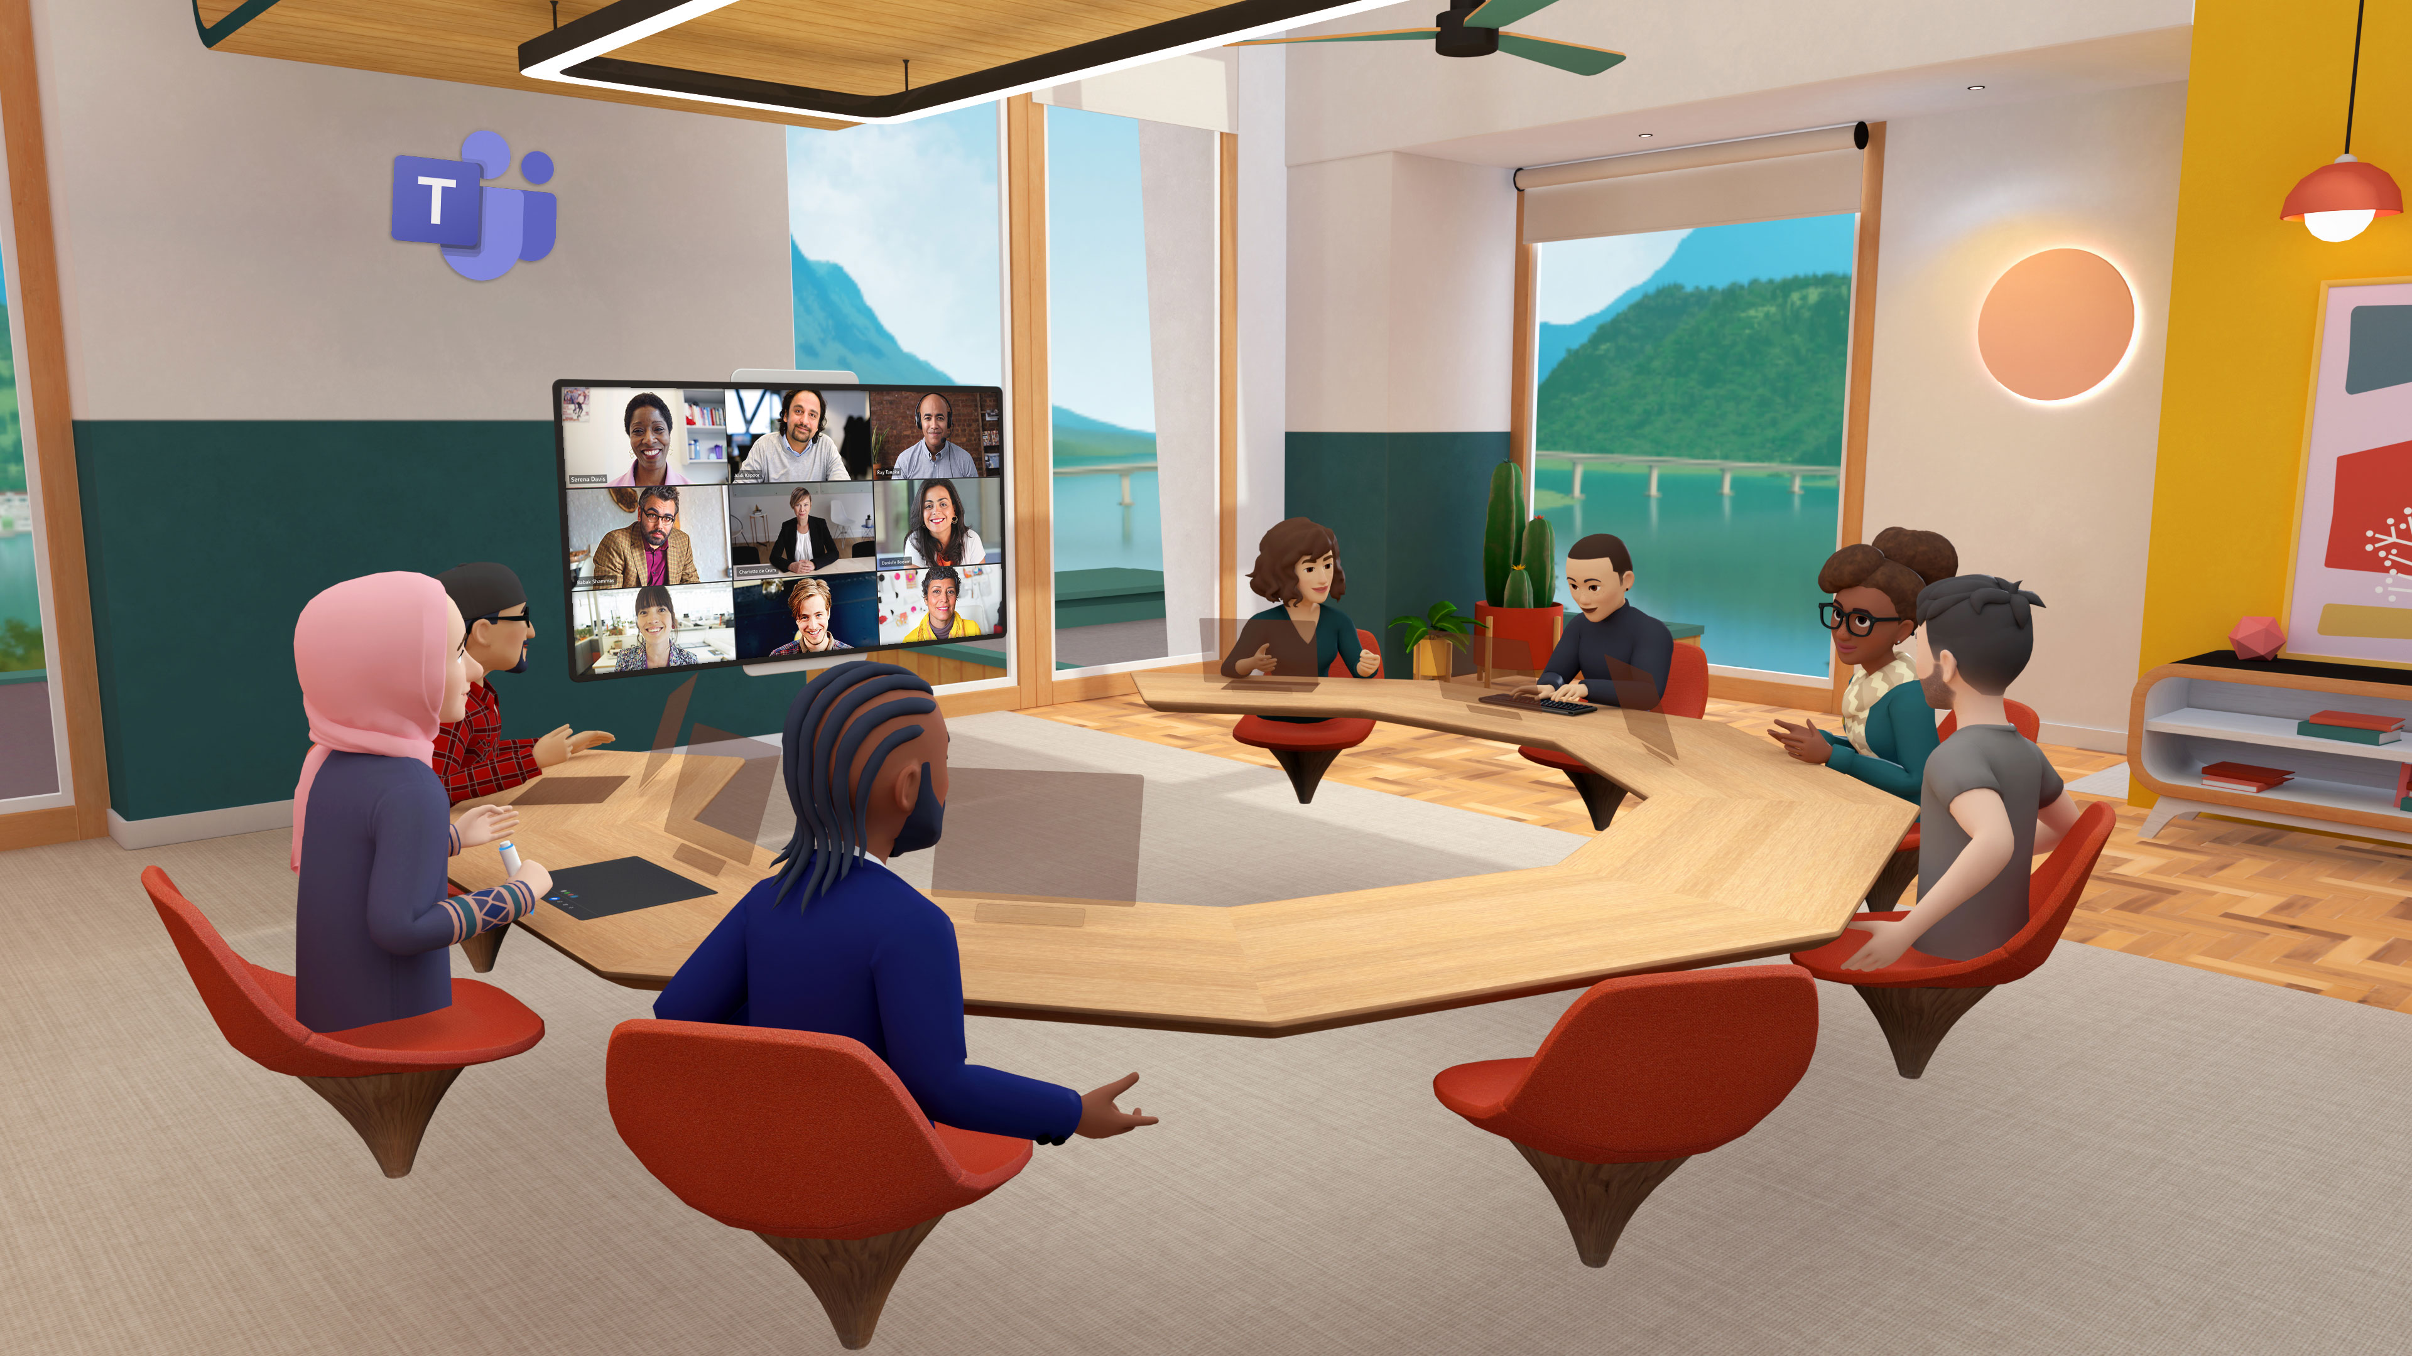
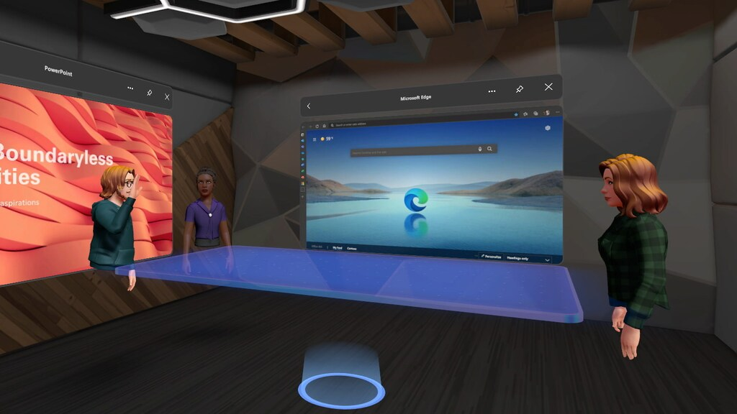
Introduction
AR 101
WebAR Prototype
AR Implementation Framework
Key Takeaways
Augmented Reality (AR) 101: Mixed Reality Spectrum
Source: P. Milgram, H. Takemura, A. Utsumi, and F. Kishino, "Augmented reality: A class of displays on the reality-virtuality continuum," in Telemanipulator and telepresence technologies, 1995, vol. 2351: Spie, pp. 282-292.
Photo credits:
https://gfycat.com/animatedmadbobcat
https://observer.com/2022/10/microsoft-teams-goes-virtual-and-avatars-finally-get-legs-as-mark-zuckerberg-announces-new-metaverse-developments/
https://www.rtlnieuws.nl/tech/artikel/5264551/microsoft-stort-zich-op-metaverse-teams-krijgt-live-3d-avatars

Slide 4
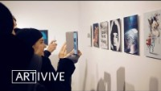
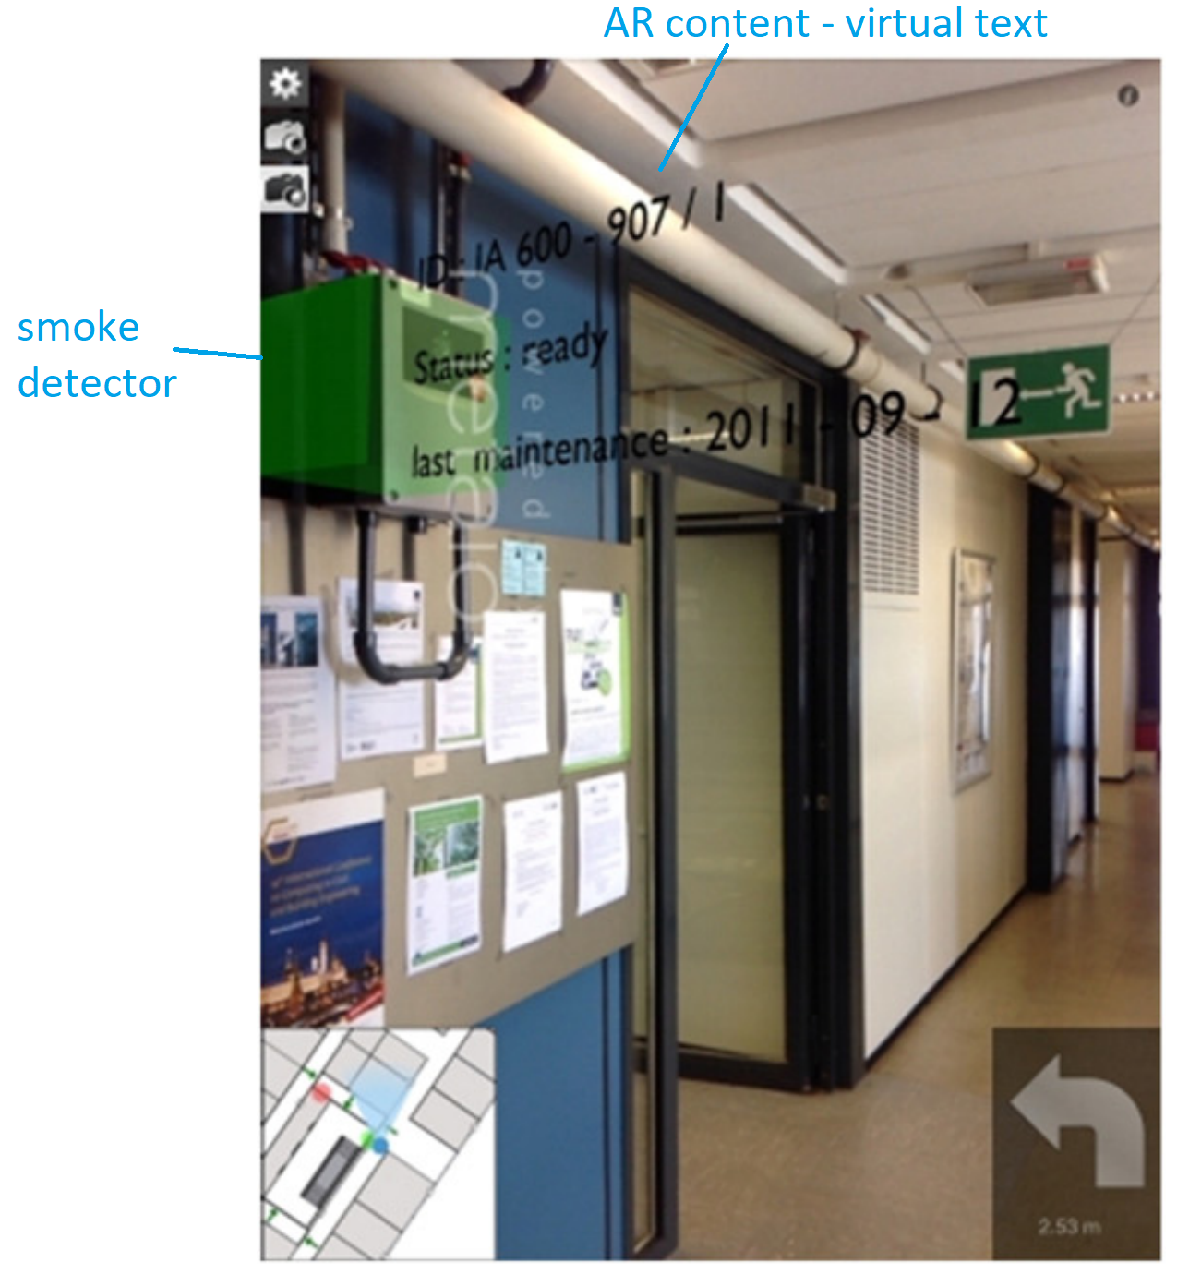
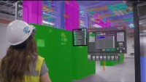

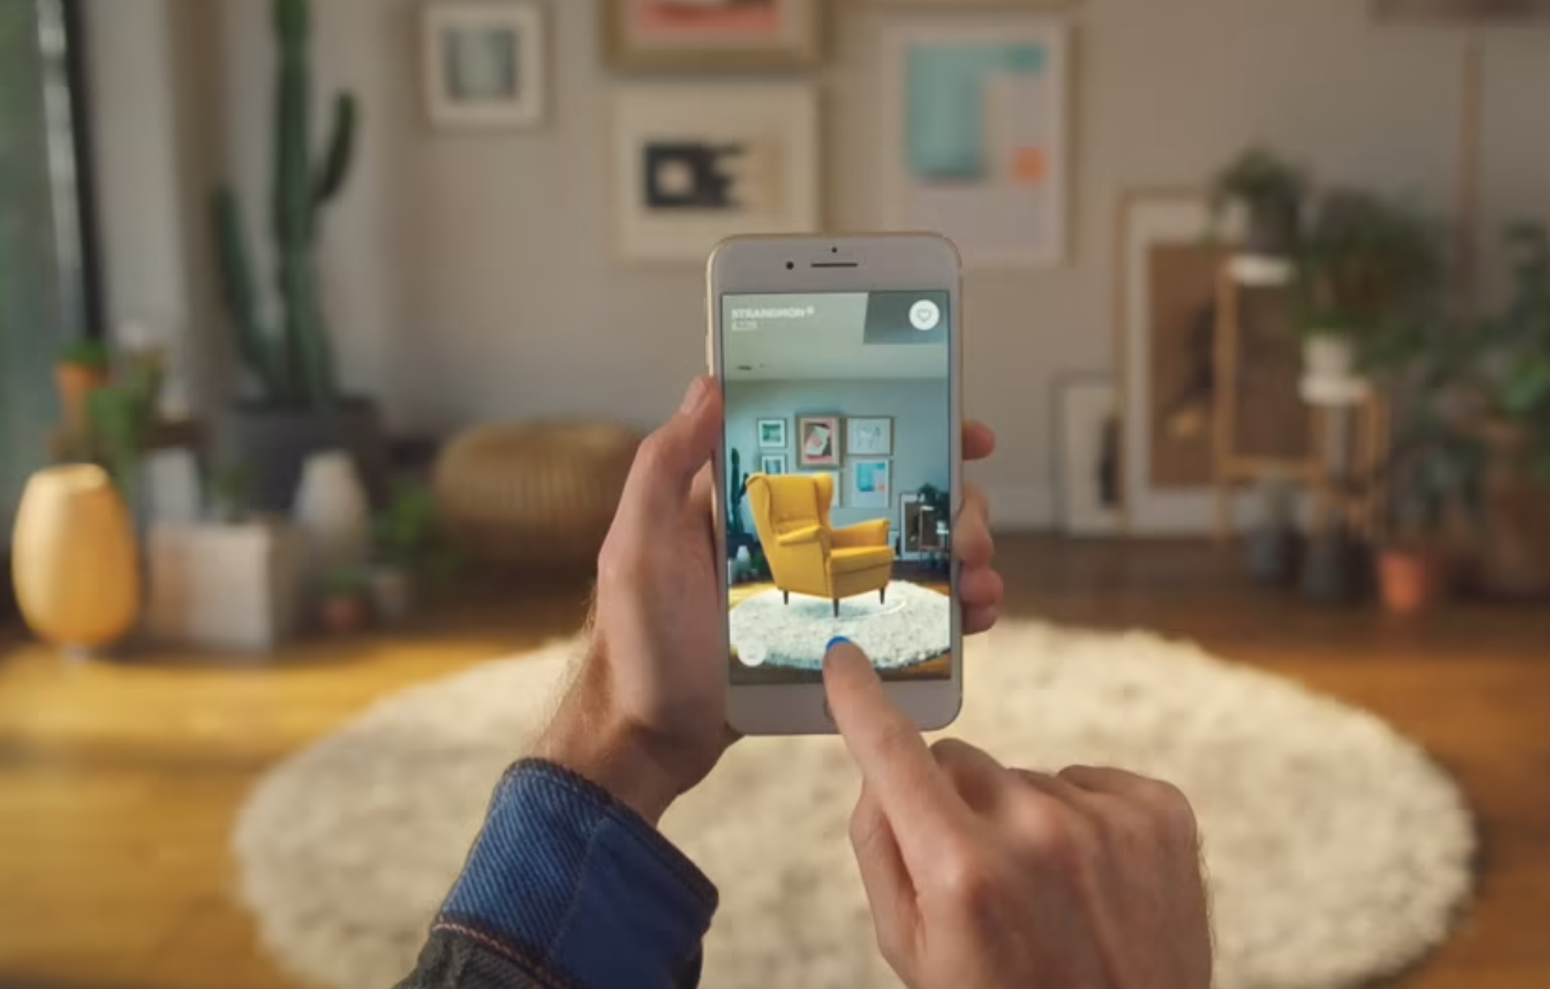
Introduction
AR 101
WebAR Prototype
AR Implementation Framework
Key Takeaways
AR: How Does It Work?
Two technologies underlie AR:
Tracking engine = Tracking the location + orientation of a physical object/ environment from live camera feed.
Rendering engine = Displaying a virtual object as anchored to the physical object/ environment
Common tracking techniques:
1. Fiducial/ image marker: 2D images
1
2
2. Object: 3D objects
3. Face: Snapchat filters
4. Location
5. Surface: planar surface
6. Spatial: 3D mesh of an environment
7. Others: Depth, hand, eye, body, head, controller tracking
6
4
5
https://www.ikea.com/au/en/customer-service/mobile-apps/say-hej-to-ikea-place-pub1f8af050
Notes:
https://www.ultraleap.com/tracking/gemini-hand-tracking-platform/#:~:text=The%20fifth%20generation%20of%20the,different%20platforms%20and%20camera%20hardware.

Slide 5
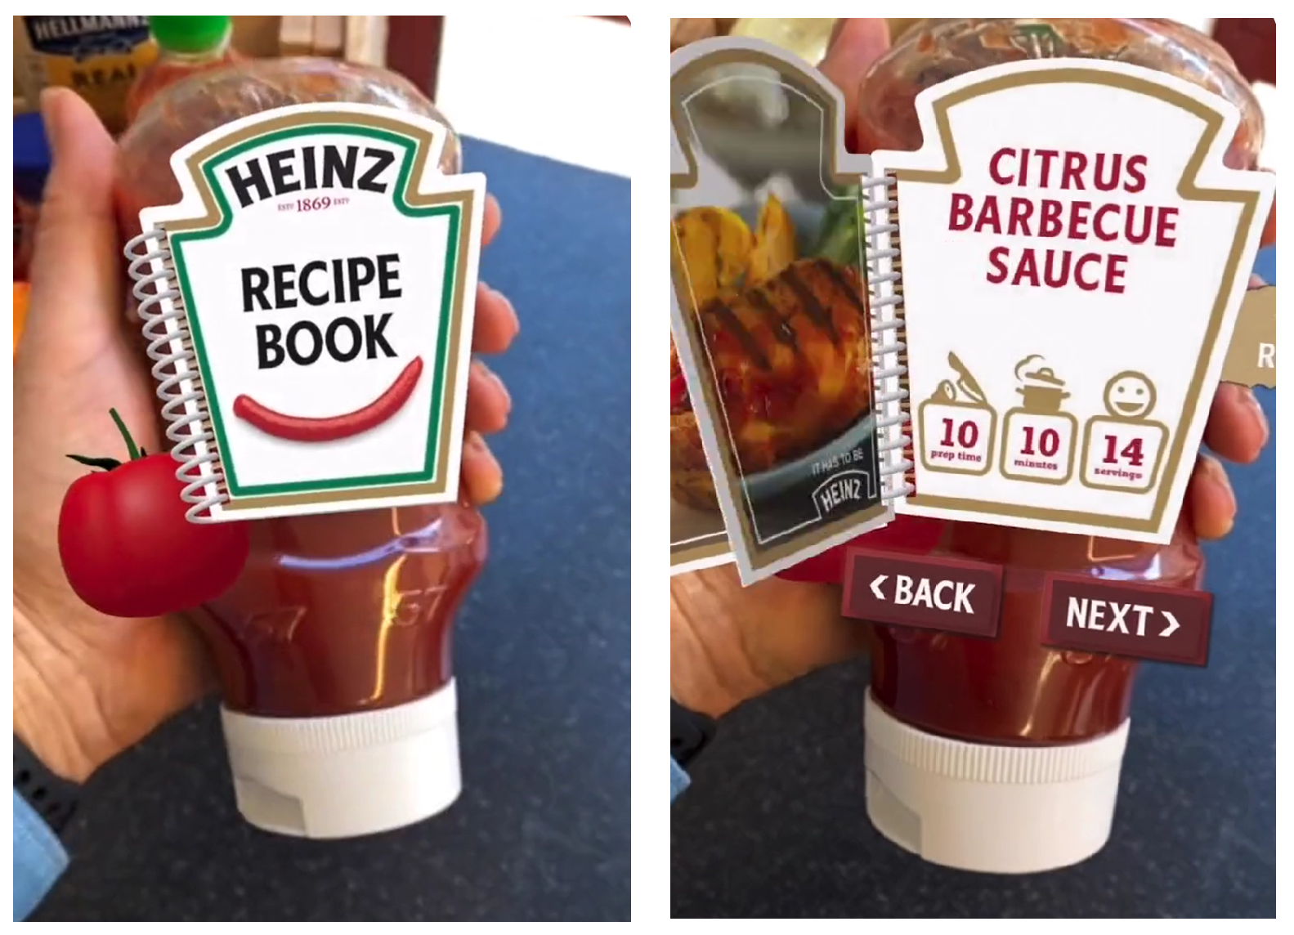
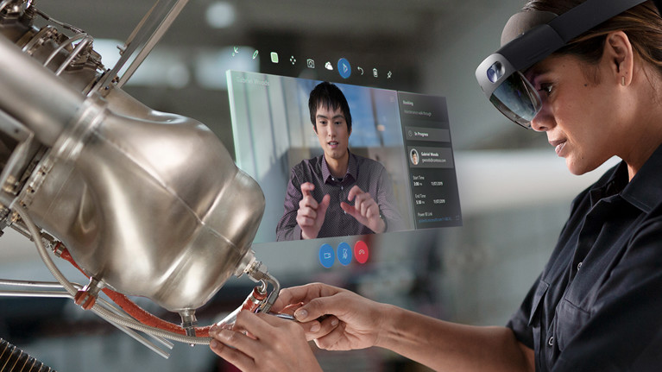
Introduction
AR 101
WebAR Prototype
AR Implementation Framework
Key Takeaways
AR 101: AR Platforms – Native AR v. WebAR v. AR Headset
Each AR platform has its capabilities and limitations.
Native AR + WebAR
AR Headset
> Native AR apps: Downloaded to and installed on user device.
> Web AR apps: Run directly from web browser; web apps are sharable through an URL.
> Requires dedicated hardware: HoloLens, Magic Leap, etc.
> Has built-in tracking capabilities (hand, eye, head, hand-held controller tracking) + can integrate external tracking engine.
A virtual recipe book rendered on the physical label of a Heinz ketchup bottle.
Colleagues collaborate remotely via video call
on a HoloLens headset.
Source: https://www.blippar.com/ar-studio; https://dynamics.microsoft.com/en-gb/mixed-reality/remote-assist/

Slide 6
Introduction
AR 101
WebAR Prototype
AR Implementation Framework
Key Takeaways
AR 101: AR Platforms – Native AR v. WebAR v. AR Headset
Each AR platform has its capabilities and limitations.
Native AR + WebAR
AR Headset
> Native AR apps: Downloaded to and installed on user device.
> Web AR apps: Run directly from web browser; Sharable through an URL.
> Requires dedicated hardware: HoloLens, Magic Leap, etc.
> Has built-in tracking capabilities (hand, eye, head, hand-held controller tracking) + can integrate external tracking engine.
A virtual recipe book rendered on the physical label of a Heinz ketchup bottle.
Colleagues collaborate remotely via video call
on a HoloLens headset.
Source: https://www.blippar.com/ar-studio; https://dynamics.microsoft.com/en-gb/mixed-reality/remote-assist/

Slide 7
Introduction
AR 101
WebAR Prototype
AR Implementation Framework
Key Takeaways
AR 101: AR Platforms – Native AR v. WebAR v. AR Headset
Each AR platform has its capabilities and limitations.
Native AR + WebAR
AR Headset
> Native AR apps: Downloaded to and installed on user device.
> Web AR apps: Run directly from web browser; Sharable through an URL.
> Requires dedicated hardware: HoloLens, Magic Leap, etc.
> Has built-in tracking capabilities (hand, eye, head, hand-held controller tracking) + can integrate external tracking engine.
A virtual recipe book rendered on the physical label of a Heinz ketchup bottle.
Colleagues collaborate remotely via video call
on a HoloLens headset.
Source: https://www.blippar.com/ar-studio; https://dynamics.microsoft.com/en-gb/mixed-reality/remote-assist/

Slide 8
Introduction
AR 101
WebAR Prototype
AR Implementation Framework
Key Takeaways
WebAR Prototype: Show Don’t Tell
Left = plant with image marker
Right = demo recording
Notes:
Desired outcome/ Goal vs. value drivers vs. KPIs:
Desired outcome = operational excellence
Value driver = worker productivity (under “talent”)
KPI = time it takes for workers to complete a task
Desired outcome = help potential investors/ professionals/ future residents explore and invest in NEOM
Value driver = an engaging way to immersively experience what the future of living at The Line is like
---from Accenture 360degree value meter: financial, experience (customer, ee, partner), sustainability, talent, inclusion & diversity, custom (e.g., innovation)
KPI = user feedback on the VR experience; how many investment potentials NEOM’s received.

Slide 9


















Introduction
AR 101
WebAR Prototype
AR Implementation Framework
Key Takeaways
WebAR Prototype: Serverless Architecture
AWS Virtual Private Cloud (VPC)
Sends sensor readings
Uses sensor’s device certificate to authenticate + publish to AWS IoT’s MQTTS broker
Writes sensor data
Device gateway
Sensor mgmt
& sensor data ingestion
Physical plant
Browser hits CloudFront’s endpoint. CloudFront returns static assets via HTTPS
Queries front-end assets (HTML, CSS, JS, media) and cache them at edge nodes
CDN
Front-end
static asset hosting
Browser invokes AWS Lambda function URL (isolating read/ write traffic)
Reads sensor data
User’s browser
Serverless function
Sensor data
(NoSQL database)
Writes watering record
Developer’s device
CI/ CD
Build artifacts storage
Serverless function
Infra-as-Code (IaC)
Watering history
WebAR dev. tools
Reads watering record
Deploys AWS resources
Serverless function

Slide 10
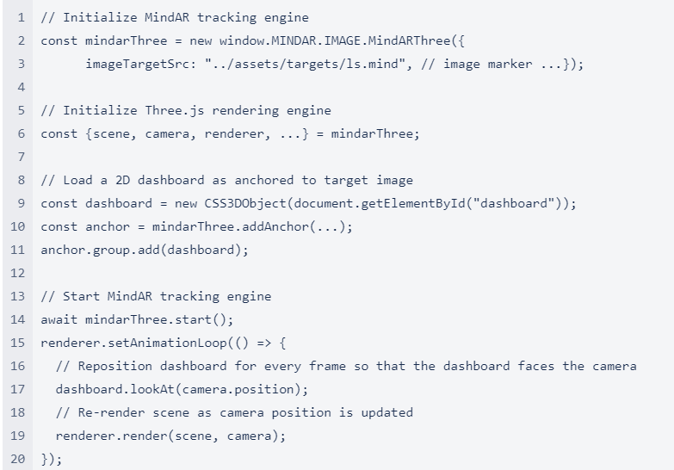
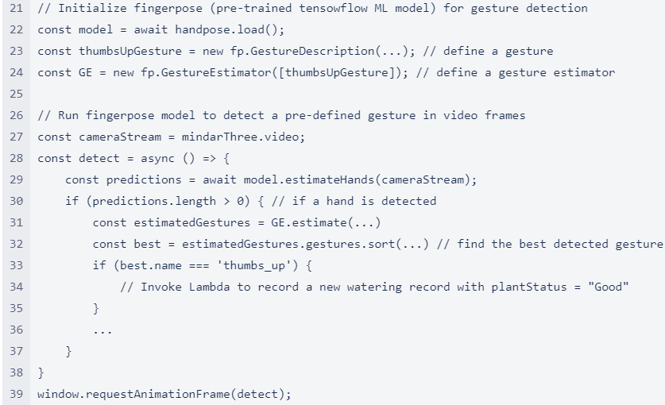
Introduction
AR 101
WebAR Prototype
AR Implementation Framework
Key Takeaways
Frontend Code Deep Dive: Tracking + Rendering + TensorFlow
Notes:
Desired outcome/ Goal vs. value drivers vs. KPIs:
Desired outcome = operational excellence
Value driver = worker productivity (under “talent”)
KPI = time it takes for workers to complete a task
Desired outcome = help potential investors/ professionals/ future residents explore and invest in NEOM
Value driver = an engaging way to immersively experience what the future of living at The Line is like
---from Accenture 360degree value meter: financial, experience (customer, ee, partner), sustainability, talent, inclusion & diversity, custom (e.g., innovation)
KPI = user feedback on the VR experience; how many investment potentials NEOM’s received.

Slide 11
Introduction
AR 101
WebAR Prototype
AR Implementation Framework
Key Takeaways
AR Implementation Framework: 3 Key Questions to Answer
PROCESS SUITABILITY FOR AR
AR PLATFORM SUITABILITY
AR DEV. TOOL SUITABILITY
Can and should a process be enhanced with the use of AR?
Which AR platform (WebAR v. native AR v. AR headset) is most suitable for the process?
Which AR development tools (tracking + rendering engines) are suitable for the select process and AR platform?
Notes:
Desired outcome/ Goal vs. value drivers vs. KPIs:
Desired outcome = operational excellence
Value driver = worker productivity (under “talent”)
KPI = time it takes for workers to complete a task
Desired outcome = help potential investors/ professionals/ future residents explore and invest in NEOM
Value driver = an engaging way to immersively experience what the future of living at The Line is like
---from Accenture 360degree value meter: financial, experience (customer, ee, partner), sustainability, talent, inclusion & diversity, custom (e.g., innovation)
KPI = user feedback on the VR experience; how many investment potentials NEOM’s received.

Slide 12
Introduction
AR 101
WebAR Prototype
AR Implementation Framework
Key Takeaways
AR Implementation Framework: 3 Key Questions to Answer
PROCESS SUITABILITY FOR AR
AR PLATFORM SUITABILITY
AR DEV. TOOL SUITABILITY
Can and should a process be enhanced with the use of AR?
Which AR platform (WebAR v. native AR v. AR headset) is most suitable for the process?
Which AR development tools (tracking + rendering engines) are suitable for the select process and AR platform?
Notes:
Desired outcome/ Goal vs. value drivers vs. KPIs:
Desired outcome = operational excellence
Value driver = worker productivity (under “talent”)
KPI = time it takes for workers to complete a task
Desired outcome = help potential investors/ professionals/ future residents explore and invest in NEOM
Value driver = an engaging way to immersively experience what the future of living at The Line is like
---from Accenture 360degree value meter: financial, experience (customer, ee, partner), sustainability, talent, inclusion & diversity, custom (e.g., innovation)
KPI = user feedback on the VR experience; how many investment potentials NEOM’s received.

Slide 13
Introduction
AR 101
WebAR Prototype
AR Implementation Framework
Key Takeaways
AR Implementation Framework: 3 Key Questions to Answer
PROCESS SUITABILITY FOR AR
AR PLATFORM SUITABILITY
AR DEV. TOOL SUITABILITY
Can and should a process be enhanced with the use of AR?
Which AR platform (WebAR v. native AR v. AR headset) is most suitable for the select process?
Which AR development tools (tracking + rendering engines) are suitable for the select process and AR platform?
Notes:
Desired outcome/ Goal vs. value drivers vs. KPIs:
Desired outcome = operational excellence
Value driver = worker productivity (under “talent”)
KPI = time it takes for workers to complete a task
Desired outcome = help potential investors/ professionals/ future residents explore and invest in NEOM
Value driver = an engaging way to immersively experience what the future of living at The Line is like
---from Accenture 360degree value meter: financial, experience (customer, ee, partner), sustainability, talent, inclusion & diversity, custom (e.g., innovation)
KPI = user feedback on the VR experience; how many investment potentials NEOM’s received.

Slide 14
Introduction
AR 101
WebAR Prototype
AR Implementation Framework
Key Takeaways
AR Implementation Framework: 3 Key Questions to Answer
PROCESS SUITABILITY FOR AR
AR PLATFORM SUITABILITY
AR DEV. TOOL SUITABILITY
Can and should a process be enhanced with the use of AR?
Which AR platform (WebAR v. native AR v. AR headset) is most suitable for the process?
Which AR development tools (tracking + rendering engines) are suitable for the select process and AR platform?
Notes:
Desired outcome/ Goal vs. value drivers vs. KPIs:
Desired outcome = operational excellence
Value driver = worker productivity (under “talent”)
KPI = time it takes for workers to complete a task
Desired outcome = help potential investors/ professionals/ future residents explore and invest in NEOM
Value driver = an engaging way to immersively experience what the future of living at The Line is like
---from Accenture 360degree value meter: financial, experience (customer, ee, partner), sustainability, talent, inclusion & diversity, custom (e.g., innovation)
KPI = user feedback on the VR experience; how many investment potentials NEOM’s received.

Slide 15
AR Implementation Framework (ARIF)
4,3
Iterative
DISCOVER
DESIGN
DEVELOP
DEPLOY
VALIDATE
3,7
5
4
2,7
ACTIVITY
Identify opportunity
Assess process suitability for AR
Assess AR platform suitability:
WebAR vs. Native AR vs. AR-on-headset
Assess AR dev. tool suitability
Refine process requirements
Develop
AR app
Deploy AR app
Test AR app with users
Sub-activities:
1. Define user personas + map user journey to identify desired outcomes and value drivers (CR3)
2. Define KPIs (CR3)
> How to measure the value drivers?
3. Collect process requirements (CR1)
> Ergonomics, data and privacy, health and safety regulations, etc.
4. Conduct a risk assessment (CR14)
> What (non)-psychological factors will likely impede the implementation of AR solutions (e.g., user’s fear of job loss, inadequate training)?
Characteristics which make a
process ideal for AR:
1. Content enriching
Benefits from intuitive ways to aggregate, publish, and interact with content as anchored to physical environment.
2. Work instructions
Benefits from step-by-step guidance in 3D.
3. Hard-to-simulate
environment
Users need to interact with 3D environments which are hard to simulate in real life e.g., patient anatomy for surgical planning.
4. Hands-free access to contents (PC6)
Users need to access contents hands-free while performing a task e.g., surgeons viewing patient data during surgery.
5. Navigation
Users need to be guided to find a location/ object.
6. Collaboration
Users across geographies work together with 3D contents.
Selection criteria:
1. Usage conditions-specific:
1. Lighting conditions
2. Network connectivity: offline mode support yes/ no
3. Noise
4-5. Temperature + humidity
6-7. Drop-safe + water/dust-proof
8. Compliance with health/ safety standards
9. Hand usage: hands-free yes/ no
10. User interactions: hand, eye, headset tracking; voice commands
11. Movement restrictions: e.g., tethered AR headsets cause more restrictions than a phone/ tablet/ non-tethered AR headsets
2. Hardware-specific:
1. Battery life
2. Device weight: causes head fatigue
3. Field-of-view
4-5. Camera + display resolution
6. Refresh rate
7-9. Storage + computation + remote rendering
10. Cross-device development
11. App download required: yes/ no
12. Cost: hardware + subscription
Selection criteria:
1. Tracking capability (CR16)
1-2. Fiducial+image tracking
3. Object tracking
4. Face tracking
5. Location tracking
6. Surface tracking
7. Spatial tracking
8. Other tracking techniques
9. Multi-marker tracking
10. Multi-user AR session
11. Depth tracking
12. Light effects
2. Rendering capability (CR17)
1. Light estimation
2. Occlusion
3. Ease of development (CR6)
1. Integration with other AR dev. tools
2. Simulation/ remote testing
3. No-code/ low-code development
4. Licensing cost (CR7)
1. Open-source: yes/ no
Sub-activities:
1. Refine process requirements collected from Discovery phase
> Functional requirements are captured as user stories
> Non-functional requirements are used as part of acceptance criteria for relevant user stories
Requirements:
1. Flexible architecture for maintainability, agility, and time-to-market (CR8)
> Microservice architecture
> Agile development
Requirements:
1. CI/CD (CR9)
2. Design for cost optimization (CR10)
E.g., Serverless architecture, auto-scaling
3. Design for performance (CR12)
E.g., Multi-zone availability, auto-scaling
4. Design for security (CR13)
E.g., Least-privilege, zero-trust zone, infra-as-code
Sub-activities:
1. Collect user feedback (CR15)
2. Validate value drivers + measure KPIs (CR4)
3. Create training materials (CR11)
ACTIVITY GUIDANCE
1. Stakeholder needs + expectations
2. User personas + user journeys
3. Prioritized use cases + value drivers + KPIs
4. Use case requirements
5. Risk assessment
1. AR platform(s) selection
2. AR development tools selection
3. Detailed functional/ non-functional requirements
4. High-level roadmap of prioritized AR use cases
1. Product backlog
2. Test cases
3. Working MVP
1. CI/CD pipelines
2. Cloud infrastructure configurations
1. Sprint review
2. Training materials
3. Validated value drivers/ KPIs
OUTCOME
Notes:
Desired outcome/ Goal vs. value drivers vs. KPIs:
Desired outcome = operational excellence
Value driver = worker productivity (under “talent”)
KPI = time it takes for workers to complete a task
Desired outcome = help potential investors/ professionals/ future residents explore and invest in NEOM
Value driver = an engaging way to immersively experience what the future of living at The Line is like
---from Accenture 360degree value meter: financial, experience (customer, ee, partner), sustainability, talent, inclusion & diversity, custom (e.g., innovation)
KPI = user feedback on the VR experience; how many investment potentials NEOM’s received.

Slide 16
Introduction
AR 101
WebAR Prototype
AR Implementation Framework
Key Takeaways
AR Implementation Framework
AR IMPLEMENTATION FRAMEWORK: GUIDING AR USE CASE ASSESSMENT
ACTIVITY
Assess process suitability
for AR
Assess AR platform suitability**:
WebAR vs. Native AR vs. AR-on-headset
Assess AR dev. tool suitability**:
Tracking + Rendering Engine
Refine process requirements
Characteristics which make a process ideal for AR:
1. Location-based context
E.g., AR-guided work instructions anchored to a machine, AR dashboard for machine status monitoring
2. Hard-to-simulate environment
E.g., 3D patient anatomy for pre-surgical planning, 3D mesh of crime scene, virtual product prototyping
3. Hands-free access to content
E.g., surgeons viewing patient data during surgery.
4. Remote assist
E.g., Remote workers visually guide and collaborate with local workers without geographical constraints.
5. Navigation
E.g., AR-guided emergency & rescue
DISCOVERY*
AGILE*:
DESIGN > DEVELOP > DEPLOY > VALIDATE
Produces ARIF’s inputs:
User personas
User journeys
List of potential AR use cases to be validated using ARIF
Preliminary process requirements (i.e., use case requirements): incl. ergonomics, health and safety standards, privacy and data protection
Risk assessment: (non)-psychological risks
Receives ARIF’s outputs:
Validation if AR is suitable for target use cases
If yes, AR platform selection, AR development tools selection, refined process requirements, and a high-level roadmap of prioritized AR use cases
ACTIVITY GUIDANCE
* Accenture’s existing frameworks
** Supplemented with Definition Tables + Decision Matrices
Notes:
Desired outcome/ Goal vs. value drivers vs. KPIs:
Desired outcome = operational excellence
Value driver = worker productivity (under “talent”)
KPI = time it takes for workers to complete a task
Desired outcome = help potential investors/ professionals/ future residents explore and invest in NEOM
Value driver = an engaging way to immersively experience what the future of living at The Line is like
---from Accenture 360degree value meter: financial, experience (customer, ee, partner), sustainability, talent, inclusion & diversity, custom (e.g., innovation)
KPI = user feedback on the VR experience; how many investment potentials NEOM’s received.

Slide 17

Introduction
AR 101
WebAR Prototype
AR Implementation Framework
Key Takeaways
AR Implementation Framework
AR IMPLEMENTATION FRAMEWORK: GUIDING AR USE CASE ASSESSMENT
ACTIVITY
Assess process suitability
for AR
Assess AR platform suitability**:
WebAR vs. Native AR vs. AR-on-headset
Assess AR dev. tool suitability**:
Tracking + Rendering Engine
Refine process requirements
Characteristics which make a process ideal for AR:
1. Location-based context
E.g., AR-guided work instructions anchored to a machine, AR dashboard for machine status monitoring
2. Hard-to-simulate environment
E.g., 3D patient anatomy for pre-surgical planning, 3D mesh of crime scene, virtual product prototyping
3. Hands-free access to content
E.g., surgeons viewing patient data during surgery.
4. Remote assist
E.g., Remote workers visually guide and collaborate with local workers without geographical constraints.
5. Navigation
E.g., AR-guided emergency & rescue
DISCOVERY*
AGILE*:
DESIGN > DEVELOP > DEPLOY > VALIDATE
Produces ARIF’s inputs:
User personas
User journeys
List of potential AR use cases to be validated using ARIF
Preliminary process requirements (i.e., use case requirements): incl. ergonomics, health and safety standards, privacy and data protection
Risk assessment: (non)-psychological risks
Receives ARIF’s outputs:
Validation if AR is suitable for target use cases
If yes, AR platform selection, AR development tools selection, refined process requirements, and a high-level roadmap of prioritized AR use cases
ACTIVITY GUIDANCE
* Accenture’s existing frameworks
** Supplemented with Definition Tables + Decision Matrices
Notes:
Desired outcome/ Goal vs. value drivers vs. KPIs:
Desired outcome = operational excellence
Value driver = worker productivity (under “talent”)
KPI = time it takes for workers to complete a task
Desired outcome = help potential investors/ professionals/ future residents explore and invest in NEOM
Value driver = an engaging way to immersively experience what the future of living at The Line is like
---from Accenture 360degree value meter: financial, experience (customer, ee, partner), sustainability, talent, inclusion & diversity, custom (e.g., innovation)
KPI = user feedback on the VR experience; how many investment potentials NEOM’s received.

Slide 18
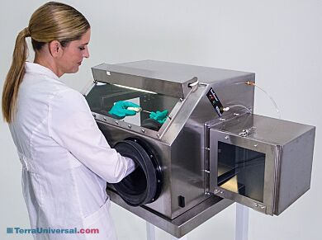
Introduction
AR 101
WebAR Prototype
AR Implementation Framework
Key Takeaways
AR Implementation Framework
AR IMPLEMENTATION FRAMEWORK: GUIDING AR USE CASE ASSESSMENT
ACTIVITY
Assess process suitability
for AR
Assess AR platform suitability**:
WebAR vs. Native AR vs. AR-on-headset
Assess AR dev. tool suitability**:
Tracking + Rendering Engine
Refine process requirements
Characteristics which make a process ideal for AR:
1. Location-based context
E.g., AR-guided work instructions anchored to a machine, AR dashboard for machine status monitoring
2. Hard-to-simulate environment
E.g., 3D patient anatomy for pre-surgical planning, 3D mesh of crime scene, virtual product prototyping
3. Hands-free access to content
E.g., surgeons viewing patient data during surgery.
4. Remote assist
E.g., Remote workers visually guide and collaborate with local workers without geographical constraints.
5. Navigation
E.g., AR-guided emergency & rescue
DISCOVERY*
AGILE*:
DESIGN > DEVELOP > DEPLOY > VALIDATE
Produces ARIF’s inputs:
User personas
User journeys
List of potential AR use cases to be validated using ARIF
Preliminary process requirements (i.e., use case requirements): incl. ergonomics, health and safety standards, privacy and data protection
Risk assessment: (non)-psychological risks
Receives ARIF’s outputs:
Validation if AR is suitable for target use cases
If yes, AR platform selection, AR development tools selection, refined process requirements, and a high-level roadmap of prioritized AR use cases
ACTIVITY GUIDANCE
* Accenture’s existing frameworks
** Supplemented with Definition Tables + Decision Matrices
Photo credit: https://www.terrauniversal.com/smart-gas-purged-glove-boxes.html
Notes:
Desired outcome/ Goal vs. value drivers vs. KPIs:
Desired outcome = operational excellence
Value driver = worker productivity (under “talent”)
KPI = time it takes for workers to complete a task
Desired outcome = help potential investors/ professionals/ future residents explore and invest in NEOM
Value driver = an engaging way to immersively experience what the future of living at The Line is like
---from Accenture 360degree value meter: financial, experience (customer, ee, partner), sustainability, talent, inclusion & diversity, custom (e.g., innovation)
KPI = user feedback on the VR experience; how many investment potentials NEOM’s received.

Slide 19
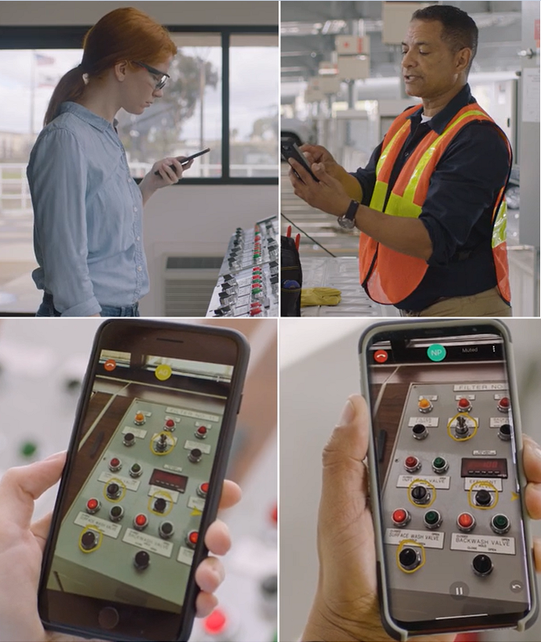
Introduction
AR 101
WebAR Prototype
AR Implementation Framework
Key Takeaways
AR Implementation Framework
AR IMPLEMENTATION FRAMEWORK: GUIDING AR USE CASE ASSESSMENT
ACTIVITY
Assess process suitability
for AR
Assess AR platform suitability**:
WebAR vs. Native AR vs. AR-on-headset
Assess AR dev. tool suitability**:
Tracking + Rendering Engine
Refine process requirements
Characteristics which make a process ideal for AR:
1. Location-based context
E.g., AR-guided work instructions anchored to a machine, AR dashboard for machine status monitoring
2. Hard-to-simulate environment
E.g., 3D patient anatomy for pre-surgical planning, 3D mesh of crime scene, virtual product prototyping
3. Hands-free access to content
E.g., surgeons viewing patient data during surgery.
4. Remote assist
E.g., Remote workers visually guide and collaborate with local workers without geographical constraints.
5. Navigation
E.g., AR-guided emergency & rescue
DISCOVERY*
AGILE*:
DESIGN > DEVELOP > DEPLOY > VALIDATE
Produces ARIF’s inputs:
User personas
User journeys
List of potential AR use cases to be validated using ARIF
Preliminary process requirements (i.e., use case requirements): incl. ergonomics, health and safety standards, privacy and data protection
Risk assessment: (non)-psychological risks
Receives ARIF’s outputs:
Validation if AR is suitable for target use cases
If yes, AR platform selection, AR development tools selection, refined process requirements, and a high-level roadmap of prioritized AR use cases
ACTIVITY GUIDANCE
* Accenture’s existing frameworks
** Supplemented with Definition Tables + Decision Matrices
Photo credit: https://www.ptc.com/en/products/vuforia/vuforia-chalk
Notes:
Desired outcome/ Goal vs. value drivers vs. KPIs:
Desired outcome = operational excellence
Value driver = worker productivity (under “talent”)
KPI = time it takes for workers to complete a task
Desired outcome = help potential investors/ professionals/ future residents explore and invest in NEOM
Value driver = an engaging way to immersively experience what the future of living at The Line is like
---from Accenture 360degree value meter: financial, experience (customer, ee, partner), sustainability, talent, inclusion & diversity, custom (e.g., innovation)
KPI = user feedback on the VR experience; how many investment potentials NEOM’s received.

Slide 20

Introduction
AR 101
WebAR Prototype
AR Implementation Framework
Key Takeaways
AR Implementation Framework
AR IMPLEMENTATION FRAMEWORK: GUIDING AR USE CASE ASSESSMENT
ACTIVITY
Assess process suitability
for AR
Assess AR platform suitability**:
WebAR vs. Native AR vs. AR-on-headset
Assess AR dev. tool suitability**:
Tracking + Rendering Engine
Refine process requirements
Characteristics which make a process ideal for AR:
1. Location-based context
E.g., AR-guided work instructions anchored to a machine, AR dashboard for machine status monitoring
2. Hard-to-simulate environment
E.g., 3D patient anatomy for pre-surgical planning, 3D mesh of crime scene, virtual product prototyping
3. Hands-free access to content
E.g., surgeons viewing patient data during surgery.
4. Remote assist
E.g., Remote workers visually guide and collaborate with local workers without geographical constraints.
5. Navigation
E.g., AR-guided emergency & rescue
Selection criteria:
1. Usage conditions-specific:
1. Lighting conditions
2. Network connectivity: offline mode support yes/ no
3. Noise
4-5. Temperature + humidity
6-7. Drop-safe + water/dust-proof
8. Health/ safety compliance
9. Hand usage
10. User interactions: hand, eye, headset tracking; voice commands
11. Movement restrictions: e.g., tethered AR headsets cause more restrictions than a phone/ tablet/ non-tethered AR headsets
2. Hardware-specific:
1-2. Battery life + device weight
3. Field-of-view
4-5. Camera + display resolution
6. Refresh rate
7-9. Storage + computation + remote rendering
10. Cross-device development
11. App download required
12. Heat distribution
13. Cost: hardware + subscription
DISCOVERY*
AGILE*:
DESIGN > DEVELOP > DEPLOY > VALIDATE
Produces ARIF’s inputs:
User personas
User journeys
List of potential AR use cases to be validated using ARIF
Preliminary process requirements (i.e., use case requirements): incl. ergonomics, health and safety standards, privacy and data protection
Risk assessment: (non)-psychological risks
Receives ARIF’s outputs:
Validation if AR is suitable for target use cases
If yes, AR platform selection, AR development tools selection, refined process requirements, and a high-level roadmap of prioritized AR use cases
ACTIVITY GUIDANCE
* Accenture’s existing frameworks
** Supplemented with Definition Tables + Decision Matrices
Photo credit: https://varjo.com/
Notes:
Desired outcome/ Goal vs. value drivers vs. KPIs:
Desired outcome = operational excellence
Value driver = worker productivity (under “talent”)
KPI = time it takes for workers to complete a task
Desired outcome = help potential investors/ professionals/ future residents explore and invest in NEOM
Value driver = an engaging way to immersively experience what the future of living at The Line is like
---from Accenture 360degree value meter: financial, experience (customer, ee, partner), sustainability, talent, inclusion & diversity, custom (e.g., innovation)
KPI = user feedback on the VR experience; how many investment potentials NEOM’s received.

Slide 21
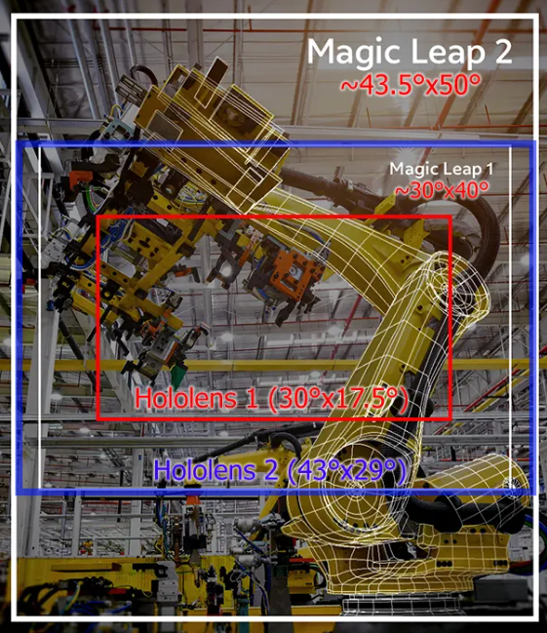
Introduction
AR 101
WebAR Prototype
AR Implementation Framework
Key Takeaways
AR Implementation Framework
AR IMPLEMENTATION FRAMEWORK: GUIDING AR USE CASE ASSESSMENT
ACTIVITY
Assess process suitability
for AR
Assess AR platform suitability**:
WebAR vs. Native AR vs. AR-on-headset
Assess AR dev. tool suitability**:
Tracking + Rendering Engine
Refine process requirements
Characteristics which make a process ideal for AR:
1. Location-based context
E.g., AR-guided work instructions anchored to a machine, AR dashboard for machine status monitoring
2. Hard-to-simulate environment
E.g., 3D patient anatomy for pre-surgical planning, 3D mesh of crime scene, virtual product prototyping
3. Hands-free access to content
E.g., surgeons viewing patient data during surgery.
4. Remote assist
E.g., Remote workers visually guide and collaborate with local workers without geographical constraints.
5. Navigation
E.g., AR-guided emergency & rescue
Selection criteria:
1. Usage conditions-specific:
1. Lighting conditions
2. Network connectivity: offline mode support yes/ no
3. Noise
4-5. Temperature + humidity
6-7. Drop-safe + water/dust-proof
8. Health/ safety compliance
9. Hand usage
10. User interactions: hand, eye, headset tracking; voice commands
11. Movement restrictions: e.g., tethered AR headsets cause more restrictions than a phone/ tablet/ non-tethered AR headsets
2. Hardware-specific:
1-2. Battery life + device weight
3. Field-of-view
4-5. Camera + display resolution
6. Refresh rate
7-9. Storage + computation + remote rendering
10. Cross-device development
11. App download required
12. Heat distribution
13. Cost: hardware + subscription
DISCOVERY*
AGILE*:
DESIGN > DEVELOP > DEPLOY > VALIDATE
Produces ARIF’s inputs:
User personas
User journeys
List of potential AR use cases to be validated using ARIF
Preliminary process requirements (i.e., use case requirements): incl. ergonomics, health and safety standards, privacy and data protection
Risk assessment: (non)-psychological risks
Receives ARIF’s outputs:
Validation if AR is suitable for target use cases
If yes, AR platform selection, AR development tools selection, refined process requirements, and a high-level roadmap of prioritized AR use cases
ACTIVITY GUIDANCE
* Accenture’s existing frameworks
** Supplemented with Definition Tables + Decision Matrices
Photo credit: https://kguttag.com/2021/10/13/magic-leap-2-for-enterprise-really-plus-another-500m/
Notes:
Desired outcome/ Goal vs. value drivers vs. KPIs:
Desired outcome = operational excellence
Value driver = worker productivity (under “talent”)
KPI = time it takes for workers to complete a task
Desired outcome = help potential investors/ professionals/ future residents explore and invest in NEOM
Value driver = an engaging way to immersively experience what the future of living at The Line is like
---from Accenture 360degree value meter: financial, experience (customer, ee, partner), sustainability, talent, inclusion & diversity, custom (e.g., innovation)
KPI = user feedback on the VR experience; how many investment potentials NEOM’s received.

Slide 22
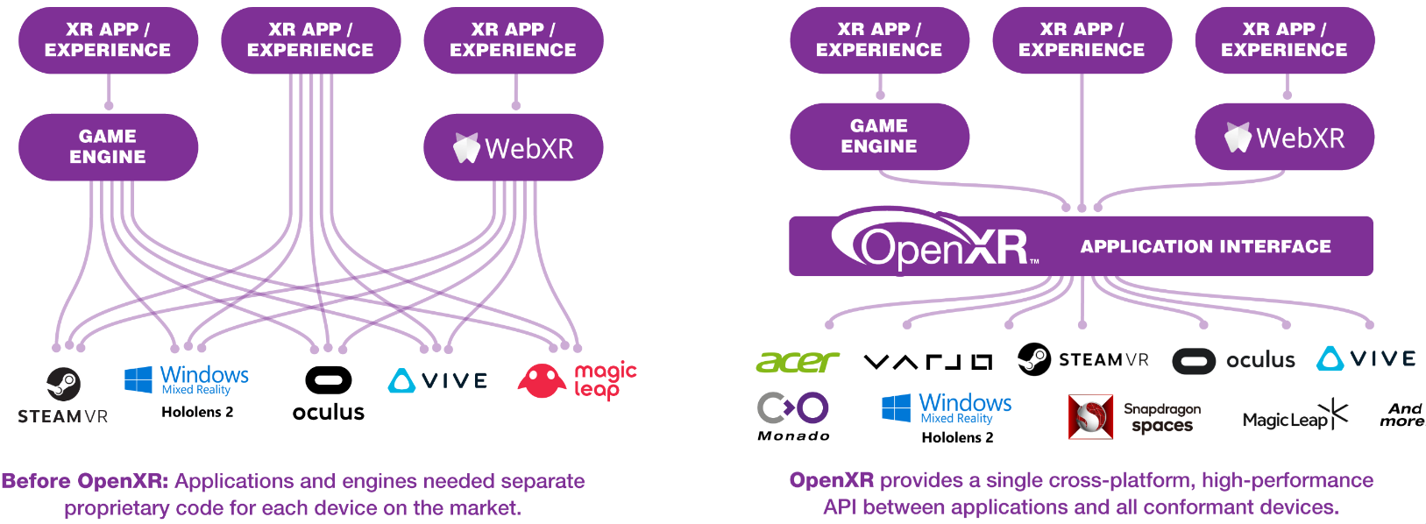
Introduction
AR 101
WebAR Prototype
AR Implementation Framework
Key Takeaways
AR Implementation Framework
AR IMPLEMENTATION FRAMEWORK: GUIDING AR USE CASE ASSESSMENT
ACTIVITY
Assess process suitability
for AR
Assess AR platform suitability**:
WebAR vs. Native AR vs. AR-on-headset
Assess AR dev. tool suitability**:
Tracking + Rendering Engine
Refine process requirements
Characteristics which make a process ideal for AR:
1. Location-based context
E.g., AR-guided work instructions anchored to a machine, AR dashboard for machine status monitoring
2. Hard-to-simulate environment
E.g., 3D patient anatomy for pre-surgical planning, 3D mesh of crime scene, virtual product prototyping
3. Hands-free access to content
E.g., surgeons viewing patient data during surgery.
4. Remote assist
E.g., Remote workers visually guide and collaborate with local workers without geographical constraints.
5. Navigation
E.g., AR-guided emergency & rescue
Selection criteria:
1. Usage conditions-specific:
1. Lighting conditions
2. Network connectivity: offline mode support yes/ no
3. Noise
4-5. Temperature + humidity
6-7. Drop-safe + water/dust-proof
8. Health/ safety compliance
9. Hand usage
10. User interactions: hand, eye, headset tracking; voice commands
11. Movement restrictions: e.g., tethered AR headsets cause more restrictions than a phone/ tablet/ non-tethered AR headsets
2. Hardware-specific:
1-2. Battery life + device weight
3. Field-of-view
4-5. Camera + display resolution
6. Refresh rate
7-9. Storage + computation + remote rendering
10. Cross-device development
11. App download required
12. Heat distribution
13. Cost: hardware + subscription
DISCOVERY*
AGILE*:
DESIGN > DEVELOP > DEPLOY > VALIDATE
Produces ARIF’s inputs:
User personas
User journeys
List of potential AR use cases to be validated using ARIF
Preliminary process requirements (i.e., use case requirements): incl. ergonomics, health and safety standards, privacy and data protection
Risk assessment: (non)-psychological risks
Receives ARIF’s outputs:
Validation if AR is suitable for target use cases
If yes, AR platform selection, AR development tools selection, refined process requirements, and a high-level roadmap of prioritized AR use cases
ACTIVITY GUIDANCE
* Accenture’s existing frameworks
** Supplemented with Definition Tables + Decision Matrices
Photo credit: https://www.khronos.org/openxr/
Notes:
Desired outcome/ Goal vs. value drivers vs. KPIs:
Desired outcome = operational excellence
Value driver = worker productivity (under “talent”)
KPI = time it takes for workers to complete a task
Desired outcome = help potential investors/ professionals/ future residents explore and invest in NEOM
Value driver = an engaging way to immersively experience what the future of living at The Line is like
---from Accenture 360degree value meter: financial, experience (customer, ee, partner), sustainability, talent, inclusion & diversity, custom (e.g., innovation)
KPI = user feedback on the VR experience; how many investment potentials NEOM’s received.

Slide 23
Introduction
AR 101
WebAR Prototype
AR Implementation Framework
Key Takeaways
AR Implementation Framework
AR IMPLEMENTATION FRAMEWORK: GUIDING AR USE CASE ASSESSMENT
ACTIVITY
Assess process suitability
for AR
Assess AR platform suitability**:
WebAR vs. Native AR vs. AR-on-headset
Assess AR dev. tool suitability**:
Tracking + Rendering Engine
Refine process requirements
Characteristics which make a process ideal for AR:
1. Location-based context
E.g., AR-guided work instructions anchored to a machine, AR dashboard for machine status monitoring
2. Hard-to-simulate environment
E.g., 3D patient anatomy for pre-surgical planning, 3D mesh of crime scene, virtual product prototyping
3. Hands-free access to content
E.g., surgeons viewing patient data during surgery.
4. Remote assist
E.g., Remote workers visually guide and collaborate with local workers without geographical constraints.
5. Navigation
E.g., AR-guided emergency & rescue
Selection criteria:
1. Usage conditions-specific:
1. Lighting conditions
2. Network connectivity: offline mode support yes/ no
3. Noise
4-5. Temperature + humidity
6-7. Drop-safe + water/dust-proof
8. Health/ safety compliance
9. Hand usage
10. User interactions: hand, eye, headset tracking; voice commands
11. Movement restrictions: e.g., tethered AR headsets cause more restrictions than a phone/ tablet/ non-tethered AR headsets
2. Hardware-specific:
1-2. Battery life + device weight
3. Field-of-view
4-5. Camera + display resolution
6. Refresh rate
7-9. Storage + computation + remote rendering
10. Cross-device development
11. App download required
12. Heat distribution
13. Cost: hardware + subscription
Tracking and rendering engines are benchmarked using the following criteria.
1. Tracking capabilities: Different use cases require different tracking capabilities
1-2. Fiducial + image tracking
3. Object tracking
4. Face tracking
5. Location tracking
6. Surface tracking
7. Spatial tracking
8. Other tracking techniques
9. Multi-marker tracking
10. Multi-user AR session
11. Depth tracking
12. Light effects
2. Rendering capabilities: Rendering speed is affected by network connection + rendering engine’s design + hardware capabilities, and therefore not assessed here.
1. Light estimation: more realistic rendering
2. Occlusion: more realistic rendering
3. Ease of development:
1. Integration with other AR dev. tools: checks which tracking engine integrates with which rendering engine
2. Simulation/ remote testing:
3. No-code/ low-code development
4. Licensing cost
1. Open-source: yes/ no
Activities:
1. Refine process requirements collected from Discovery phase
> Functional requirements are captured as user stories
> Non-functional requirements are used as part of acceptance criteria for relevant user stories
DISCOVERY*
AGILE*:
DESIGN > DEVELOP > DEPLOY > VALIDATE
Produces ARIF’s inputs:
User personas
User journeys
List of potential AR use cases to be validated using ARIF
Preliminary process requirements (i.e., use case requirements): incl. ergonomics, health and safety standards, privacy and data protection
Risk assessment: (non)-psychological risks
Receives ARIF’s outputs:
Validation if AR is suitable for target use cases
If yes, AR platform selection, AR development tools selection, refined process requirements, and a high-level roadmap of prioritized AR use cases
ACTIVITY GUIDANCE
* Accenture’s existing frameworks
** Supplemented with Definition Tables + Decision Matrices
Notes:
Desired outcome/ Goal vs. value drivers vs. KPIs:
Desired outcome = operational excellence
Value driver = worker productivity (under “talent”)
KPI = time it takes for workers to complete a task
Desired outcome = help potential investors/ professionals/ future residents explore and invest in NEOM
Value driver = an engaging way to immersively experience what the future of living at The Line is like
---from Accenture 360degree value meter: financial, experience (customer, ee, partner), sustainability, talent, inclusion & diversity, custom (e.g., innovation)
KPI = user feedback on the VR experience; how many investment potentials NEOM’s received.

Slide 24

Introduction
AR 101
WebAR Prototype
AR Implementation Framework
Key Takeaways
Key Takeaways
AR by itself = cool…
But AR when combined with the right technologies for the right use cases = superpower.
First times are beautiful. So are second’s and third’s.
AR as uncharted territory.
Transitioning from GCP to AWS.
There are always better ways to do things.
Notes:
Desired outcome/ Goal vs. value drivers vs. KPIs:
Desired outcome = operational excellence
Value driver = worker productivity (under “talent”)
KPI = time it takes for workers to complete a task
Desired outcome = help potential investors/ professionals/ future residents explore and invest in NEOM
Value driver = an engaging way to immersively experience what the future of living at The Line is like
---from Accenture 360degree value meter: financial, experience (customer, ee, partner), sustainability, talent, inclusion & diversity, custom (e.g., innovation)
KPI = user feedback on the VR experience; how many investment potentials NEOM’s received.

Slide 25
Appendix: Definition Table of Characteristics of Ideal Process for AR
# | Process Characteristic | Definition
1 | Location-based context | A process is ideal for AR when worker productivity is improved when provided location-based context i.e., (real-time) information as anchored to a physical object or environment. For example, a shopfloor manager can view an AR dashboard with real-time sensor data as anchored to a physical equipment to quickly inspect the current status of the equipment. Another example is an AR-guided work instructions anchored to a physical machine which allows workers to approach the machine and access the work instructions on demand as the worker carry out a complex task (video).
2 | Hard-to-simulate environment | A process is ideal for AR when worker productivity is improved when allowed to interact with AR contents which are hard to be simulated otherwise in real life. For example, instead of relying on 2D medical scan images, surgeons can view a 3D model of a patient anatomy for pre-surgical planning. In this case, patient anatomy is considered a hard-to-simulate environment. Additional examples are AR-enabled product prototyping (experimenting with different design before actual product fabrication), 3D mesh of a crime scene (video), construction planning (video), layout planning (video), and bridge inspection (video).
3 | Hands-free access to content | A process is ideal for AR when worker productivity is improved when provided access to content without having to use their hands. For example, surgeons can view patient’s medical records during surgeries using voice commands (video).
4 | Remote assist | A process is ideal for AR when worker productivity is improved when remote workers can guide and collaborate without geographical constraints. For example, through live camera streaming, a remote worker can share the same view as the local worker and makes live, virtual annotations on the view to guide the local worker through a task (video).
5 | Navigation | A process is ideal when worker productivity is improved when guided to a target destination by virtual AR contents. For example, a traveler can be guided to their gate at an unfamiliar airport by following virtual arrows for directions (photo).

Slide 26
Appendix: Definition Table of AR Platform Selection Criteria 1/2
# | Category | Selection Criteria | Definition
1 | Usage conditions-specific | Lighting conditions | Harsh lighting conditions (too dim or too bright) will require AR platforms whose tracking engine must be robust enough to process live camera feed of degrading quality and detect a marker.
2 |  | Network connectivity | When deployed in environments without stable internet connection like shopfloors, ideal AR platforms are the ones with offline mode support.
3 |  | Noise | When deployed in loud environments like shopfloors, ideal AR platforms are those with noise-cancelling microphones.
4-7 |  | Temperature + Humidity + Drop-safe + Water/dust-proof | When deployed in rugged conditions, ideal AR platforms are those built for extreme temperature, humidity, drop-safe, waterproof, and dustproof.
8 |  | Health/ safety compliance | Some use cases will require AR platforms to comply with specific health and safety standards e.g., hardhat integration, medical certifications for clean room usage, eye safety.
9 |  | Hand usage | Some tasks require users to use both of their hands e.g., surgeons carrying out a surgery (making AR headsets most ideal) while some tasks occupy only one hand, allowing users to use their other hand to hold a mobile device (making it possible to use webAR or native AR).
10 |  | 10. User interactions | Different AR platforms support different built-in user interactions e.g., voice/ gesture/ gaze controls for an intuitive and enhanced user experience.
11 |  | 11. Movement restrictions | Some tasks require users to have a full range of movement (e.g., shopfloor operators), making non-tethered AR headsets, webAR, and native AR ideal options. Some other tasks require only a limited range of movements, making tethered AR headsets an acceptable option in exchange for better tracking and rendering performance and lower latency since the tethered headset usually is connected to a powerful computer.

Slide 27
Appendix: Definition Table of AR Platform Selection Criteria 2/2
# | Category | Selection Criteria | Definition
1 | Hardware-specific | Battery life | The longer the battery life, the fewer charges are required between usage.
2 |  | Device weight | The heavier the device, the more fatigue it causes, especially head fatigue when using AR headsets.
3 |  | Field-of-view (FoV) | The wider the FoV, the bigger virtual contents users can view and the more immersive the AR experience feels.
4 |  | Camera resolution | The higher the camera resolution, the higher quality video the camera can capture. It is valuable, for example, when the live camera is streamed to a remote worker for the use case of AR-guided remote assistance.
5 |  | Display resolution | The higher the display resolution, the higher fidelity the virtual contents are.
6 |  | Refresh rate | The higher refresh rate, the smoother the virtual contents appear.
7-9 |  | Storage + computation + remote rendering | Storage, computation, and remote rendering dictate how much tracking and rendering can be performed locally on the AR device (no latency) or remotely in the cloud (requiring less powerful AR devices but results in higher latency).
10 |  | Cross-device development | Allows developers to develop a WebAR, native AR, and AR-on-headset application once and deploy the application on multiple browsers, Android/ iOS devices, and AR headsets, respectively.
11 |  | App download required | Refers to if a user needs to download and install the AR app to their device. WebAR is the only platform that does not require users to download and install WebAR apps since WebAR runs directly from a browser, giving it an advantage over native AR and AR headsets.
12 |  | Heat distribution | Refers to how much heat an AR device produces while running and how fast the heat can dissipate because of the thermal model of the AR device. This factor is important because heating AR devices, especially AR headsets, can cause skin burns and affect user experience.
13 |  | Cost: hardware + subscription | Refers to the cost of using the AR platforms (hardware cost + subscription cost).

Slide 28
Appendix: Definition Table of AR Dev. Tool Selection Criteria 1/2
# | Category | Selection Criteria | Definition
1-7 | Tracking capabilities | Fiducial tracking; Image tracking; Face tracking; Location tracking; Object tracking; Surface tracking; Spatial tracking | Different use cases require different tracking techniques. In the example of an art book in here, the art book is implemented using an image tracking engine which allows users to scan an image of a sculpture in the artbook and view a 3D model of the sculpture rendered on top of the image. On the other hand, spatial tracking is more appropriate for implementing, say, an AR-guided evacuation route for an underground mine since it would not be feasible to attach image markers to rock faces and make sure the image markers stay put.
8 |  | Depth tracking | Depth tracking is an additional capability of tracking engines to understand the physical environment. With depth knowledge, tracking engines can instruct rendering engines to occlude virtual objects if they are behind physical objects for a more realistic experience.
9 |  | Other tracking | As more computer vision technology evolves, more tracking techniques are being developed. This criterion serves as a catch-all for those techniques.
10 |  | Multi-marker tracking | Refers to a capability of tracking engines to detect and track multiple markers in a single video frame, creating a richer experience (picture).
11 |  | Multi-user tracking | Refers to the ability of tracking engines to synchronize across multiple devices and allow multiple users to join a single AR session. For example, an AR-guided remote assistance solution requires the use of multi-user tracking (video).
12 |  | Lighting effects | Refers to additional capabilities of tracking engines such as light estimate i.e., predicting the lighting conditions of the physical environment (picture).

Slide 29
Appendix: Definition Table of AR Dev. Tool Selection Criteria 2/2
# | Category | Selection Criteria | Definition
1 | Rendering capabilities | Light estimates | Using the light estimate data from tracking engines, rendering engines can shade the virtual contents to match the lighting conditions of the physical environment for more realistic virtual contents (picture).
2 |  | Occlusion | Using the depth data from tracking engines, rendering engines can occlude virtual objects which stand behind physical objects for more realistic virtual contents (picture).
1 | Ease of develop-ment | Integration with other AR development tools | Cross-references which tracking engines integrate with which rendering engines. Refresher: an AR application requires both tracking and rendering engines, and the two engines need to integrate with each other.
2 |  | Simulation/ remote testing | Allows developers to test and debug AR applications more quickly.
3 |  | Low-code/ no-code development | Allows business users with little to no programming knowledge to create new AR experiences e.g., allowing shopfloor operators to create new AR-guided work instructions.
1 | Licensing cost | Open-source | Checks if the tracking/ rendering engines are open-source or not.

Slide 30
Appendix: AR Platform Suitability Decision Matrix 1/4
Selection criteria for AR platforms (web AR vs. native AR vs. AR-on-headset) are categorized by: 1) Usage condition-specific 2) Hardware
 | Selection Criteria | WebAR (web browser) | Native AR (Android, iOS) | Varjo XR-3 (2020) | HoloLens 2 (2019) | Magic Leap 2 (2022) | Meta Quest Pro (2022) | Vuzix Blade 2 (2022) | Vuzix M400 (2020) | Google Glass 2 (2019)
1. Usage conditions-specific selection criteria | 1. Lighting conditions | Irrespective of AR platforms, their tracking engine performs better or worse in different light conditions due to the fluctuating quality of video frames being captured in different light conditions, making it easy or hard for the tracking engine’s computer vision algorithms to detect a marker in those video frames. In order to choose an AR platform that best accommodates the target lighting conditions: Test different candidate AR platforms in different lighting conditions and choose the most performant one Or: customize the tracking engine’s computer vision algorithms Or: customize the camera’s properties to improve the quality of the captured video frames e.g., reduce the camera’s exposure level in an overly bright environment (source)
 | 2. Network connectivity | Offline mode supported when implementing Service Worker | Offline mode supported | Offline mode supported with offline subscription | Work instructions in Dynamics 365 Guides support offline mode with limitations (e.g., no video calls) | No info about offline mode support | No info about offline mode support | Offline mode supported | Offline mode supported | No info about offline mode support
 | 3. Noise | Device-specific | Device-specific | No info | 5 noise cancelling microphones | No info | No info | 2 noise-cancelling microphones | 3 noise-cancelling microphones | 3 noise cancelling microphones
 | 4. Operating temperature | Device-specific | Device-specific | No info | 10°C to 35°C | 10°C to 30°C | No info | 0°C to 35°C | -20°C to 45°C | 0°C to 35°C
 | 5. Operating humidity | Device-specific | Device-specific | No info | No info | No info | No info | 0% to 95% | 0% to 95% | 5% to 95%
 | 6. Drop-safe | Device-specific | Device-specific | No info | No info | No info | No info | No info | MIL-STD-810G certification | No info
 | 7. Water/ Dustproof | Device-specific | Device-specific | No info | IP50 Dust proof | No info | No info | No info | IP67 Dust + water protection certification | IP53 (Resistant to water spray and limited dust ingression)

Slide 31
Appendix: AR Platform Suitability Decision Matrix 2/4
Selection criteria for AR platforms (web AR vs. native AR vs. AR-on-headset) are categorized by: 1) Usage condition-specific 2) Hardware
 | Selection Criteria | WebAR (web browser) | Native AR (Android, iOS) | Varjo XR-3 (2020) | HoloLens 2 (2019) | Magic Leap 2 (2022) | Meta Quest Pro (2022) | Vuzix Blade 2 (2022) | Vuzix M400 (2020) | Google Glass 2 (2019)
1. Usage conditions-specific selection criteria | 8. Compliance with health/ safety standards | Device-specific | Device-specific | No info | ANSI Z87.1, CSA Z94.3 and EN 166 certifications for eye safety. Hardhat-integrated; Compliant with regulated environments e.g., clean rooms; | IEC 60601 certifications for medical use | No info | UV protection lens; ANSI Z87.1 for eye safety.; | IEC 60601 certifications for medical use Comes with hardhat mount; | No info
 | 9. Hand usage | One hand occupied to hold mobile device. | One hand occupied | Hands-free | Hands-free | Hands-free with one hand-held controller | Hands-free with two hand-held controllers | Hands-free | Hands-free | Hands-free
 | 10. User interactions | Hand tracking possible when implementing hand tracking engines like Ultraleap and Handtrack.js; Voice commands are possible using speech recognition APIs like Web Speech API (for web AR) or Cordova Speech Recognition API (native AR Android/ iOS); | Hand tracking possible when implementing hand tracking engines like Ultraleap and Handtrack.js | Eye tracking; Headset and controller tracking; | Voice command; Eye tracking; Headset tracking; Hand tracking; | Eye tracking; Hand tracking; Voice commands; Controller tracking | Eye tracking; Controller tracking; Hand tracking; | Touchpad gestures; Voice control; | Voice control; | Touchpad gestures; voice commands;
 | 11. Movement restrictions | Non-tethered | Non-tethered | Tethered | Non-tethered | Non-tethered but comes with a wired, pocket-size external processor called Compute Pack | Non-tethered | Non-tethered | Non-tethered | Non-tethered
Notes:
https://learn.microsoft.com/en-us/windows/mixed-reality/design/gaze-and-dwell-head
https://learn.microsoft.com/en-us/windows/mixed-reality/design/eye-tracking
Hand tracking = impossible when hands are occupied with tools or parts; HoloLens has some built-in gestures by using a pre-trained ML model. If wanting to use custom hand gestures, need to use an external tracking engine(?) or train your own ML model (https://www.notion.so/Gestures-Hand-Tracking-in-HoloLens-2-b14713225a544affb348c2c3bc3f96af)
Voice commands = impossible in noisy environment;
Headset tracking = can be more fatiguing than eye tracking; to synchronize your movements in the real world with those in the virtual environment (https://varjo.com/use-center/get-started/varjo-headsets/setting-up-tracking/steamvr-tracking/)
Eye tracking = more precise than headset tracking + can be used for biometric authentication + performs actions like page scroll-down

Slide 32
Appendix: AR Platform Suitability Decision Matrix 3/4
Selection criteria for AR platforms (web AR vs. native AR vs. AR-on-headset) are categorized by: 1) Usage condition-specific 2) Hardware
 | Selection Criteria | WebAR (web browser) | Native AR (Android, iOS) | Varjo XR-3 (2020) | HoloLens 2 (2019) | Magic Leap 2 (2022) | Meta Quest Pro (2022) | Vuzix Blade 2 (2022) | Vuzix M400 (2020) | Google Glass 2 (2019)
2. Hardware-specific selection criteria | 1. Battery life | Device-specific | Device-specific | No info | 2-3 hours | 3.5 hours | 1-2 hours | No info | 2 hours with external battery possible | 8 hours
 | 2. Device weight | Device-specific | Device-specific | 594 g + headband 386 g | 566 g | 260 g | 722 g | No info | 182 g | 51 g
 | 3. Field of view (horizontal) | N/A |  | 115° | 43° | 70° | 106° | 20° | 16.8° | 83°
 | 4. Camera resolution | Device-specific | Device-specific | 12 MP | 8 MP | 12.6 MP | No info | 8 MP | 12.8 MP | 8 MP
 | 5. Display resolution (per eye) | Device-specific | Device-specific | Focus area (27° x 27°) at 1920 x 1920 pixel; Peripheral area at 2880 x 2720 pixel; | 1440 x 936 pixel | 1440 x 1760 pixel | 1800 x 1920 pixel | 480 x 480 pixel | 854 x 480 pixel | 640 x 360 pixel
 | 6. Refresh rate | Depending on the tracking and rendering engine |  | 90 Hz | 60 Hz | 120 Hz | 90 Hz | No info | No info | No info
 | 7. Storage capacity | Device-specific | Device-specific | No info | 4GB RAM; 64GB storage; | 16GB RAM; 256GB storage; | 12GB RAM; 256GB storage; | 40GB storage | 6GB RAM; 64GB storage | 3GB RAM; 32GB storage
 | 8. Computation capacity | Device-specific | Device-specific | No info | CPU: Octa-core Kryo 385; GPU: Adreno 630 | CPU: AMD 7nm Quad-core Zen2 X86 core; GPU: AMD GFX10.2 | CPU: Octa-core Kryo 585; GPU: Adreno 650 | CPU: Quad Core ARM | CPU: 8 Core 2.52Ghz Qualcomm XR1 | CPU: Octa-core Kryo; GPU: Adreno 615
 | 9. Remote rendering | No native integration | No native integration | Yes – Varjo Reality Cloud | Yes – Azure Remote rendering | Yes – Integrates with NVIDIA CloudXR | No info | No info | No info | No info
Notes:
https://learn.microsoft.com/en-us/windows/mixed-reality/design/gaze-and-dwell-head
https://learn.microsoft.com/en-us/windows/mixed-reality/design/eye-tracking
Hand tracking = impossible when hands are occupied with tools or parts; HoloLens has some built-in gestures by using a pre-trained ML model. If wanting to use custom hand gestures, need to use an external tracking engine(?) or train your own ML model (https://www.notion.so/Gestures-Hand-Tracking-in-HoloLens-2-b14713225a544affb348c2c3bc3f96af)
Voice commands = impossible in noisy environment;
Headset tracking = can be more fatiguing than eye tracking; to synchronize your movements in the real world with those in the virtual environment (https://varjo.com/use-center/get-started/varjo-headsets/setting-up-tracking/steamvr-tracking/)
Eye tracking = more precise than headset tracking + can be used for biometric authentication + performs actions like page scroll-down

Slide 33
Appendix: AR Platform Suitability Decision Matrix 4/4
Selection criteria for AR platforms (web AR vs. native AR vs. AR-on-headset) are categorized by: 1) Usage condition-specific 2) Hardware
 | Selection Criteria | Selection criteria description | WebAR (web browser) | Native AR (Android, iOS) | Varjo XR-3 (2020) | HoloLens 2 (2019) | Magic Leap 2 (2022) | Meta Quest Pro (2022) | Vuzix Blade 2 (2022) | Vuzix M400 (2020) | Google Glass 2 (2019)
2. Hardware-specific selection criteria | 10. Cross-device develop-ment | Allows developers to develop a webAR, native AR, and AR-on-headset application once and deploy the application on multiple browsers, Android/ iOS devices, and AR headsets, respectively. | Likely – Most webAR tracking and rendering engines are built upon browser’s natively supported features such as WebGL – see example of browser requirements for 8th Wall tracking engine | Likely – Some tracking engines like Vuforia support build for both Android and iOS. ARCore only supports Android. ARKit only supports iOS – see AR Development Tool Decision Matrix for details | Yes – integrates with OpenXR*; | Yes – integrates with OpenXR; | Yes – integrates with OpenXR; | No info | No integration with OpenXR (yet) | No integration with OpenXR (yet) | No integration with OpenXR (yet)
 | 11. App download required | Refers to if a user needs to download and install the AR app to their device. | No | Yes | Yes | Yes | Yes | Yes | Yes | Yes | Yes
 | 12. Heat distribution | Refers to how much heat an AR device produces while running and how fast the heat dissipates according to the thermal design of the AR device. Note heating AR devices, especially AR headsets, can cause skin burns and affect user experience. | It appears that there is no standard measure for benchmarking the thermal model of different AR devices. Heat distribution is primarily a hardware problem with the chips being one of the main heat-generating components (source). Therefore, it is recommended to experiment with different AR devices for the target usage conditions and select the most comfortable headset.
 | 13. Cost | Refers to the cost of using the AR platforms. | Device-specific | Device-specific | €6.495 + mandatory XR Subscription | € 3.849,00+ + optional HoloLens subscription | ~€3,167+ ($3.299+) | €1.799,99 | €1,669.80 | €2.311,10 | ~€1,090 ($1,144)
Notes:
About OpenXR for AR headsets: https://www.khronos.org/api/index_2017/openxr

Slide 34
Appendix: AR Dev. Tool Suitability Decision Matrix 1/3
Selection criteria for AR platforms (web AR vs. native AR vs. AR-on-headset) are categorized by:
1) Tracking capabilities 2) Rendering capabilities 3) Ease of development 4) Licensing cost
Tracking engine
Rendering engine
Tracking + Rendering
 | Selection Criteria (SC) | MindAR | AR.js | WebXR | 8th Wall | Lightship ARDK (2021) | Vuforia (2011) | Azure Spatial Anchors | ARCore (2018) | ARKit (2017) | Manifest (2017) | Three.js | A-frame | Unity | Unreal | RealityKit | Adobe Aero (2019) | Meta Spark Studio (2017)
 | AR platforms supported | WebAR | WebAR | WebAR | WebAR | Native AR (Android, iOS) | Native AR, AR headset (HoloLens 2, Magic Leap 2, Vuzix, RealWear) | Native AR (Android, iOS), AR headset (HoloLens) | Native AR (Android) | Native AR (iOS) | Native AR, AR headset (HoloLens, Magic Leap, Realwear) | WebAR | WebAR | Native AR, AR headset | Native AR, AR headset | Native AR (iOS) | WebAR (Aero URL); Native AR (Android, iOS) | Native AR ( Android, iOS), AR headset (Meta Quest Pro)
1. Tracking capabilities | 1. Fiducial tracking |  | X |  |  |  | X (VuMark) |  |  |  | No info | N/A | N/A | N/A | N/A | N/A
 | 2. Image tracking | X | X | X | X | X | X (Image, cylinder, multi targets) |  | X | X | No info | N/A | N/A | N/A | N/A | N/A | X (Image anchor) | X (target tracking)
 | 3. Face tracking | X |  |  | X |  |  |  | X | X | No info | N/A | N/A | N/A | N/A | N/A |  | X
 | 4. Location tracking |  | X |  | X | X |  |  | X | X | No info | N/A | N/A | N/A | N/A | N/A
 | 5. Object tracking |  |  |  |  |  | X (Model targets) |  |  | X (Physical objects) | No info | N/A | N/A | N/A | N/A | N/A
 | 6. Surface tracking |  |  | X (Hit test) | X | X | X (Ground plane) |  | X (Hit test) | X (Surface detection) | No info | N/A | N/A | N/A | N/A | N/A | X (Surface anchor) | X (plane tracking)

Slide 35
Appendix: AR Dev. Tool Suitability Decision Matrix 2/3
Selection criteria for AR platforms (web AR vs. native AR vs. AR-on-headset) are categorized by:
1) Tracking capabilities 2) Rendering capabilities 3) Ease of development 4) Licensing cost
Tracking engine
Rendering engine
Tracking + Rendering
 | Selection Criteria (SC) | MindAR | AR.js | WebXR | 8th Wall | Lightship ARDK (2021) | Vuforia (2011) | Azure Spatial Anchors | ARCore (2018) | ARKit (2017) | Manifest (2017) | Three.js | A-frame | Unity | Unreal | RealityKit | Adobe Aero (2019) | Meta Spark Studio (2017)
1. Tracking capabilities | 7. Spatial tracking |  |  |  |  | X | X (Area targets) | X (Spatial anchors) |  |  | No info | N/A | N/A | N/A | N/A | N/A
 | 8. Other tracking |  |  |  |  |  |  |  |  | Body tracking; | No info | N/A | N/A | N/A | N/A | N/A |  | Iris tracking; body tracking; Hand tracking;
 | 9. Multi-marker tracking | X | X |  | X (image tracking) |  | X |  | X (image tracking) | X (image tracking) | No info | N/A | N/A | N/A | N/A | N/A |  | X (image tracking; plane tracking)
 | 10. Multi-user AR session |  |  | Possible with tools like Wrapper.js |  | X | X (Vuforia Chalk remote assist) | X | X (Cloud anchors) | X | No info | N/A | N/A | N/A | N/A | N/A
 | 11. Depth tracking |  |  | X |  | X |  |  | X | X | No info | N/A | N/A | N/A | N/A | N/A
 | 12. Lighting effects |  |  | Light estimate; | Light estimate; | Light estimate; |  |  |  | Light estimate; realistic reflection; | No info | N/A | N/A | N/A | N/A | N/A
Notes:
Multi player stellarx: https://www.stellarx.ai/faq

Slide 36
Appendix: AR Dev. Tool Suitability Decision Matrix 3/3
Selection criteria for AR platforms (web AR vs. native AR vs. AR-on-headset) are categorized by:
1) Tracking capabilities 2) Rendering capabilities 3) Ease of development 4) Licensing cost
Tracking engine
Rendering engine
Tracking + Rendering
 | Selection Criteria (SC) | MindAR | AR.js | WebXR | 8th Wall | Lightship ARDK (2021) | Vuforia (2011) | Azure Spatial Anchors | ARCore (2018) | ARKit (2017) | Manifest (2017) | Three.js | A-frame | Unity | Unreal | RealityKit | Adobe Aero (2019) | Meta Spark Studio (2017)
2. Rendering engine | 1. Light estimation | N/A | N/A | N/A | N/A | N/A | N/A | N/A | N/A | N/A | N/A | X (WebXR) | X (WebXR) | X (ARCore, ARKit) | X (ARCore; ARKit) | X (ARKit)
 | 2. Occlusion | N/A | N/A | N/A | N/A | N/A | N/A | N/A | N/A | N/A | N/A |  |  | X (ARCore, ARKit) | X (ARCore;ARKit) | X (ARKit)
3. Ease of develop-ment | 1. Integration with other AR dev. tools | Three.js; A-frame; | Three.js; A-frame; | Three.js; A-frame; | Three.js; A-frame; | Unity; | MRTK; Magic Leap OS; ARCore/ARKit; | Unity; ARCore; | Vuforia; Unity; Unreal; WebXR; | Vuforia; Unity; Unreal; | Unity; | WebXR; | WebXR; | OpenXR; MRTK; ARCore; ARKit; | OpenXR; MRTK; ARCore; ARKit; | ARKit
 | 2. Simulation/ remote testing |  |  | X (WebXR API Emulator) |  | X (Mock mode) | X (Play mode) |  | X (Android emulator) |  | No info |  |  | X (AR Foundation Remote for ARCore+ARKit) | X (In-editor testing) |  |  | X (simulator)
 | 3. Low-code/ no-code development |  |  |  |  |  | X (Vuforia Chalk, Expert Capture, Instruct, Studio) |  |  |  | X (Manifest Maker) |  |  |  |  |  | X | X
4. Licensing cost | 1. Open-source | X | X | X |  |  |  |  |  |  |  | X | X
Notes:
Multi player stellarx: https://www.stellarx.ai/faq

Slide 37
Introduction
AR 101
WebAR Prototype
AR Implementation Framework
Key Takeaways
Key Takeaways
Notes:
Desired outcome/ Goal vs. value drivers vs. KPIs:
Desired outcome = operational excellence
Value driver = worker productivity (under “talent”)
KPI = time it takes for workers to complete a task
Desired outcome = help potential investors/ professionals/ future residents explore and invest in NEOM
Value driver = an engaging way to immersively experience what the future of living at The Line is like
---from Accenture 360degree value meter: financial, experience (customer, ee, partner), sustainability, talent, inclusion & diversity, custom (e.g., innovation)
KPI = user feedback on the VR experience; how many investment potentials NEOM’s received.

Slide 38
AR Implementation Framework (ARIF)
AR IMPLEMENTATION FRAMEWORK (ARIF): GUIDING AR USE CASE ASSESSMENT
Assess process suitability
for AR
Assess AR platform suitability:
WebAR vs. Native AR vs. AR-on-headset
Assess AR Dev. Tool Suitability
Refine process requirements
ACTIVITY
Characteristics which make a process ideal for AR:
1. Making the invisible visible
Adding AR contents to enhance user experience and storytelling.
2. Location-based context
AR contents provide information about a physical object/ environment at a specific location e.g., AR-guided work instructions.
3. Hard-to-simulate environment
Users need to interact with 3D environments which are otherwise hard to simulate in real life e.g., patient anatomy for pre-surgical planning, 3D mesh of crime scene, product prototyping
4. Hands-free access to content
Users need access to content hands-free while performing a task e.g., surgeons viewing patient data during surgery.
5. Remote assist
Remote workers visually guide and collaborate with local workers without geographical constraints.
6. Navigation
Users need to be guided to find a location/ object. e.g., AR-guided evacuation
Selection criteria:
1. Usage conditions-specific:
1. Lighting conditions
2. Network connectivity: offline mode support yes/ no
3. Noise
4-5. Temperature + humidity
6-7. Drop-safe + water/dust-proof
8. Compliance with health/ safety standards
9. Hand usage: hands-free yes/ no
10. User interactions: hand, eye, headset tracking; voice commands
11. Movement restrictions: e.g., tethered AR headsets cause more restrictions than a phone/ tablet/ non-tethered AR headsets
2. Hardware-specific:
1. Battery life
2. Device weight: causes head fatigue
3. Field-of-view
4-5. Camera + display resolution
6. Refresh rate
7-9. Storage + computation + remote rendering
10. Cross-device development
11. App download required: yes/ no
12. Heat distribution
13. Cost: hardware + subscription
Tracking and rendering engines are benchmarked using the following criteria.
1. Tracking capabilities: Different use cases require different tracking capabilities
1-2. Fiducial + image tracking
3. Object tracking
4. Face tracking
5. Location tracking
6. World tracking
7. Spatial tracking
8. Other tracking techniques
9. Multi-marker tracking
10. Multi-user AR session
11. Depth tracking
12. Light effects
2. Rendering capabilities: Different use cases require different rendering capabilities. Rendering speed is affected by network connection, rendering engine’s design, and hardware capabilities.
1. Light estimation: more realistic rendering
2. Occlusion: more realistic rendering
3. Ease of development:
1. Integration with other AR dev. tools: checks which tracking engine integrates with which rendering engine
2. Simulation/ remote testing: allows for faster development
3. No-code/ low-code development: allows business users with no/ little programming knowledge to create new AR experience
4. Licensing cost
1. Open-source: yes/ no
Activities:
1. Refine process requirements collected from Discovery phase
> Functional requirements are captured as user stories
> Non-functional requirements are used as part of acceptance criteria for relevant user stories
DISCOVER*
AGILE*:
DESIGN > DEVELOP > DEPLOY > VALIDATE
Produces ARIF’s inputs:
User personas
User journeys
List of potential AR use cases to be validated using ARIF
Preliminary process requirements (i.e., use case requirements): incl. ergonomics, health and safety standards, privacy and data protection
Risk assessment: (non)-psychological risks
Receives ARIF’s outputs:
Validation if AR is suitable for target use cases
If yes, AR platform selection, AR development tools selection, refined process requirements, and a high-level roadmap of prioritized AR use cases
ACTIVITY GUIDANCE
* Accenture’s existing frameworks
Notes:
Desired outcome/ Goal vs. value drivers vs. KPIs:
Desired outcome = operational excellence
Value driver = worker productivity (under “talent”)
KPI = time it takes for workers to complete a task
Desired outcome = help potential investors/ professionals/ future residents explore and invest in NEOM
Value driver = an engaging way to immersively experience what the future of living at The Line is like
---from Accenture 360degree value meter: financial, experience (customer, ee, partner), sustainability, talent, inclusion & diversity, custom (e.g., innovation)
KPI = user feedback on the VR experience; how many investment potentials NEOM’s received.

Slide 39
AR Implementation Framework (ARIF)
4,3
Iterative
DISCOVER
DESIGN
DEVELOP
DEPLOY
VALIDATE
3,7
5
4
2,7
ACTIVITY
Identify opportunity
Assess process suitability for AR
Assess AR platform suitability:
WebAR vs. Native AR vs. AR-on-headset
Assess AR dev. tool suitability
Refine process requirements
Develop
AR app
Deploy AR app
Test AR app with users
Sub-activities:
1. Define user personas + map user journey to identify desired outcomes and value drivers (CR3)
2. Define KPIs (CR3)
> How to measure the value drivers?
3. Collect process requirements (CR1)
> Ergonomics, data and privacy, health and safety regulations, etc.
4. Conduct a risk assessment (CR14)
> What (non)-psychological factors will likely impede the implementation of AR solutions (e.g., user’s fear of job loss, inadequate training)?
Characteristics which make a
process ideal for AR:
1. Content enriching
Benefits from intuitive ways to aggregate, publish, and interact with content as anchored to physical environment.
2. Work instructions
Benefits from step-by-step guidance in 3D.
3. Hard-to-simulate
environment
Users need to interact with 3D environments which are hard to simulate in real life e.g., patient anatomy for surgical planning.
4. Hands-free access to contents (PC6)
Users need to access contents hands-free while performing a task e.g., surgeons viewing patient data during surgery.
5. Navigation
Users need to be guided to find a location/ object.
6. Collaboration
Users across geographies work together with 3D contents.
Selection criteria:
1. Usage conditions-specific:
1. Lighting conditions
2. Network connectivity: offline mode support yes/ no
3. Noise
4-5. Temperature + humidity
6-7. Drop-safe + water/dust-proof
8. Compliance with health/ safety standards
9. Hand usage: hands-free yes/ no
10. User interactions: hand, eye, headset tracking; voice commands
11. Movement restrictions: e.g., tethered AR headsets cause more restrictions than a phone/ tablet/ non-tethered AR headsets
2. Hardware-specific:
1. Battery life
2. Device weight: causes head fatigue
3. Field-of-view
4-5. Camera + display resolution
6. Refresh rate
7-9. Storage + computation + remote rendering
10. Cross-device development
11. App download required: yes/ no
12. Cost: hardware + subscription
Selection criteria:
1. Tracking capability (CR16)
1-2. Fiducial+image tracking
3. Object tracking
4. Face tracking
5. Location tracking
6. Surface tracking
7. Spatial tracking
8. Other tracking techniques
9. Multi-marker tracking
10. Multi-user AR session
11. Depth tracking
12. Light effects
2. Rendering capability (CR17)
1. Light estimation
2. Occlusion
3. Ease of development (CR6)
1. Integration with other AR dev. tools
2. Simulation/ remote testing
3. No-code/ low-code development
4. Licensing cost (CR7)
1. Open-source: yes/ no
Sub-activities:
1. Refine process requirements collected from Discovery phase
> Functional requirements are captured as user stories
> Non-functional requirements are used as part of acceptance criteria for relevant user stories
Requirements:
1. Flexible architecture for maintainability, agility, and time-to-market (CR8)
> Microservice architecture
> Agile development
Requirements:
1. CI/CD (CR9)
2. Design for cost optimization (CR10)
E.g., Serverless architecture, auto-scaling
3. Design for performance (CR12)
E.g., Multi-zone availability, auto-scaling
4. Design for security (CR13)
E.g., Least-privilege, zero-trust zone, infra-as-code
Sub-activities:
1. Collect user feedback (CR15)
2. Validate value drivers + measure KPIs (CR4)
3. Create training materials (CR11)
ACTIVITY GUIDANCE
1. Stakeholder needs + expectations
2. User personas + user journeys
3. Prioritized use cases + value drivers + KPIs
4. Use case requirements
5. Risk assessment
1. AR platform(s) selection
2. AR development tools selection
3. Detailed functional/ non-functional requirements
4. High-level roadmap of prioritized AR use cases
1. Product backlog
2. Test cases
3. Working MVP
1. CI/CD pipelines
2. Cloud infrastructure configurations
1. Sprint review
2. Training materials
3. Validated value drivers/ KPIs
OUTCOME
Notes:
Desired outcome/ Goal vs. value drivers vs. KPIs:
Desired outcome = operational excellence
Value driver = worker productivity (under “talent”)
KPI = time it takes for workers to complete a task
Desired outcome = help potential investors/ professionals/ future residents explore and invest in NEOM
Value driver = an engaging way to immersively experience what the future of living at The Line is like
---from Accenture 360degree value meter: financial, experience (customer, ee, partner), sustainability, talent, inclusion & diversity, custom (e.g., innovation)
KPI = user feedback on the VR experience; how many investment potentials NEOM’s received.

Slide 40
AR Implementation Framework (ARIF) High-Level Design
Iterative
DISCOVER
DESIGN
DEVELOP
DEPLOY
VALIDATE
ACTIVITY
Define problem
Assess process suitability for AR
Assess AR platform suitability:
WebAR vs. Native AR vs. AR-on-headset
Assess AR dev. tool suitability
Refine process requirements
Develop
AR app
Deploy AR app
Test AR app with users
Sub-activities:
1. Define user personas + map user journey to identify desired outcomes and value drivers (CR3)
2. Define KPIs (CR3)
3. Identify process requirements (CR1)
4. Conduct a risk assessment: (non)-psychological risks (CR14)
Selection criteria:
1. Usage conditions-specific (CR2)
2. Hardware-specific (CR5)
Selection criteria:
1. Tracking capability-specific (CR16)
2. Rendering capability-specific (CR17)
3. Ease of development (CR6)
4. Licensing cost (CR7)
Sub-activities:
1. Refine process requirements collected from Discovery phase
Requirements:
1. Flexible architecture for maintainability, agility, and time-to-market (CR8)
Requirements:
1. CI/CD pipelines (CR9)
2. Design for cost optimization (CR10)
3. Design for performance (CR12)
4. Design for security (CR13)
Sub-activities:
1. Collect user feedback (CR15)
2. Validate value drivers + measure KPIs (CR4)
3. Create training materials (CR11)
ACTIVITY GUIDANCE
1. Stakeholder needs + expectations
2. User personas + user journeys
3. Prioritized use cases + value drivers + KPIs
4. Use case requirements
5. Risk assessment
1. AR platform(s) selection
2. AR development tools selection
3. Detailed functional/ non-functional requirements
4. High-level roadmap of prioritized AR use cases
1. Product backlog
2. Test cases
3. Working MVP
1. CI/CD pipelines
2. Cloud infrastructure configurations
1. Sprint review
2. Training materials
3. Validated value drivers/ KPIs
OUTCOME

Slide 41
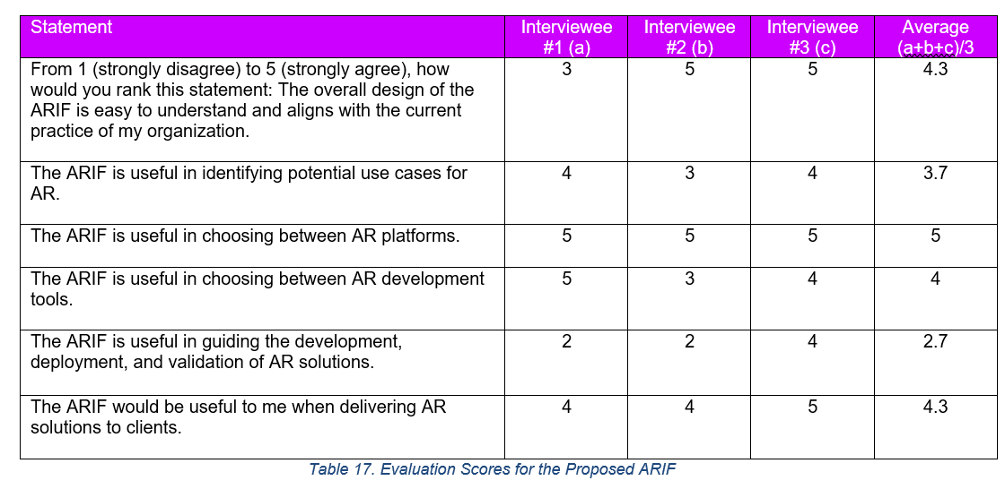

Slide 42
Cover Page 1

Slide 43
Research question slide

Slide 44
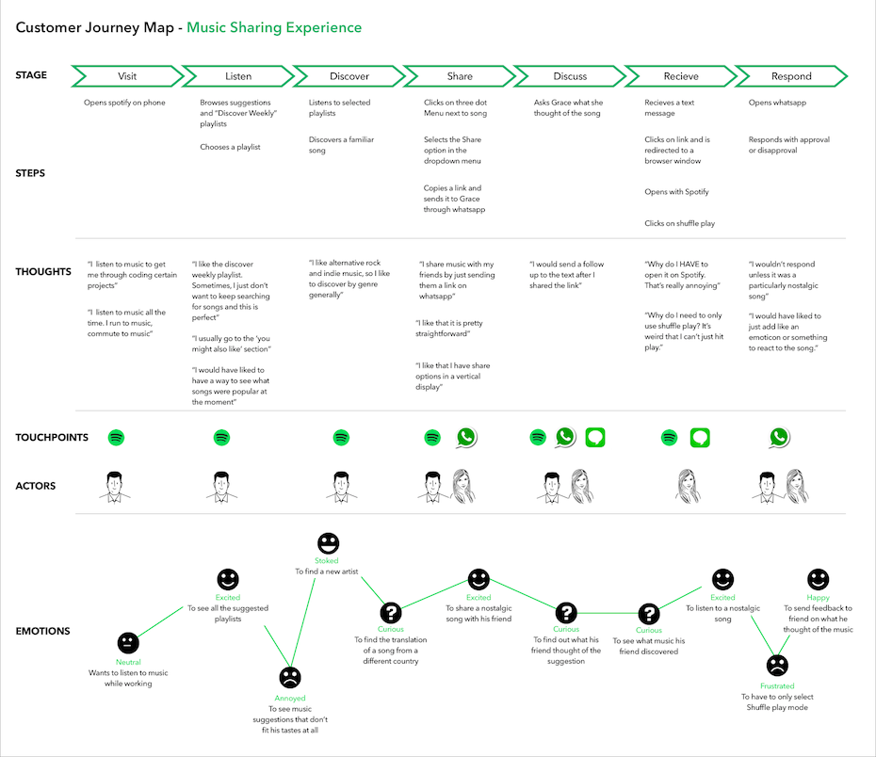

Slide 45
AR Implementation Framework (ARIF)
Iterative
DISCOVER
DESIGN
DEVELOP
DEPLOY
VALIDATE
ACTIVITY
Define problem
Assess process suitability for AR
Assess AR platform suitability:
WebAR vs. Native AR vs. AR-on-headset
Assess AR dev. tool suitability
Refine process requirements
Develop
AR app
Deploy AR app
Test AR app with users
Sub-activities:
1. Define user personas + map user journey to identify desired outcomes and value drivers (CR3)
2. Define KPIs (CR3)
> How to measure the value drivers?
3. Collect process requirements (CR1)
> Ergonomics, data and privacy, health and safety regulations, etc.
4. Conduct a risk assessment (CR14)
> What (non)-psychological factors will likely impede the implementation of AR solutions (e.g., user’s fear of job loss, inadequate training)?
Characteristics which make a
process ideal for AR:
1. Content enriching
Benefits from intuitive ways to aggregate, publish, and interact with content as anchored to physical environment.
2. Work instructions
Benefits from step-by-step guidance in 3D.
3. Hard-to-simulate
environment
Users need to interact with 3D environments which are hard to simulate in real life e.g., patient anatomy for surgical planning.
4. Hands-free access to contents (PC6)
Users need to access contents hands-free while performing a task e.g., surgeons viewing patient data during surgery.
5. Navigation
Users need to be guided to find a location/ object.
6. Collaboration
Users across geographies work together with 3D contents.
Selection criteria:
1. Usage conditions-specific:
1. Lighting conditions
2. Network connectivity: offline mode support yes/ no
3. Noise
4-5. Temperature + humidity
6-7. Drop-safe + water/dust-proof
8. Compliance with health/ safety standards
9. Hand usage: hands-free yes/ no
10. User interactions: hand, eye, headset tracking; voice commands
11. Movement restrictions: e.g., tethered AR headsets cause more restrictions than a phone/ tablet/ non-tethered AR headsets
2. Hardware-specific:
1. Battery life
2. Device weight: causes head fatigue
3. Field-of-view
4-5. Camera + display resolution
6. Refresh rate
7-9. Storage + computation + remote rendering
10. Cross-device development
11. App download required: yes/ no
12. Cost: hardware + subscription
Selection criteria:
1. Tracking capability (CR16)
1-2. Fiducial+image tracking
3. Object tracking
4. Face tracking
5. Location tracking
6. Surface tracking
7. Spatial tracking
8. Other tracking techniques
9. Multi-marker tracking
10. Multi-user AR session
11. Depth tracking
12. Light effects
2. Rendering capability (CR17)
1. Light estimation
2. Occlusion
3. Ease of development (CR6)
1. Integration with other AR dev. tools
2. Simulation/ remote testing
3. No-code/ low-code development
4. Licensing cost (CR7)
1. Open-source: yes/ no
Sub-activities:
1. Refine process requirements collected from Discovery phase
> Functional requirements are captured as user stories
> Non-functional requirements are used as part of acceptance criteria for relevant user stories
Requirements:
1. Flexible architecture for maintainability, agility, and time-to-market (CR8)
> Microservice architecture
> Agile development
Requirements:
1. CI/CD (CR9)
2. Design for cost optimization (CR10)
E.g., Serverless architecture, auto-scaling
3. Design for performance (CR12)
E.g., Multi-zone availability, auto-scaling
4. Design for security (CR13)
E.g., Least-privilege, zero-trust zone, infra-as-code
Sub-activities:
1. Collect user feedback (CR15)
2. Validate value drivers + measure KPIs (CR4)
3. Create training materials (CR11)
ACTIVITY GUIDANCE
1. Stakeholder needs + expectations
2. User personas + user journeys
3. Prioritized use cases + value drivers + KPIs
4. Use case requirements
5. Risk assessment
1. AR platform(s) selection
2. AR development tools selection
3. Detailed functional/ non-functional requirements
4. High-level roadmap of prioritized AR use cases
1. Product backlog
2. Test cases
3. Working MVP
1. CI/CD pipelines
2. Cloud infrastructure configurations
1. Sprint review
2. Training materials
3. Validated value drivers/ KPIs
OUTCOME
Notes:
Desired outcome/ Goal vs. value drivers vs. KPIs:
Desired outcome = operational excellence
Value driver = worker productivity (under “talent”)
KPI = time it takes for workers to complete a task
Desired outcome = help potential investors/ professionals/ future residents explore and invest in NEOM
Value driver = an engaging way to immersively experience what the future of living at The Line is like
---from Accenture 360degree value meter: financial, experience (customer, ee, partner), sustainability, talent, inclusion & diversity, custom (e.g., innovation)
KPI = user feedback on the VR experience; how many investment potentials NEOM’s received.

Slide 46






Stage
Before watering
During watering
After watering
Plant Owner
Happy
“What a great day. Think I might water the plant”
Concerned
“Wait. When’s the last time I watered it?
Unsure
Worried
“Vaguely remember watering it last week. Might as well water it again”
“The leaves look brown. Only if I know what is going on. Maybe I should note down how often I water it.” [Never did]
House Sitter
Happy
“What a great day. Think I might water the plant”
Indifferent
Indifferent
“No idea when the plant was last watered. But I’m only house-sitting for 2 days. Might as well water them.”
“The leaves look brown, but it are not even my plant.
Perhaps I leave a note.” [Never did]

Slide 47

Stage
Before watering
During watering
After watering
Plant Owner
House Sitter
Happy
Happy
“What a great day. Think I might water the plant”
Curious and informed
“Ahh the soil moisture is below the ideal level, and I haven’t watered in a few days.
Time to water now.”
“When was the plan last watered?
Does it need water now?
Let’s check out the watering history and the current soil moisture level on the AR dashboard!”
Worried but no worries
“The leaves look brown. But at least I can check out some videos about how to care for the plant + note the health status of the plant on the AR dashboard.
That way I can keep monitoring it.”

Slide 48
Introduction
AR 101
Web AR 101
Prototype
AR Implementation Framework (ARIF)
ARIF: Design
ARIF: Develop
ARIF: Deploy
Key Takeaways
Prototype Demo: Show Don’t Tell

Slide 49
Introduction
AR 101
Web AR 101
Prototype
AR Implementation Framework (ARIF)
ARIF: Design
ARIF: Develop
ARIF: Deploy
Key Takeaways
AR Implementation Framework (ARIF) Overview
A solution template built on existing literature to accelerate the creation of AR applications for maximized user acceptance.
DESIGN
DEVELOP
DEPLOY
Assess process suitability for AR
Assess AR platform suitability:
web AR vs. native AR vs. AR on headset
Assess AR dev. tool suitability
Develop AR app using the selected AR dev. tools
Deploy AR app using cloud resources
Definition of “suitability”:
Whether a technology (hardware/ software)
can and should be used to solve a problem at hand
RESEARCH OUTPUT: ARIF
Conduct user journey exploration with following objectives:
UR1. Define KPIs UR2. Check health/safety + data/ privacy regulation UR3. Define training UR4. Survey psychological risks UR5. Test ergonomics + usage conditions
LITERATURE

Slide 50
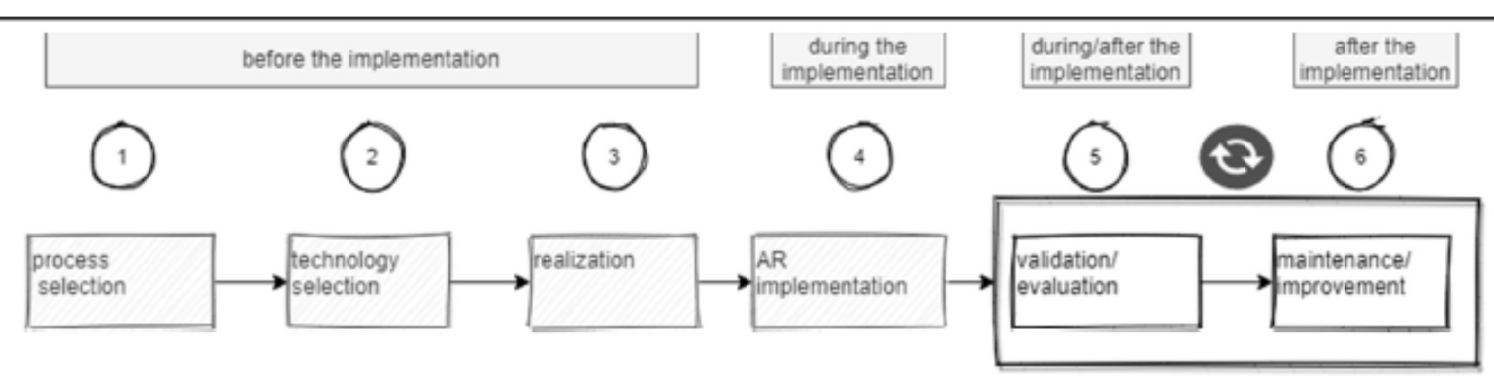
Introduction
AR 101
Web AR 101
Prototype
AR Implementation Framework (ARIF)
ARIF: Design
ARIF: Develop
ARIF: Deploy
Key Takeaways
AR Implementation Framework (ARIF) Overview
A solution template built on existing literature to accelerate the creation of AR applications for maximized user acceptance.
DESIGN
DEVELOP
DEPLOY
Assess process suitability for AR
Assess AR platform suitability:
web AR vs. native AR vs. AR on headset
Assess AR dev. tool suitability
Develop AR app using the selected AR dev. tools
Deploy AR app using cloud resources
RESEARCH OUTPUT: ARIF
Why?
No clear answer from literature, but likely due to:
(Previous) limitations of JavaScript: low performance
(Previous) limitations of web applications: no offline mode compared to native apps, etc.
Abundant research on native AR + AR on headset, but limited on web AR
LITERATURE
Existing framework: Select process > No concrete guidance for process selection
Existing framework : Select technology > No selection criteria
Existing framework: Implement AR solution using external/ in-house capabilities > No technical guidance

Slide 51
Introduction
AR 101
Web AR 101
Prototype
AR Implementation Framework (ARIF)
ARIF: Design
ARIF: Develop
ARIF: Deploy
Key Takeaways
AR Implementation Framework (ARIF) Overview
A solution template built on existing literature to accelerate the creation of AR applications for maximized user acceptance.
DESIGN
DEVELOP
DEPLOY
Assess process suitability for AR
Assess AR platform suitability:
web AR vs. native AR vs. AR on headset
Assess AR dev. tool suitability
Develop AR app using the selected AR dev. tools
Deploy AR app using cloud resources
Process characteristics (synthesized from 82 use cases reviewed):
PC1. Information enriching
PC2. Work instructions
PC3. Navigation
PC4. Collaboration
PC5. Hard-to-simulate environment
PC6. Hand-free control
RESEARCH OUTPUT: ARIF
AR use cases > No design process
Technical specifications of different AR platforms + tools > Too much into the weeds
Success factors for AR adoption
Abundant research on native AR + AR on headset, but limited on web AR
LITERATURE
Existing framework: Select process > No concrete guidance for process selection
Existing framework : Select technology > No selection criteria
Existing framework: Implement AR solution using external/ in-house capabilities > No technical guidance

Slide 52
Introduction
AR 101
Web AR 101
Prototype
AR Implementation Framework (ARIF)
ARIF: Design
ARIF: Develop
ARIF: Deploy
Key Takeaways
AR Implementation Framework (ARIF) Overview
A solution template built on existing literature to accelerate the creation of AR applications for maximized user acceptance.
DESIGN
DEVELOP
DEPLOY
Assess process suitability for AR
Assess AR platform suitability:
web AR vs. native AR vs. AR on headset
Assess AR dev. tool suitability
Develop AR app using the selected AR dev. tools
Deploy AR app using cloud resources
Assess AR platform suitability
Process characteristics (synthesized from 82 use cases reviewed):
PC1. Information enriching
PC2. Work instructions
PC3. Navigation
PC4. Collaboration
PC5. Hard-to-simulate environment
PC6. Hand-free control
Requirements:
PR1. Usage conditions-specific requirements
> Lighting
> Compliance with health/safety standards, etc.
PR2. Hardware requirements
> Computation + storage
> Remote rendering
> Field-of-view
> User interactivity, etc.
Success factor: Compliance with health and safety standards.
High-level requirement (Design > AR Platform Suitability): Usage conditions-specific criteria.
Use case: Using AR during surgery or at a construction site.
Low-level requirement: Compliance with safety and health standards.
Decision matrix: Vuzix M400 headset has certifications for medical uses. HoloLens has a hardhat-integrated version.
RESEARCH OUTPUT: ARIF
AR use cases > No design process
Technical specifications of different AR platforms + tools > Too much into the weeds
Success factors for AR adoption
Abundant research on native AR + AR on headset, but limited on web AR
LITERATURE
Existing framework: Select process > No concrete guidance for process selection
Existing framework : Select technology > No selection criteria
Existing framework: Implement AR solution using external/ in-house capabilities > No technical guidance

Slide 53
Introduction
AR 101
Web AR 101
Prototype
AR Implementation Framework (ARIF)
ARIF: Design
ARIF: Develop
ARIF: Deploy
Key Takeaways
AR Implementation Framework (ARIF) Overview
A solution template built on existing literature to accelerate the creation of AR applications for maximized user acceptance.
DESIGN
DEVELOP
DEPLOY
Assess process suitability for AR
Assess AR platform suitability:
web AR vs. native AR vs. AR on headset
Assess AR dev. tool suitability
Develop AR app using the selected AR dev. tools
Deploy AR app using cloud resources
Assess AR dev. tool suitability
Success factor: Acceptable latency with accurate tracking and rendering.
High-level requirement (Design – AR dev tool suitability): Tracking engine
Use case: When implementing AR solution for emergency navigation in underground mines, it’s better to rely on spatial mapping instead of markers (no losing markers or compromised tracking because of poor lighting conditions).
Low-level requirement: Different tracking technique supports by different AR development tools.
Process characteristics (synthesized from 82 use cases reviewed):
PC1. Information enriching
PC2. Work instructions
PC3. Navigation
PC4. Collaboration
PC5. Hard-to-simulate environment
PC6. Hand-free control
Requirements :
TR1. Tracking engine
> Tracking techniques, multi-user, etc.
TR2. Rendering engine
> Light estimation, occlusion
TR3. Integration with enterprise systems
TR4. Ease of development
> Graphic user interface, etc.
TR5. Licensing cost
RESEARCH OUTPUT: ARIF
AR use cases > No design process
Technical specifications of different AR platforms + tools > Too much into the weeds
Success factors for AR adoption
Abundant research on native AR + AR on headset, but limited on web AR
LITERATURE
Existing framework: Select process > No concrete guidance for process selection
Existing framework : Select technology > No selection criteria
Existing framework: Implement AR solution using external/ in-house capabilities > No technical guidance

Slide 54
Introduction
AR 101
Web AR 101
Prototype
AR Implementation Framework (ARIF)
ARIF: Design
ARIF: Develop
ARIF: Deploy
Key Takeaways
AR Implementation Framework (ARIF) Overview
A solution template built on existing literature to accelerate the creation of AR applications for maximized user acceptance.
DESIGN
DEVELOP
DEPLOY
Assess process suitability for AR
Assess AR platform suitability:
web AR vs. native AR vs. AR on headset
Assess AR dev. tool suitability
Develop AR app using the selected AR dev. tools
Deploy AR app using cloud resources
Process characteristics (synthesized from 82 use cases reviewed):
PC1. Information enriching
PC2. Work instructions
PC3. Navigation
PC4. Collaboration
PC5. Hard-to-simulate environment
PC6. Hand-free control
Success factor: AR solution is ergonomic and does not interfere with worker’s tasks.
Requirement (Design > User Journey Exploration): Have user try out a mock prototype to test for ergonomics + usage conditions.
RESEARCH OUTPUT: ARIF
Conduct user journey exploration with following objectives:
UR1. Define KPIs UR2. Check health/safety + data/ privacy regulation UR3. Define training UR4. Survey psychological risks UR5. Test ergonomics + usage conditions
AR use cases > No design process
Technical specifications of different AR platforms + tools > Too much into the weeds
Success factors for AR adoption
Abundant research on native AR + AR on headset, but limited on web AR
LITERATURE
Existing framework: Select process > No concrete guidance for process selection
Existing framework : Select technology > No selection criteria
Existing framework: Implement AR solution using external/ in-house capabilities > No technical guidance

Slide 55
Introduction
AR 101
Web AR 101
Prototype
AR Implementation Framework (ARIF)
ARIF: Design
ARIF: Develop
ARIF: Deploy
Key Takeaways
AR Implementation Framework (ARIF) Overview
A solution template built on existing literature to accelerate the creation of AR applications for maximized user acceptance.
DESIGN
DEVELOP
DEPLOY
Assess AR platform suitability:
web AR vs. native AR vs. AR on headset
Develop AR app using the selected AR dev. tools
Assess process suitability for AR
Assess AR dev. tool suitability
Develop AR app using the selected AR dev. tools
Deploy AR app using cloud resources
Process characteristics (synthesized from 82 use cases reviewed):
PC1. Information enriching
PC2. Work instructions
PC3. Navigation
PC4. Collaboration
PC5. Hard-to-simulate environment
PC6. Hand-free control
Requirements:
SR1. Flexible architecture for maintainability, agility and time-to-market
> Microservice architecture
> Agile development
RESEARCH OUTPUT: ARIF
Success factor: Implementation cost of AR solutions.
High-level requirement (Develop): Flexible architecture for maintainability, agility and time-to-market.
Low-level requirement: Microservice architecture + Agile development.
AR use cases > No design process
Technical specifications of different AR platforms + tools > Too much into the weeds
Success factors for AR adoption
Abundant research on native AR + AR on headset, but limited on web AR
LITERATURE
Existing framework: Select process > No concrete guidance for process selection
Existing framework : Select technology > No selection criteria
Existing framework: Implement AR solution using external/ in-house capabilities > No technical guidance

Slide 56
Introduction
AR 101
Web AR 101
Prototype
AR Implementation Framework (ARIF)
ARIF: Design
ARIF: Develop
ARIF: Deploy
Key Takeaways
AR Implementation Framework (ARIF) Overview
A solution template built on existing literature to accelerate the creation of AR applications for maximized user acceptance.
DESIGN
DEVELOP
DEPLOY
Assess AR platform suitability:
web AR vs. native AR vs. AR on headset
Develop AR app using the selected AR dev. tools
Deploy AR app using cloud resources
Assess process suitability for AR
Assess AR dev. tool suitability
Deploy AR app using cloud resources
Success factor: Compliance with data and privacy protection.
High-level requirement (Deploy): Design for security.
Use case: When a hacker compromises a server, hacker should not be able to move laterally + compromise additional servers.
Low-level requirement: Least privilege, zero-trust, infrastructure-as-code (from industry literature).
Serverless architecture: Configure and version control network policies to allow only legitimate traffic.
Process characteristics (synthesized from 82 use cases reviewed):
PC1. Information enriching
PC2. Work instructions
PC3. Navigation
PC4. Collaboration
PC5. Hard-to-simulate environment
PC6. Hand-free control
Requirements:
DR1. CI/CD pipelines
DR2. Design for cost optimization
> Serverless architecture
> Auto-scaling
DR3. Design for scalability
> Multi-zone availability
> Auto-scaling
DR4. Design for security
> Least-privilege
> Zero-trust zone
> Infrastructure-as-code
RESEARCH OUTPUT: ARIF
AR use cases > No design process
Technical specifications of different AR platforms + tools > Too much into the weeds
Success factors for AR adoption
Abundant research on native AR + AR on headset, but limited on web AR
LITERATURE
Existing framework: Select process > No concrete guidance for process selection
Existing framework : Select technology > No selection criteria
Existing framework: Implement AR solution using external/ in-house capabilities > No technical guidance

Slide 57
Introduction
AR 101
Web AR 101
Prototype
AR Implementation Framework (ARIF)
ARIF: Design
ARIF: Develop
ARIF: Deploy
Key Takeaways
AR Implementation Framework (ARIF) Overview
A solution template built on existing literature to accelerate the creation of AR applications for maximized user acceptance.
DESIGN
DEVELOP
DEPLOY
Assess process suitability for AR
Assess AR platform suitability:
web AR vs. native AR vs. AR on headset
Assess AR dev. tool suitability
Develop AR app using the selected AR dev. tools
Deploy AR app using cloud resources
Process characteristics (synthesized from 82 use cases reviewed):
PC1. Information enriching
PC2. Work instructions
PC3. Navigation
PC4. Collaboration
PC5. Hard-to-simulate environment
PC6. Hand-free control
Requirements:
PR1. Usage conditions-specific requirements
> Lighting
> Compliance with health/safety standards, etc.
PR2. Hardware requirements
> Computation + storage
> Remote rendering
> Field-of-view
> User interactivity, etc.
Requirements :
TR1. Tracking engine
> Tracking techniques, multi-user, etc.
TR2. Rendering engine
> Light estimation, occlusion
TR3. Integration with enterprise systems
TR4. Ease of development
> Graphic user interface, etc.
TR5. Licensing cost
Requirements:
SR1. Flexible architecture for maintainability, agility and time-to-market
> Microservice architecture
> Agile development
Requirements:
DR1. CI/CD pipelines
DR2. Design for cost optimization
> Serverless architecture
> Auto-scaling
DR3. Design for scalability
> Multi-zone availability
> Auto-scaling
DR4. Design for security
> Least-privilege
> Zero-trust zone
> Infrastructure-as-code
RESEARCH OUTPUT: ARIF
Conduct user journey exploration with following objectives:
UR1. Define KPIs UR2. Check health/safety + data/ privacy regulation UR3. Define training UR4. Survey psychological risks UR5. Test ergonomics + usage conditions
AR use cases > No design process
Technical specifications of different AR platforms + tools > Too much into the weeds
Success factors for AR adoption
Abundant research on native AR + AR on headset, but limited on web AR
LITERATURE
Existing framework: Select process > No concrete guidance for process selection
Existing framework : Select technology > No selection criteria
Existing framework: Implement AR solution using external/ in-house capabilities > No technical guidance

Slide 58
Appendix: AR Adoption Success Factors Mapping To Requirements 1/2
Category | Sub-category | Success Factor (SF) | Mapped to: AR Platform Suitability Selection Criteria | Mapped to: AR Dev Tool Suitability Selection Criteria | Mapped to: AR User Journey Testing Objectives | Mapped to: Development phase | Mapped to: Deployment phase
Organization | Company | SF1. Task identification: suitable for working conditions + helps enhance worker performance | PR1. Usage conditions-specific criteria: lighting condition, internet, etc. |  | UR1. Define KPIs
 |  | SF2. Compliance with health + safety concerns: distractions, visual fatigue, etc. |  |  | UR2. Check compliance
 |  | SF3. Implementation cost: design, develop, deploy, maintain | PR1. Hardware specification criteria: hardware cost | TR4. Licensing cost |  | SR1. Flexible architecture for maintainability, agility and time-to-market | DR1. CI/CD pipeline DR2. Design for cost optimization
 |  | SF4. Change management: adequate training and support |  |  | UR3. Identify required training
 | User | SF5. User experience during AR usage: user-friendly UI, intuitive interactions, etc. | PR1. Hardware specification criteria: user interactivity |  |  |  | DR3. Design for scalability
 |  | SF6. Privacy and data protection |  |  |  |  | DR4. Design for security
 |  | SF7. User technology quotient: the more tech savvy users are, the higher adoption rate |  |  | See UR3
 |  | SF8: Address psychological risks e.g., fear of over-reliance on technology, job loss, etc. |  |  | UR4. Survey for perceived psychologic risks

Slide 59
Appendix: AR Adoption Success Factors Mapping To Requirements 2/2
Category | Sub-category | Success Factor (SF) | Mapped to: AR Platform Suitability Selection Criteria | Mapped to: AR Dev Tool Suitability Selection Criteria | Mapped to: AR User Journey Testing Objectives | Mapped to: Development phase | Mapped to: Deployment phase
Technology | Hardware | SF9. Essential hardware requirements: battery lifetime, camera and display resolution, etc. | PR1. Hardware specification criteria
 |  | SF10. Ergonomics |  |  | UR5. Test solution ergonomics
 | Software | SF11. Essential software requirements: acceptable latency with accurate tracking and rendering |  | TR1. Tracking engine TR2. Rendering engine
 |  | SF12. Integration with enterprise systems | PR1. Hardware specification criteria: integration with 3rd party systems
 |  | SF13. Easy authoring systems | See PR1 – integrations with 3rd party systems | TR3. Ease of development
Environment | Regulations | SF14. Compliance with employee protection regulations: health and safety concerns | PR1. Usage conditions-specific criteria: compliance with health and safety standards
 | Third party | SF15. Integration with 3rd party systems |  | See TR3
 |  | SF16. External support to guide the implementation of AR solutions | N/A | N/A | N/A | N/A | N/A
 |  | SF17. Reference industry-wide tried-and-tested AR solutions | N/A | N/A | N/A | N/A | N/A

Slide 60
Introduction
AR 101
Web AR 101
Prototype
AR Implementation Framework (ARIF)
ARIF: Design
ARIF: Develop
ARIF: Deploy
Key Takeaways
Design: Process Suitability for AR
Below are characteristics which make a process an ideal candidate for AR as synthesized from 82 use cases reviewed.
6 Process Characteristics
1. CONTENT ENRICHING
4. COLLABORATION
Process is enhanced when provided intuitive ways to aggregate, publish, and interact with contents.
Decision making is enhanced when provided real-time collaboration while working with AR contents.
2. WORK INSTRUCTIONS
5. HARD-TO-SIMULATE ENVIRONMENT
Worker productivity is enhanced when provided step-by-step work instructions.
Process requires workers to work in hard-to-simulate environment.
3. NAVIGATION
6. (PARTIALLY) HAND-FREE CONTROL
Process is enhanced when provided real-time navigation.
Process is enhanced when user can interact with AR contents hand-free via the use of voice, speech, and gaze control.
Design phase
Process suitability for AR
AR platform suitability
AR dev. tool suitability

Slide 61
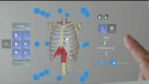
Introduction
AR 101
Web AR 101
Prototype
AR Implementation Framework (ARIF)
ARIF: Design
ARIF: Develop
ARIF: Deploy
Key Takeaways
Design: Process Suitability for AR – Use Case Highlights 1/8
Medicals: Medical training + pre-surgical planning and patient care.
Process Characteristics
Content enriching
Navigation
Collaboration
Hard-to-simulate environment
Work instructions
Gesture control
Voice control
Gaze control
Tracking
Fiduciary/ Image
Face
Natural feature
Location
World
Spatial
Design phase
Process suitability for AR
AR platform suitability
AR dev. tool suitability
Notes:
Design and Implementation of “AugMedicine: Lung Cases,” an Augmented Reality Application for the Medical Curriculum on the Presentation of Dyspnea: video here
Multiple students together view a 3d model of lung and listen to the sound it makes for different lung conditions
YT video: A hospital revolution: VSI HoloMedicine®
Construct a 3d model of patient’s organs and tumors from 2d MRI/ CT scan images.
Examine the 3D model to plan for surgery and determine success rate.
Walk patient thru surgery procedural to ease them before the surgery.
View patient data during and post-surgery to assist in decision making.

Slide 62
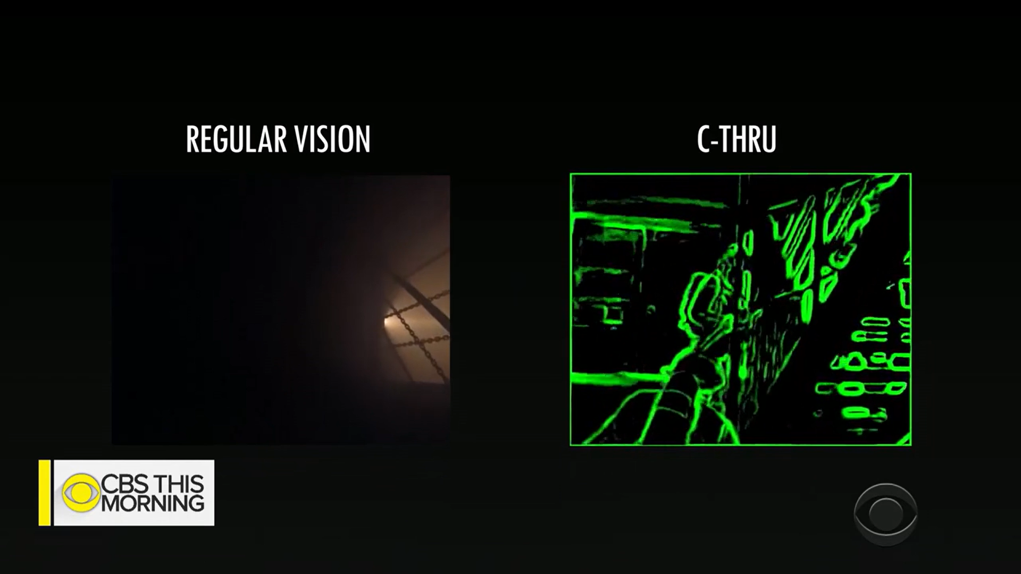
Introduction
AR 101
Web AR 101
Prototype
AR Implementation Framework (ARIF)
ARIF: Design
ARIF: Develop
ARIF: Deploy
Key Takeaways
Design: Process Suitability for AR – Use Case Highlights 2/8
Emergency services: Firefighter with x-ray vision + using drones to localize and AR to navigate to the location of buried victims in collapsed buildings + 3D view of building blueprint and remote support.
Process Characteristics
Content enriching
Navigation
Collaboration
Hard-to-simulate environment
Work instructions
Gesture control
Voice control
Gaze control
Tracking
Fiduciary/ Image
Face
Natural feature
Location
World
Spatial
Design phase
Process suitability for AR
AR platform suitability
AR dev. tool suitability
Source: Identification of Living Human Objects from Collapsed Architecture Debris to Improve the Disaster Rescue Operations Using IoT and Augmented Reality; Augmented Reality for Fire & Emergency Services
Notes:
YT video: Augmented reality could be a game-changer for firefighters
Use thermal camera to highlight the contour of a room and objects inside that room in neon colors > enable fire fighters to see in a smoke-filled room
Identification of Living Human Objects from Collapsed Architecture Debris to Improve the Disaster Rescue Operations Using IoT and Augmented Reality:
(no screenshot; no video):
use drones to detect signals from wearable devices and locate buried victims in collapsed buildings
prioritize victims based on age, heart rate, etc.
navigate firefighters to the victim’s location
Augmented Reality for Fire & Emergency Services:
view building blueprint,
stream live video to control center,
receive navigation instructions,
mark an area as search complete,
voice memo of the patient condition and first aid performed.

Slide 63
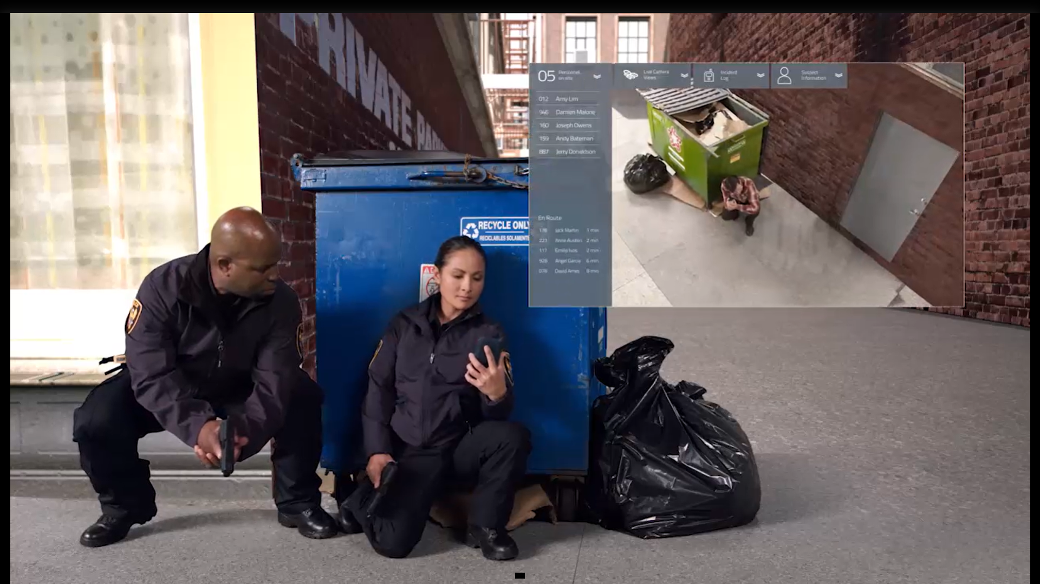
Introduction
AR 101
Web AR 101
Prototype
AR Implementation Framework (ARIF)
ARIF: Design
ARIF: Develop
ARIF: Deploy
Key Takeaways
Design: Process Suitability for AR – Use Case Highlights 3/8
Policing: Create crime scene 3D mesh + live data stream + location tracking to avoid friendly fire.
Process Characteristics
Content enriching
Navigation
Collaboration
Hard-to-simulate environment
Work instructions
Gesture control
Voice control
Gaze control
Tracking
Fiduciary/ Image
Face
Natural feature
Location
World
Spatial
Design phase
Process suitability for AR
AR platform suitability
AR dev. tool suitability
Notes:
YT video: Microsoft HoloLens: Partner Spotlight with Black Marble (policing work)
3d mesh of crime scene + live stream data to command center
Based on live stream video, remote forensics specialists can guide on-site police officers (e.g., bagging a special piece of evidence) and avoid overcrowding the crime scene and potentially contaminate the scene
View reports + crime scene back in station: detectives to retrace the steps of the murder to solve the case
Future of First Response: Vision for Police
Track live location of fellow officers to avoid friendly fire
View live camera from drone to see where the suspect is and how to best approach
Receive navigation instructions from remote officers

Slide 64

Introduction
AR 101
Web AR 101
Prototype
AR Implementation Framework (ARIF)
ARIF: Design
ARIF: Develop
ARIF: Deploy
Key Takeaways
Design: Process Suitability for AR – Use Case Highlights 4/8
Constructions: Fabrication planning and progress monitoring + layout planning.
Process Characteristics
Content enriching
Navigation
Collaboration
Hard-to-simulate environment
Work instructions
Gesture control
Voice control
Gaze control
Tracking
Fiduciary/ Image
Face
Natural feature
Location
World
Spatial
Design phase
Process suitability for AR
AR platform suitability
AR dev. tool suitability
Notes:
YT video: Microsoft HoloLens 2: Partner Spotlight with VisualLive and NOX Innovations
Used for the construction of a Microsoft data center
Review structure to be built before actual build
Persistently anchor 3d model of the structures in physical space
Visually inspect and track the progress: e.g., pull data from construction monitoring platform and label the virtual structure with “behind schedule”, “on schedule”, or “ahead of schedule”
YT video: Microsoft HoloLens: Design spaces in real-world context with Microsoft Layout (floorplan design)
Microsoft Layout is a specialized solution for designing floorplan layout
Construct a new layout using existing 3d models
Review layout with colleagues.

Slide 65

Introduction
AR 101
Web AR 101
Prototype
AR Implementation Framework (ARIF)
ARIF: Design
ARIF: Develop
ARIF: Deploy
Key Takeaways
Design: Process Suitability for AR – Use Case Highlights 5/8
Industrials: Easy authoring of step-by-step work instructions.
Process Characteristics
Content enriching
Navigation
Collaboration
Hard-to-simulate environment
Work instructions
Gesture control
Voice control
Gaze control
Tracking
Fiduciary/ Image
Face
Natural feature
Location
World
Spatial
Design phase
Process suitability for AR
AR platform suitability
AR dev. tool suitability
Notes:
YT video: More detailed demo of Manifest's AR work instructions solution + how to author a new work instruction/ training
Business users can create new work instructions without having to write a single line of code

Slide 66
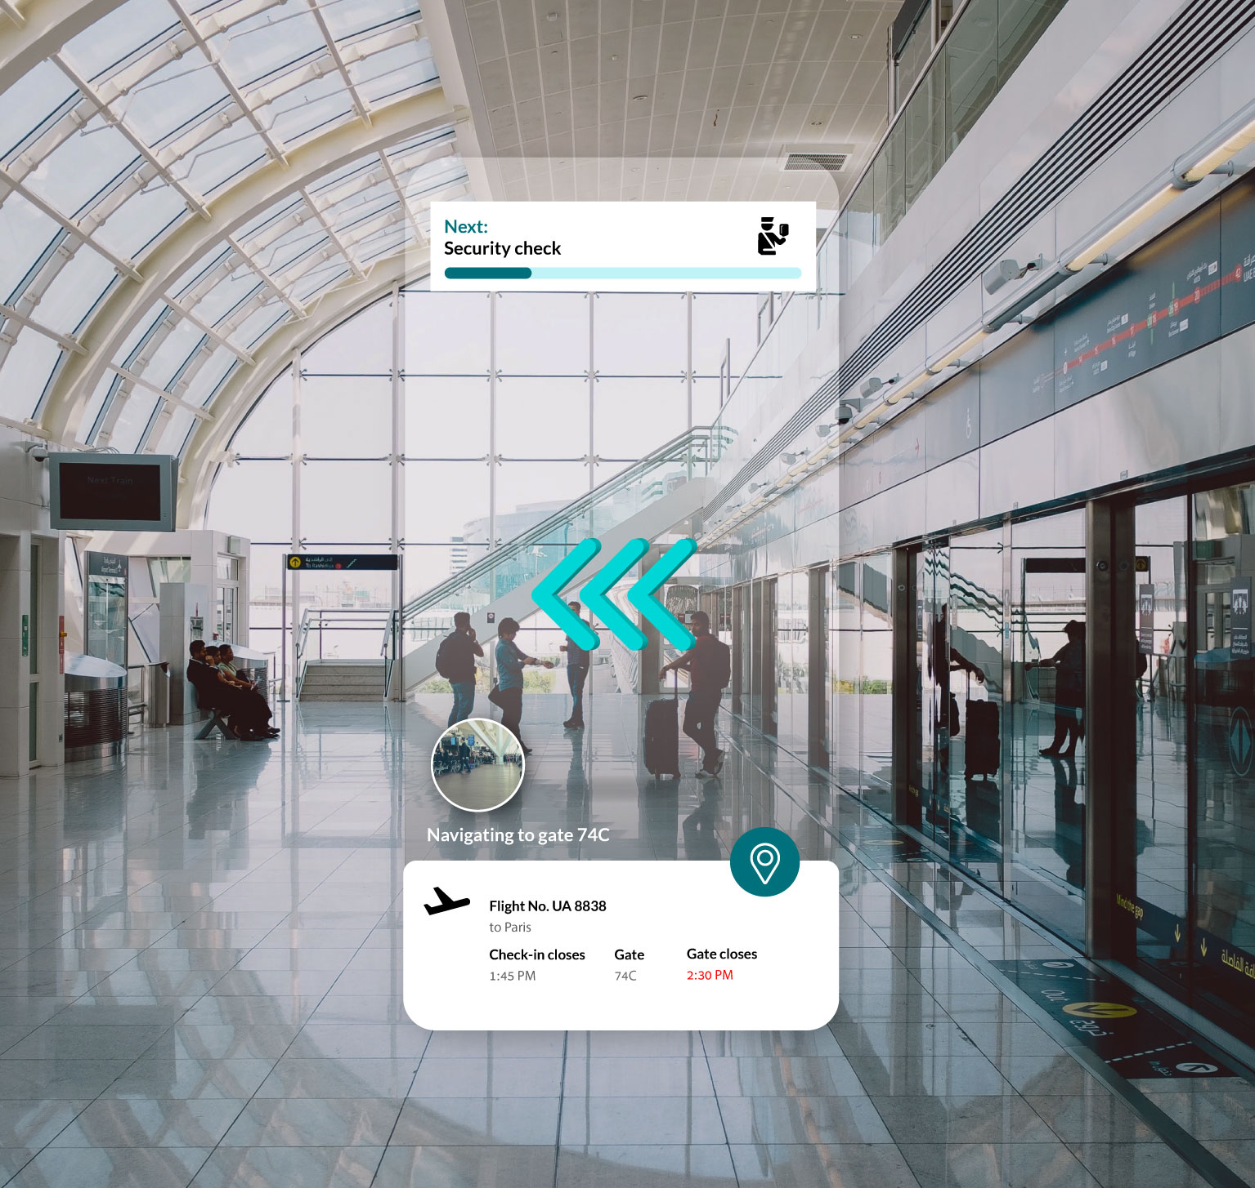
Introduction
AR 101
Web AR 101
Prototype
AR Implementation Framework (ARIF)
ARIF: Design
ARIF: Develop
ARIF: Deploy
Key Takeaways
Design: Process Suitability for AR – Use Case Highlights 6/8
Airport navigation.
Process Characteristics
Content enriching
Navigation
Collaboration
Hard-to-simulate environment
Work instructions
Gesture control
Voice control
Gaze control
Tracking
Fiduciary/ Image
Face
Natural feature
Location
World
Spatial
Design phase
Process suitability for AR
AR platform suitability
AR dev. tool suitability
Source: https://www.resonai.com/blog/smart-buildings-101

Slide 67

Introduction
AR 101
Web AR 101
Prototype
AR Implementation Framework (ARIF)
ARIF: Design
ARIF: Develop
ARIF: Deploy
Key Takeaways
Design: Process Suitability for AR – Use Case Highlights 7/8
Bridge inspection.
Process Characteristics
Content enriching
Navigation
Collaboration
Hard-to-simulate environment
Work instructions
Gesture control
Voice control
Gaze control
Tracking
Fiduciary/ Image
Face
Natural feature
Location
World
Spatial
Design phase
Process suitability for AR
AR platform suitability
AR dev. tool suitability

Slide 68
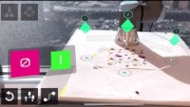
Introduction
AR 101
Web AR 101
Prototype
AR Implementation Framework (ARIF)
ARIF: Design
ARIF: Develop
ARIF: Deploy
Key Takeaways
Design: Process Suitability for AR – Use Case Highlights 8/8
Robotics: Program a robotic arm using AR.
Process Characteristics
Content enriching
Navigation
Collaboration
Hard-to-simulate environment
Work instructions
Gesture control
Voice control
Gaze control
Tracking
Fiduciary/ Image
Face
Natural feature
Location
World
Spatial
Design phase
Process suitability for AR
AR platform suitability
AR dev. tool suitability
Notes:
YT video: Programming a Robotic Arm Using Augmented Reality & Spatial Computing | PTC Reality Lab
Intuitively program a robotic arm using spatial tracking.

Slide 69
Introduction
AR 101
Web AR 101
Prototype
AR Implementation Framework (ARIF)
ARIF: Design
ARIF: Develop
ARIF: Deploy
Key Takeaways
Design phase
Design: Determine AR Platform Suitability
Translate AR adoption success factors into AR platform requirements categorized into 2 groups.
Process suitability for AR
AR platform suitability
AR dev. tool suitability
Usage Condition-Specific Requirements
Hardware Requirements
Lighting conditions
Network connectivity
Noise
Operating temperature
Operating humidity
Drop-safe
Water-/ dust-proof
Compliance with health/ safety standards
Hand usage
User interactions

Slide 70
Introduction
AR 101
Web AR 101
Prototype
AR Implementation Framework (ARIF)
ARIF: Design
ARIF: Develop
ARIF: Deploy
Key Takeaways
Design phase
Design: Determine AR Platform Suitability
Translate AR adoption success factors into AR platform requirements categorized into 2 groups.
Process suitability for AR
AR platform suitability
AR dev. tool suitability
Usage Condition-Specific Requirements
Hardware Requirements
Lighting conditions
Network connectivity
Noise
Operating temperature
Operating humidity
Drop-safe
Water-/ dust-proof
Compliance with health/ safety standards
Hand usage
User interactions
E.g., An AR solution deployed in damp, dimly lit, underground mines with no internet connection (criteria #1, 2, 6, 7, 8) for rescue navigation.

Slide 71
Introduction
AR 101
Web AR 101
Prototype
AR Implementation Framework (ARIF)
ARIF: Design
ARIF: Develop
ARIF: Deploy
Key Takeaways
Design phase
Design: Determine AR Platform Suitability
Translate AR adoption success factors into AR platform requirements categorized into 2 groups.
Process suitability for AR
AR platform suitability
AR dev. tool suitability
Usage Condition-Specific Requirements
Hardware Requirements
Lighting conditions
Network connectivity
Noise
Operating temperature
Operating humidity
Drop-safe
Water-/ dust-proof
Compliance with health/ safety standards
Hand usage
User interactions
E.g., An AR solution deployed in damp, dimly lit, underground mines with no internet connection (criteria #1, 2, 6, 7, 8) for rescue navigation.
E.g., When an AR solution assists a surgeon during a surgery, best that the surgeon can control the AR solution hand-free (criteria #9) > Only AR headsets offer hand-free usage.

Slide 72
Introduction
AR 101
Web AR 101
Prototype
AR Implementation Framework (ARIF)
ARIF: Design
ARIF: Develop
ARIF: Deploy
Key Takeaways
Design phase
Design: Determine AR Platform Suitability
Translate AR adoption success factors into AR platform requirements categorized into 2 groups.
Process suitability for AR
AR platform suitability
AR dev. tool suitability
Usage Condition-Specific Requirements
Hardware Requirements
Lighting conditions
Network connectivity
Noise
Operating temperature
Operating humidity
Drop-safe
Water-/ dust-proof
Compliance with health/ safety standards
Hand usage
User interactions
E.g., An AR solution deployed in damp, dimly lit, underground mines with no internet connection (criteria #1, 2, 6, 7, 8) for rescue navigation.
E.g., When an AR solution assists a surgeon during a surgery, best that the surgeon can control the AR solution hand-free (criteria #9) > Only AR headsets offer hand-free usage.
E.g., Most AR headsets have built-in functionalities for remote support (criteria #10) including making video calls and streaming live camera feed.

Slide 73
Introduction
AR 101
Web AR 101
Prototype
AR Implementation Framework (ARIF)
ARIF: Design
ARIF: Develop
ARIF: Deploy
Key Takeaways
Design phase
Design: Determine AR Platform Suitability
Translate AR adoption success factors into AR platform requirements categorized into 2 groups.
Process suitability for AR
AR platform suitability
AR dev. tool suitability
Usage Condition-Specific Requirements
Hardware Requirements
Lighting conditions
Network connectivity
Noise
Operating temperature
Operating humidity
Drop-safe
Water-/ dust-proof
Compliance with health/ safety standards
Hand usage
User interactions
E.g., An AR solution deployed in damp, dimly lit, underground mines with no internet connection (criteria #1, 2, 6, 7, 8) for rescue navigation.
E.g., When an AR solution assists a surgeon during a surgery, best that the surgeon can control the AR solution hand-free (criteria #9) > Only AR headsets offer hand-free usage.
E.g., Most AR headsets have built-in functionalities for remote support (criteria #10) including making video calls and streaming live camera feed.
Battery life
Device weight
Connectivity
Camera resolution
Display resolution
Field-of-view
Refresh rate
Storage capacity
Computation capability
Remote rendering
Integration with 3rd party systems
Hardware cost

Slide 74
Introduction
AR 101
Web AR 101
Prototype
AR Implementation Framework (ARIF)
ARIF: Design
ARIF: Develop
ARIF: Deploy
Key Takeaways
Design phase
Design: Determine AR Platform Suitability
Translate AR adoption success factors into AR platform requirements categorized into 2 groups.
Process suitability for AR
AR platform suitability
AR dev. tool suitability
Usage Condition-Specific Requirements
Hardware Requirements
Lighting conditions
Network connectivity
Noise
Operating temperature
Operating humidity
Drop-safe
Water-/ dust-proof
Compliance with health/ safety standards
Hand usage
User interactions
E.g., An AR solution deployed in damp, dimly lit, underground mines with no internet connection (criteria #1, 2, 6, 7, 8) for rescue navigation.
E.g., When an AR solution assists a surgeon during a surgery, best that the surgeon can control the AR solution hand-free (criteria #9) > Only AR headsets offer hand-free usage.
E.g., Most AR headsets have built-in functionalities for remote support (criteria #10) including making video calls and streaming live camera feed.
Battery life
Device weight
Connectivity
Camera resolution
Display resolution
Field-of-view
Refresh rate
Storage capacity
Computation capability
Remote rendering
Integration with 3rd party systems
Hardware cost
E.g., HoloLens has limited computation and storage capability (criteria #8, 9) but can rely on Azure Remote Rendering for rendering high-fidelity 3D models.

Slide 75
Introduction
AR 101
Web AR 101
Prototype
AR Implementation Framework (ARIF)
ARIF: Design
ARIF: Develop
ARIF: Deploy
Key Takeaways
Design phase
Design: Determine AR Platform Suitability
Translate AR adoption success factors into AR platform requirements categorized into 2 groups.
Process suitability for AR
AR platform suitability
AR dev. tool suitability
Usage Condition-Specific Requirements
Hardware Requirements
Lighting conditions
Network connectivity
Noise
Operating temperature
Operating humidity
Drop-safe
Water-/ dust-proof
Compliance with health/ safety standards
Hand usage
User interactions
E.g., An AR solution deployed in damp, dimly lit, underground mines with no internet connection (criteria #1, 2, 6, 7, 8) for rescue navigation.
E.g., When an AR solution assists a surgeon during a surgery, best that the surgeon can control the AR solution hand-free (criteria #9) > Only AR headsets offer hand-free usage.
E.g., Most AR headsets have built-in functionalities for remote support (criteria #10) including making video calls and streaming live camera feed.
Battery life
Device weight
Connectivity
Camera resolution
Display resolution
Field-of-view
Refresh rate
Storage capacity
Computation capability
Remote rendering
Integration with 3rd party systems
Hardware cost
E.g., HoloLens has limited computation and storage capability (criteria #8, 9) but can rely on Azure Remote Rendering for rendering high-fidelity 3D models.
E.g., Google Glass 2 is one of the lightest AR headsets (criteria #2), causing less head fatigue during usage.

Slide 76
Introduction
AR 101
Web AR 101
Prototype
AR Implementation Framework (ARIF)
ARIF: Design
ARIF: Develop
ARIF: Deploy
Key Takeaways
Design phase
Design: Determine AR Platform Suitability
Translate AR adoption success factors into AR platform requirements categorized into 2 groups.
Process suitability for AR
AR platform suitability
AR dev. tool suitability
Usage Condition-Specific Requirements
Hardware Requirements
Lighting conditions
Network connectivity
Noise
Operating temperature
Operating humidity
Drop-safe
Water-/ dust-proof
Compliance with health/ safety standards
Hand usage
User interactions
E.g., An AR solution deployed in damp, dimly lit, underground mines with no internet connection (criteria #1, 2, 6, 7, 8) for rescue navigation.
E.g., When an AR solution assists a surgeon during a surgery, best that the surgeon can control the AR solution hand-free (criteria #9) > Only AR headsets offer hand-free usage.
E.g., Most AR headsets have built-in functionalities for remote support (criteria #10) including making video calls and streaming live camera feed.
Battery life
Device weight
Connectivity
Camera resolution
Display resolution
Field-of-view
Refresh rate
Storage capacity
Computation capability
Remote rendering
Integration with 3rd party systems
Hardware cost
E.g., HoloLens has limited computation and storage capability (criteria #8, 9) but can rely on Azure Remote Rendering for rendering high-fidelity 3D models.
E.g., Google Glass 2 is one of the lightest AR headsets (criteria #2), causing less head fatigue during usage.
E.g., Vuzix M400 has built-in integration with Zoom and WebEx video conferencing software (criteria #10).

Slide 77
Introduction
AR 101
Web AR 101
Prototype
AR Implementation Framework (ARIF)
ARIF: Design
ARIF: Develop
ARIF: Deploy
Key Takeaways
Design phase
Design: AR Platform Suitability Decision Matrix 1/X
Assist in choosing an appropriate AR platform: web AR vs. native AR vs. AR headset (non-exhaustive).
Process suitability for AR
AR platform suitability
AR dev. tool suitability
 | Selection Criteria | Web AR | Native AR | HoloLens 2 (2019) | Magic Leap 2 (2022) | Meta Quest Pro (2022) | Vuzix Blade 2 (2022) | Vuzix M400 (2020) | Google Glass 2 (2019)
PR1. Usage conditions-specific criteria | 1. Lighting conditions | Irrespective of AT platforms, their tracking engine performs better or worse in different light conditions due to the fluctuating quality of video frames being captured in different light conditions, making it easy or hard for the tracking engine’s computer vision algorithm to detect a marker in those video frames. In order to choose an AR platform that best accommodates the target lighting conditions: Test different candidate AR platforms in different lighting conditions and choose the most performant one Or: customize the tracking engine’s computer vision algorithm Or: customize the camera to improve the quality of the captured video frames (source)
 | 2. Network connectivity | Offline mode supported when implementing as Progressive Web Apps (PWA) or Web Assembly? | Offline mode supported | Offline mode supported with limitations (e.g., no calls) | No information | No information | No information | No information | No information
 | 3. Noise | Device-specific, but likely | Device-specific, but likely | Built-in noise cancelling microphone | No information | No information | Built-in dual noise-cancelling microphones | Built-in triple noise-canceling microphone | No information
 | 4. Operating temperature | Device-specific | Device-specific | 10°C to 35°C | 10°C to 30°C | No information | 0°C to 35°C | -20°C to 45°C | 0°C to 35°C
 | 5. Operating humidity | Device-specific | Device-specific | No information | No information | No information | 0% to 95% | 0% to 95% | 5% to 95%

Slide 78
Introduction
AR 101
Web AR 101
Prototype
AR Implementation Framework (ARIF)
ARIF: Design
ARIF: Develop
ARIF: Deploy
Key Takeaways
Design phase
Design: AR Platform Suitability Decision Matrix 2/X
Assist in choosing an appropriate AR platform: web AR vs. native AR vs. AR headset (non-exhaustive).
Process suitability for AR
AR platform suitability
AR dev. tool suitability
 | Selection Criteria | Web AR | Native AR | HoloLens 2 (2019) | Magic Leap 2 (2022) | Meta Quest Pro (2022) | Vuzix Blade 2 (2022) | Vuzix M400 (2020) | Google Glass 2 (2019)
PR1. Usage conditions-specific criteria | 6. Drop-safe | Device-specific | Device-specific | No information | No information | No information | No information | MIL-STD-810G certification | No information
 | 7. Water-proof/ Dust-proof | Device-specific | Device-specific | IP50 Dust proof | No information | No information | No information | IP67 Dust + water protection certification | No information
 | 8. Compliance with health/ safety standards | Device-specific, but unlikely | Device-specific, but unlikely | ANSI Z87.1, CSA Z94.3 and EN 166 for eye safety. Integrates with hardhat; Compliant with regulated environments e.g., clean rooms | IEC 60601 certifications for medical use | No information | UV protection lens; ANSI Z87.1 for eye safety. | IEC 60601 certifications for medical use | No information

Slide 79
Introduction
AR 101
Web AR 101
Prototype
AR Implementation Framework (ARIF)
ARIF: Design
ARIF: Develop
ARIF: Deploy
Key Takeaways
Design phase
Design: AR Platform Suitability Decision Matrix 3/X
Assist in choosing an appropriate AR platform: web AR vs. native AR vs. AR headset (non-exhaustive).
Process suitability for AR
AR platform suitability
AR dev. tool suitability
 | Selection Criteria | Web AR | Native AR | HoloLens 2 (2019) | Magic Leap 2 (2022) | Meta Quest Pro (2022) | Vuzix Blade 2 (2022) | Vuzix M400 (2020) | Google Glass 2 (2019)
PR1. Usage conditions-specific criteria | 9. Hand usage | One hand occupied | One hand occupied | Hands-free | Hands-free | Hands-free | Hands-free | Hands-free | Hands-free
 | 10. User interactions | Video call? Annotations? Multi-user? Voice Gesture Gaze |  |  |  |  | Voice command;

Slide 80
Introduction
AR 101
Web AR 101
Prototype
AR Implementation Framework (ARIF)
ARIF: Design
ARIF: Develop
ARIF: Deploy
Key Takeaways
Design phase
Design: AR Platform Suitability Decision Matrix 4/X
Assist in choosing an appropriate AR platform: web AR vs. native AR vs. AR headset (non-exhaustive).
Process suitability for AR
AR platform suitability
AR dev. tool suitability
 | Selection Criteria | Web AR | Native AR | HoloLens 2 (2019) | Magic Leap 2 (2022) | Meta Quest Pro (2022) | Vuzix Blade 2 (2022) | Vuzix M400 (2020) | Google Glass 2 (2019)
PR2. Hardware specification criteria | 1. Battery life | Device-specific | Device-specific | 2-3 hours | 3.5 hours | 2 hours | No information | 2 hours with external battery possible | 8 hours
 | 2. Device weight | Device-specific | Device-specific | 566 grams | 260 grams | 722 grams | No information | 85 grams | 51 grams
 | 3. Connectivity | Device-specific | Device-specific | Wi-Fi, Bluetooth | Wi-Fi, Bluetooth | Wi-Fi, Bluetooth | Wi-Fi, Bluetooth | Wi-Fi, Bluetooth | Wi-Fi, Bluetooth
 | 4. Camera resolution | Device-specific | Device-specific | 8 MP | 12.6 MP |  | 8 MP | 12.8 MP | 8 MP
 | 5. Display resolution | Device-specific | Device-specific | 1440 x 936 pixel | 1440 x 1760 pixel | 1800x1920 pixel | 480 x 480 pixel | 854 x 480 pixel | 640 x 360 pixel
 | 6. Field of view |  |  | 43° | 70° | 106° | 20° | 16.8° | 83°
 | 7. Refresh rate |  |  | 60 Hz | 120 Hz | 90 Hz | No information | No information | No information
 | 8. Storage capacity | Device-specific | Device-specific | 4GB RAM; 64GB storage; | 16GB RAM; 256GB storage; | 12GB RAM; 256GB storage; | 40GB storage | 6GB RAM; 64GB storage | 3GB RAM; 32GB storage
 | 9. Computation capability | Device-specific | Device-specific | CPU: Octa-core Kryo 385; GPU: Adreno 630 | CPU: AMD 7nm Quad-core Zen2 X86 core; GPU: AMD GFX10.2 | CPU: Octa-core Kryo 585; GPU: Adreno 650 | Quad Core ARM CPU | 8 Core 2.52Ghz Qualcomm XR1 | CPU: Octa-core Kryo; GPU: Adreno 615
Notes:
Is Hz refresh rate same as fps?

Slide 81
Introduction
AR 101
Web AR 101
Prototype
AR Implementation Framework (ARIF)
ARIF: Design
ARIF: Develop
ARIF: Deploy
Key Takeaways
Design phase
Design: AR Platform Suitability Decision Matrix 5/X
Assist in choosing an appropriate AR platform: web AR vs. native AR vs. AR headset (non-exhaustive).
Process suitability for AR
AR platform suitability
AR dev. tool suitability
 | Selection Criteria | Web AR | Native AR | HoloLens 2 (2019) | Magic Leap 2 (2022) | Meta Quest Pro (2022) | Vuzix Blade 2 (2022) | Vuzix M400 (2020) | Google Glass 2 (2019)
PR2. Hardware specification criteria | 10. Remote rendering | No | No | Yes – Azure Remote rendering | No | No | No | No | No
 | 11. Integration with 3rd party systems | No | No | Dynamics 365 Guides, MS Teams |  |  |  | Zoom, WebEx video conferencing
 | 12. Hardware cost | Device-specific | Device-specific | €3,849+ | €3,167+ ($3,299) | €1,799.99 | €1,669.80 | €1,910.00 | €960.00 ($999)

Slide 82
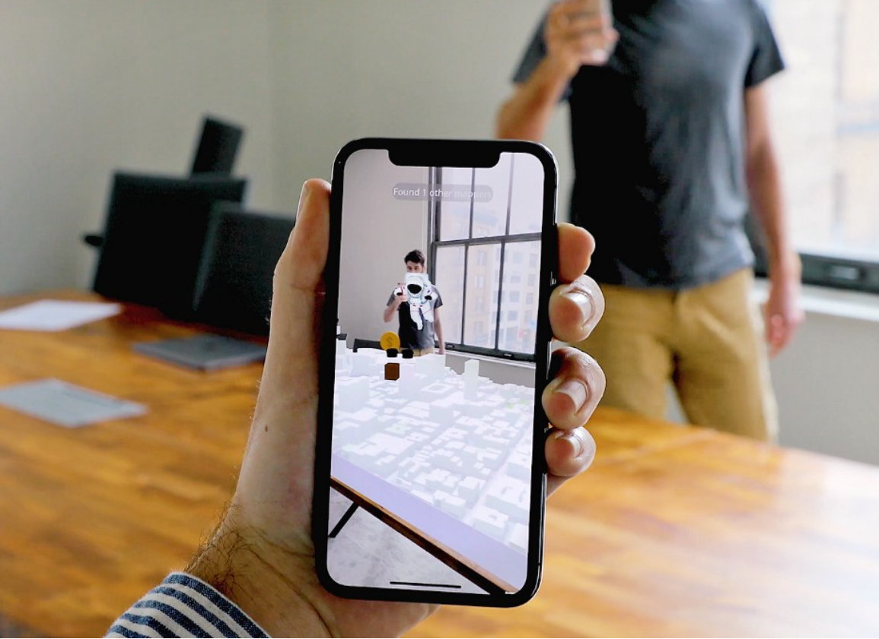
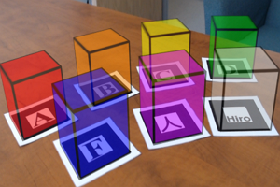
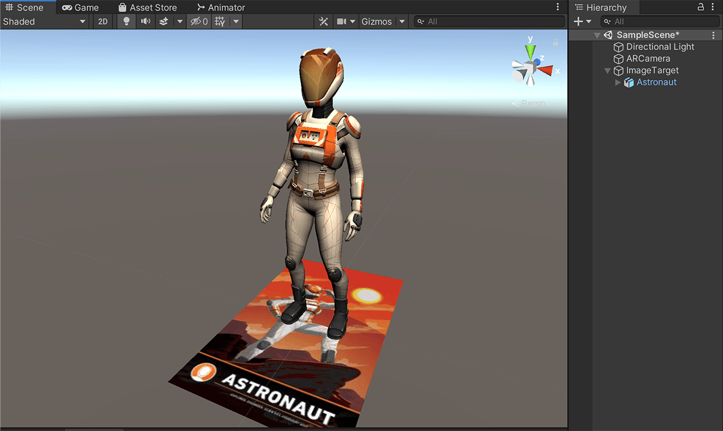


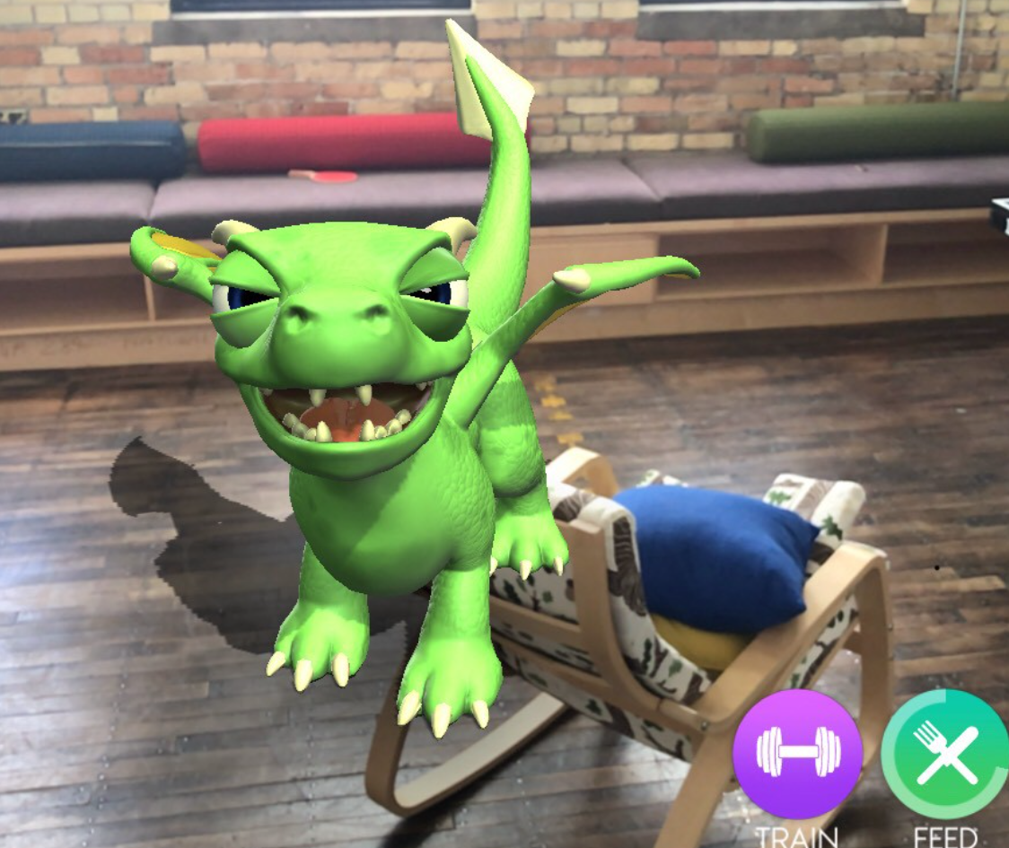
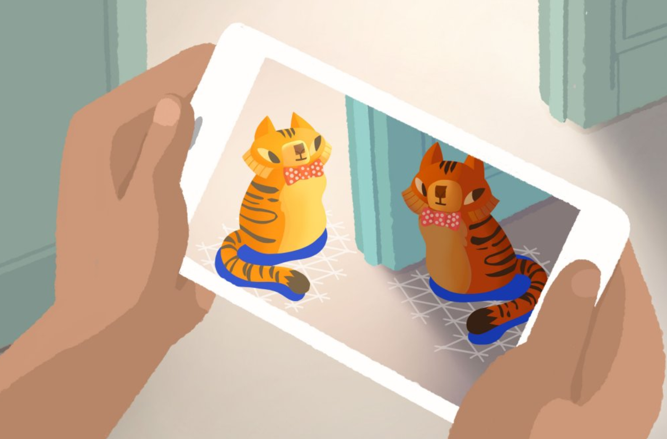
Introduction
AR 101
Web AR 101
Prototype
AR Implementation Framework (ARIF)
ARIF: Design
ARIF: Develop
ARIF: Deploy
Key Takeaways
Design phase
Design: Determine AR Devevelopment Tool Suitability
Translate AR adoption success factors into criteria for selecting
web AR vs. native AR vs. AR-on-headset development tools as categorized into 4 groups.
Process suitability for AR
AR platform suitability
AR dev. tool suitability
1. Tracking Engine
3. Ease of Development
Tracking techniques: 7
Multi-marker tracking
Multi-user AR sessions
Graphic user interface
Simulator testing
Integration of tracking and rendering engine
Integration with other AR developments tools
3
2
1
4
2. Rendering Engine
Light estimation
Occlusion
4. Licensing Cost
2
1
Open-source or commercial
Source: https://stemkoski.github.io/AR-Examples/; https://blog.mapbox.com/multi-user-ar-experience-1a586f40b2ce; https://developers.google.com/ar/develop/lighting-estimation; https://medium.com/hackernoon/why-is-occlusion-in-augmented-reality-so-hard-7bc8041607f9; https://library.vuforia.com/getting-started/getting-started-vuforia-engine-unity

Slide 83
Introduction
AR 101
Web AR 101
Prototype
AR Implementation Framework (ARIF)
ARIF: Design
ARIF: Develop
ARIF: Deploy
Key Takeaways
Design phase
Design: AR Dev. Tool Suitability Decision Matrix 1/X
Assist in choosing appropriate AR development tools (non-exhaustive).
Process suitability for AR
AR platform suitability
AR dev. tool suitability
 | Selection Criteria | MindAR | AR.js | WebXR | 8th Wall | ZapWorks | Lightship (2021) | Vuforia (2011) | here | ARCore (2018) | ARKit (2017) | Three.js | A-frame | Unity | Unreal | Wikitude (2008)
 | AR platforms supported | Web AR | Web AR | Web AR | Web AR | Web AR | Native AR | Native AR, AR headset (HoloLens, Magic Leap, Vuzix) |  | Native AR (Android) | Native AR (iOS) | Web AR | Web AR | Native AR, AR headset |  | Native AR, AR headset (HoloLens, Vuzix)
TR1. Tracking engine | 1. Fiduciary tracking |  | X |  |  |  |  |  |  |  |  | N/A | N/A | N/A | N/A
 | 2. Image tracking | X | X |  | X | X |  |  |  |  |  | N/A | N/A | N/A | N/A
 | 3. Face tracking | X |  |  |  | X |  |  |  |  |  | N/A | N/A | N/A | N/A
 | 4. Location tracking |  |  |  | X |  | X |  |  |  |  | N/A | N/A | N/A | N/A
 | 5. Natural feature tracking |  |  |  |  |  |  |  |  |  |  | N/A | N/A | N/A | N/A
 | 6. World tracking (planar) |  |  | X |  | X |  |  |  | X |  | N/A | N/A | N/A | N/A
 | 7. Spatial tracking |  |  |  |  |  |  |  |  |  |  | N/A | N/A | N/A | N/A
Tracking engine
Rendering engine
Tracking + Rendering

Slide 84
Introduction
AR 101
Web AR 101
Prototype
AR Implementation Framework (ARIF)
ARIF: Design
ARIF: Develop
ARIF: Deploy
Key Takeaways
Design phase
Design: AR Dev. Tool Suitability Decision Matrix 2/X
Assist in choosing appropriate AR development tools (non-exhaustive).
Process suitability for AR
AR platform suitability
AR dev. tool suitability
 | Selection Criteria | MindAR | AR.js | WebXR | 8th Wall | ZapWorks | Lightship (2021) | Vuforia (2011) |  | ARCore (2018) | ARKit (2017) | Three.js | A-frame | Unity | Unreal (2022) | Wikitude (2008)
 | AR platforms supported | Web AR | Web AR | Web AR | Web AR | Web AR | Native AR | Native AR, AR headset (HoloLens, Magic Leap, Vuzix) |  | Native AR (Android) | Native AR (iOS) | Web AR | Web AR | Native AR, AR headset |  | Native AR, AR headset (HoloLens, Vuzix)
TR1. Tracking engine | 8. Multi-marker tracking |  | X
 | 9 Multi-user AR sessions |  |  |  |  |  | X
TR2. Rendering engine | 1. Light estimation |  |  |  |  |  |  |  |  | X | X
 | 2. Occlusion

Slide 85
Introduction
AR 101
Web AR 101
Prototype
AR Implementation Framework (ARIF)
ARIF: Design
ARIF: Develop
ARIF: Deploy
Key Takeaways
Design phase
Design: AR Dev. Tool Suitability Decision Matrix 3/X
Assist in choosing appropriate AR development tools (non-exhaustive).
Process suitability for AR
AR platform suitability
AR dev. tool suitability
 | Selection Criteria | MindAR | AR.js | WebXR | 8th Wall | ZapWorks | Lightship (2021) | Vuforia (2011) |  | ARCore (2018) | ARKit (2017) | Three.js | A-frame | Unity | Unreal (2022) | Wikitude (2008)
 | AR platforms supported | Web AR | Web AR | Web AR | Web AR | Web AR | Native AR | Native AR, AR headset (HoloLens, Magic Leap, Vuzix) |  | Native AR (Android) | Native AR (iOS) | Web AR | Web AR | Native AR, AR headset |  | Native AR, AR headset (HoloLens, Vuzix)
TR3. Ease of development | 1. Graphic design interface |  |  |  | X | X | X | X |  |  |  |  |  | X | X
 | 2. Simulator testing | No | No
 | 3. Integration with rendering engine | Three.js A-frame | Three.js, A-frame |  | Three.js, A-frame | Three.js, A-frame, Unity | Unity | ARCore, ARKit, Unity, Unreal |  | Vuforia, Unity | Vuforia, Unity | N/A | N/A | N/A |  | Unity
 | 4. Integration with other AR dev. tools |  |  |  |  |  |  | Mixed Reality Toolkit, Magic Leap OS |  |  |  |  |  | Mixed Reality Toolkit
TR4. Licensing cost | 1. Open-source | X | X | X |  |  |  |  |  |  |  | X | X

Slide 86






AWS Virtual Private Cloud (VPC)
(2) Microcontroller uses sensor’s device certificate to authenticate + publish to
AWS IoT’s MQTTS broker
(3) IAM role with policy to write to sensor data table
Add data config (e..g, time to live) + schema
IoT sensor mgmt and sensor data ingestion
Physical plant
Device gateway
(4) Browser hits CloudFront endpoint. CloudFront returns static HTML, CSS, JS to browser via HTTPS
(5) CloudFront queries front-end assets (HTML, CSS, JS) stored in S3 and cache them at edge nodes
CDN
Front-end assets
(7) Read sensor data
(8) IAM role to query sensor data table
Create simplify ver. For CAN presentation
(6) Browser invokes AWS Lambda function URL
Serverless function
Sensor data
(Serverless NoSQL database)
User’s device
(9) Write watering record
(10) IAM role to write to watering history table
Replace npm with yarn if need be
Serverless function
Developer’s device
CI/ CD
Infra-as-Code (IaC)
Watering history
(1) Developer commits code to Azure DevOps which runs CI/ CD pipelines to test and deploy to AWS using AWS CloudFormation
WebAR dev. tools
(11) Read watering record
(12) IAM role to query watering history table
Serverless function

Slide 87
Appendix: References
AR platform suitability
https://nsflow.com/blog/microsoft-hololens-2-main-features-use-cases-benefits
https://learn.microsoft.com/en-us/dynamics365/mixed-reality/guides/operator-offline-mode
https://learn.microsoft.com/en-us/hololens/hololens2-hardware
https://www.microsoft.com/nl-nl/hololens/hardware
https://vr-compare.com/headset/microsofthololens2
https://www.microsoft.com/en-us/hololens/buy
https://vr-compare.com/headset/microsofthololens2
https://hololens.reality.news/news/microsofts-hololens-2-team-answers-more-questions-about-biometric-security-audio-hand-tracking-0194712/
https://www.magicleap.com/hubfs/Magic-Leap-2_Safety-Guide_English.pdf
https://www.magicleap.care/hc/en-us/articles/7813913215373-Product-Specifications
https://www.magicleap.com/en-us/
https://vr-compare.com/headset/metaquestpro
https://www.vuzix.com/products/vuzix-blade-2-smart-glasses
https://www.vuzix.eu/products/m400-smart-glasses
https://vr-compare.com/headset/vuzixm400
https://www.vuzix.com/blogs/vuzix-blog/vuzix-blade%C2%AE-ar-smart-glasses-perfect-for-on-the-go-users
https://www.vuzix.eu/
https://vr-compare.com/headset/googleglassenterpriseedition2
https://www.google.com/glass/tech-specs/
https://nsflow.com/blog/google-glass-enterprise-edition-2-main-features-use-cases-benefits
AR dev tool suitability
https://stemkoski.github.io/AR-Examples/
https://www.8thwall.com/docs/web/#lightship-vps
https://docs.zap.works/studio/getting-started/types-of-tracking/
https://gameworldobserver.com/2021/11/09/niantic-launches-lightship-ardk-and-20-million-fund-planning-to-build-its-own-real-world-metaverse
https://lightship.dev/products/ardk/
https://library.vuforia.com/platform-support/recommended-devices
https://www.ptc.com/en/news/2017/vuforia-7
https://library.vuforia.com/platform-support/using-arcore-vuforia-engine
https://github.com/codefluegel/vuforia4unreal
https://library.vuforia.com/platform-support/developing-vuforia-engine-apps-hololens
https://library.vuforia.com/getting-started/getting-started-vuforia-engine-and-magic-leap-2
https://en.wikipedia.org/wiki/Wikitude
https://www.wikitude.com/products/wikitude-sdk-features/
https://en.wikipedia.org/wiki/ARCore
https://developers.google.com/ar/develop
https://developer.apple.com/documentation/arkit/arlightestimate
https://docs.unity3d.com/Packages/com.unity.xr.arkit@5.0/manual/arkit-light-estimation.html
https://xinreality.com/wiki/ARKit
https://learn.microsoft.com/en-us/windows/mixed-reality/mrtk-unity/mrtk2/?view=mrtkunity-2022-05
https://en.wikipedia.org/wiki/Unreal_Engine
not included AR SDKs:
Blippar

Slide 88
Introduction
AR 101
Web AR 101
Prototype
AR Implementation Framework (ARIF)
ARIF: Design
ARIF: Develop
ARIF: Deploy
Key Takeaways
Develop: Microservice Architecture

Slide 89
Introduction
AR 101
Web AR 101
Prototype
AR Implementation Framework (ARIF)
ARIF: Design
ARIF: Develop
ARIF: Deploy
Key Takeaways
Deploy: Serverless Architecture on AWS

Slide 90

Prototype Serverless Architecture
AWS Virtual Private Cloud (VPC)
Database configuration design decisions:
E.g., configure time-to-live setting to avoid consuming write capacity.
Device certificate with policy to connect + publish to IoT MQTT broker
IAM role with policy to write to sensor data table (principle of least privilege + zero-trust)
Device gateway
Data modeling design decisions:
Physical plant
Read
sensor data
IAM role to query sensor data table
Serve static HTML, CSS, JS
v1: MySQL
SELECT *
FROM watering-history
ORDER BY timestamp DESC
LIMIT 3
Front-end
IAM role to write to watering history table
Sensor data
Use unauthenticated role to access Lambda
Write watering record
v2: NoSQL with limited horizontal scalability
plantId | timestamp | plantStatus
User’s device
CI/CD pipeline
Infra-as-Code
Watering history
IAM role to query watering history table
Read
watering record
v3: NoSQL with better partitioning for better horizontal scalability
Developer’s device
plantId | month | timestamp | plantStatus
WebAR dev. tools

Slide 91
AWS Virtual Private Cloud (VPC)
(2) Microcontroller uses sensor’s device certificate to authenticate + publish to
AWS IoT’s MQTTS broker
(3) IAM role with policy to write to sensor data table
Add data config (e..g, time to live) + schema
IoT sensor mgmt and sensor data ingestion
Physical plant
Device gateway
(4) Browser hits CloudFront endpoint. CloudFront returns static HTML, CSS, JS to browser via HTTPS
(5) CloudFront queries front-end assets (HTML, CSS, JS) stored in S3 and cache them at edge nodes
CDN
Front-end assets
(7) Read sensor data
(8) IAM role to query sensor data table
Create simplify ver. For CAN presentation
(6) Browser invokes AWS Lambda function URL
Serverless function
Sensor data
(Serverless NoSQL database)
User’s device
(9) Write watering record
(10) IAM role to write to watering history table
Replace npm with yarn if need be
Serverless function
Developer’s device
CI/ CD
Infra-as-Code (IaC)
Watering history
(1) Developer commits code to Azure DevOps which runs CI/ CD pipelines to test and deploy to AWS using AWS CloudFormation
WebAR dev. tools
(11) Read watering record
(12) IAM role to query watering history table
Serverless function

Slide 92
Introduction
AR 101
Web AR 101
Prototype
AR Implementation Framework (ARIF)
ARIF: Design
ARIF: Develop
ARIF: Deploy
Key Takeaways
Key Takeaways

Slide 93
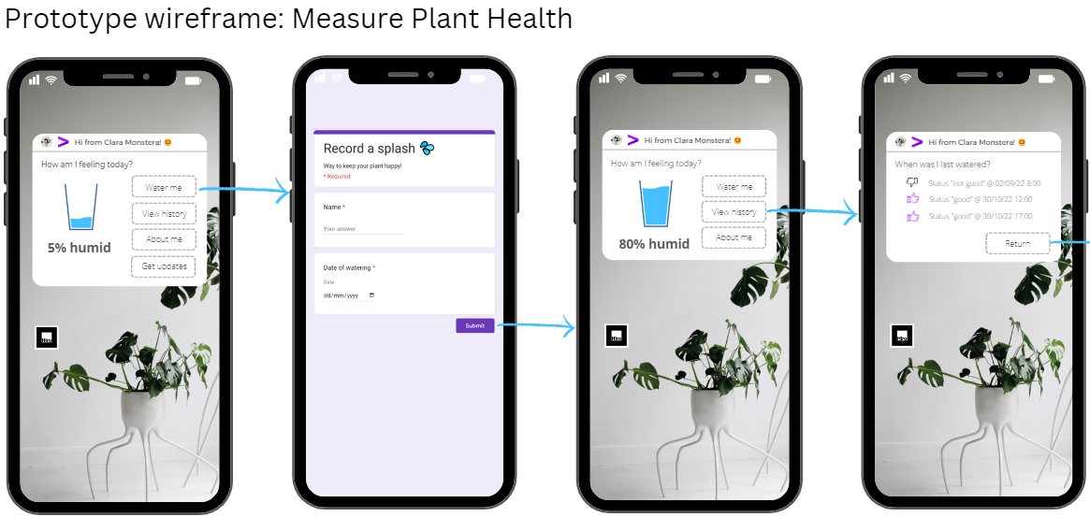
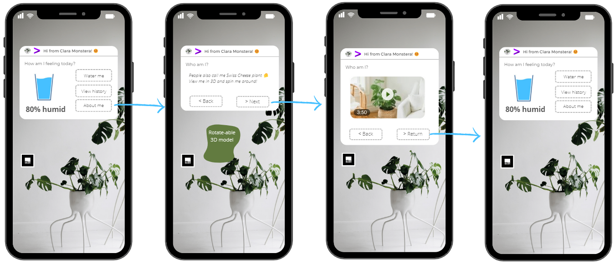
Previously: Wireframe

Slide 94
Problem Statement
Augmented Reality (AR) presents an exciting medium to consume and interact with information. Existing research features technical implementation of primarily native mobile AR apps (‘native AR’ for short) and AR apps on AR headsets (‘AR headset’ for short) while little attention has been paid to web-based AR apps (or ‘web AR’ for short), a feasible and appealing alternative.
Furthermore, the literature review (thesis phase 1) reveals that there is inadequate guidance on the design process of AR applications to help stakeholders and developers assess if a process is suitable for AR, which AR platform (web AR vs. native AR vs. AR headset) is most suitable for the selected process, and which AR development tools are most suitable for the selected process and AR platform.
Solution/ Thesis Scope
An industry-agnostic, tool-agnostic implementation framework for designing, developing, and deploying AR applications in the cloud.
Research Summary
Research Topics/ Key Enablers: AR, web development, cloud infrastructure, IoT.
Research Output Design (Artifact): AR implementation framework (ARIF).
Research Output Demonstration: A web AR application prototype.
Research Output Evaluation: Expert interviews on the utility of the proposed ARIF.
Thesis Phase 1: Systematic Literature Review
This phase focuses on conducting a literature review to answer the following research questions (RQs) i.e., knowledge questions and set the scientific foundation for the ARIF to be designed in phase 2.
Thesis Phase 2: AR Implementation Framework (ARIF)
The phase focuses on the design, demonstration, and evaluation of an industry-agnostic, tool-agnostic ARIF which guides the design, development, and deployment of AR applications.
Artifact Design: ARIF
Design question – RQ#9: How to design an industry-agnostic, tool-agnostic AR implementation framework which guides the design, development, and deployment of AR applications while enabling the resulting AR applications to achieve high user acceptance?
Artifact Demonstration
Demonstration question – RQ#10:
How can the proposed ARIF be used in practice?
RQ#1: What is AR?
sect 2.2
RQ#2: How does AR work?
sect 2.3
Web AR prototype
Design
Input: RQ#4, 9
RQ#3: What factors influence AR adoption?
Input: RQ#1, 2, 3, 5, 8
Implement a web AR prototype using the ARIF.
sect 2.4
Assist business stakeholders and developers in assessing:
Process suitability for AR – RQ#9.1: What makes a process ideal to be enhanced with the use of AR?
AR platform suitability – RQ#9.2: How to choose between web AR vs. native AR vs. AR headsets for a selected process?
AR development tool suitability – RQ#9.3: What tools are most appropriate for a selected process and AR platform?
RQ#4: For web AR, what development tools are available?
sect 2.5
RQ#5: From a technical standpoint, what is the difference between web AR vs. native AR vs. AR headset application development?
Artifact Evaluation
Evaluation question – RQ#11:
What is the efficacy of the proposed ARIF?
sect 2.6
RQ#6: From a technical standpoint, what is the difference between web AR vs. regular, non-AR web application development?
Development
sect 2.7
Input: RQ#1, 2, 3, 5, 6
Input: RQ#9, interview protocol
RQ#9.4: What are the requirements for the development of AR apps?
Expert interviews
RQ#7: What is cloud serverless infrastructure?
Conduct expert interviews to gather feedback on the efficacy of the proposed ARIF.
sect 2.8
Deployment
Input: RQ#8
RQ#8: What is existing research on AR implementation frameworks?
RQ#9.5: What are the requirements for the deployment of AR apps?
sect 2.9

Slide 95
Problem Statement
Augmented Reality (AR) presents an exciting medium to consume and interact with information. Existing research features technical implementation of primarily native mobile AR apps (‘native AR’ for short) and AR apps on AR headsets (‘AR headset’ for short) while little attention has been paid to web-based AR apps (or ‘web AR’ for short), a feasible and appealing alternative.
Furthermore, there is inadequate guidance on the design process of AR applications to help stakeholders and developers assess if a process is suitable for AR, which AR platform (web AR vs. native AR vs. AR headset) is most suitable for the selected process, and which AR development tools are most suitable for the selected AR platform.
Solution/ Thesis Scope
An industry-agnostic, tool-agnostic implementation framework for designing, developing, and deploying AR applications in the cloud.
Research Summary
Research Topics/ Key Enablers: AR, web development, IoT, cloud infrastructure.
Research Output: AR implementation framework
Research Output Validation: web AR app prototype, expert interviews.
Phase 1: Systematic Literature Review
The following preliminary questions (PQ) set the scientific foundation for answering the RQ:
Phase 2: Design, Demonstrate, and Evaluate an AR Implementation Framework
The AR implementation framework provide guidance and reference materials for 3 primary software development lifecycle phases:
Includes design steps and design considerations to help stakeholder and developers assess
Process suitability for AR
AR platform suitability
AR development tool suitability
Includes a reference web AR software architecture
Includes a serverless cloud deployment reference architecture for web AR applications.
Research Question (RQ): What does an implementation framework for web AR applications look like?
sect 2
PQ#1: What is AR?
input for
Design
Research Output Validation
A web AR app prototype: demonstrate how the framework is used in practice and add additional insights to the framework.
Expert interviews: validate and fine-tune the framework.
sect 3.2
PQ#2: How does AR work?
Use framework when developing prototype
sect 3.3
PQ#3: What factors influence AR adoption?
Identify deficiencies in existing AR implementation frameworks which will be addressed in this RQ
sect 3.4
PQ#4: For web AR, what development tools are available?
input for
sect 3.5
Development
Revise framework based on insights collected during prototype development 2) expert interviews
PQ#5: How is web AR application development different from native AR and AR headset application development?
sect 3.5
PQ#6: How is web AR application development different from non-AR application development?
sect 3.6
v3 – AIF: expand scope to AR, not just web AR per Ilia’s suggestion. RT paper v3 submitted Nov 6th
PQ#7: What is cloud serverless infrastructure?
input for
Deployment
sect 3.6
PQ#8: What is existing research on AR implementation frameworks?
sect 3.6

Slide 96
Problem Statement
Augmented Reality (AR) presents an exciting medium to consume and interact with info. Existing research features primarily proof-of-concept (PoC), small scale native mobile AR apps (‘native AR’ for short) and AR apps on AR headsets (‘AR headset’ for short) while little attention has been paid to web-based AR apps (or ‘web AR’ for short), a feasible and appealing alternative.
Solution/ Thesis Scope
Create an industry-agnostic, tool-agnostic implementation framework for designing, developing, and deploying web AR applications in the cloud.
Research Summary
Research Topics/ Key Enablers: Web AR, web app development, IoT, cloud infrastructure.
Research Output: An industry-agnostic, tool-agnostic Web AR implementation framework.
Research Output Validation: web AR app prototype, expert interviews.
Literature Review
The following preliminary questions (PQ) set the scientific foundation for answering the RQ:
Research Output
The web AR implementation framework provide guidance and reference materials for 3 primary software development lifecycle phases:
Includes design steps and design considerations which assist developers in assessing 1) process suitability for AR and 2) web AR suitability for the selected process.
Includes:
1) development steps with a catalog of available web AR development tools based on functionalities
2) a reference web AR software architecture
Includes a serverless cloud deployment reference architecture for web AR applications.
Research Question (RQ): What does an implementation framework for web AR applications look like?
sect 2
PQ#1: What is AR?
input for
Design
Research Output Validation
A web AR app prototype: demonstrate how the framework is used in practice and add additional insights to the framework.
Expert interviews: validate and fine-tune the framework.
sect 3.2
PQ#2: How does AR work?
Use framework when developing prototype
sect 3.3
PQ#3: What factors influence AR adoption?
Identify deficiencies in existing AR implementation frameworks which will be addressed in this RQ
sect 3.4
PQ#4: For web AR, what development tools are available?
input for
Development
sect 3.5
Revise framework based on insights collected during prototype development 2) expert interviews
PQ#5: How is web AR application development different from native AR and AR headset application development?
sect 3.5
PQ#6: How is web AR application development different from non-AR application development?
sect 3.6
v2 – WAIF: restricted to web AR before a status update chat with Ilia Nov 4th + added PQs per Florian’s suggestions. RT v3 submitted Oct 17th
PQ#7: What is cloud serverless infrastructure?
input for
Deployment
sect 3.6
PQ#8: What is existing research on AR implementation frameworks?
sect 3.6

Slide 97
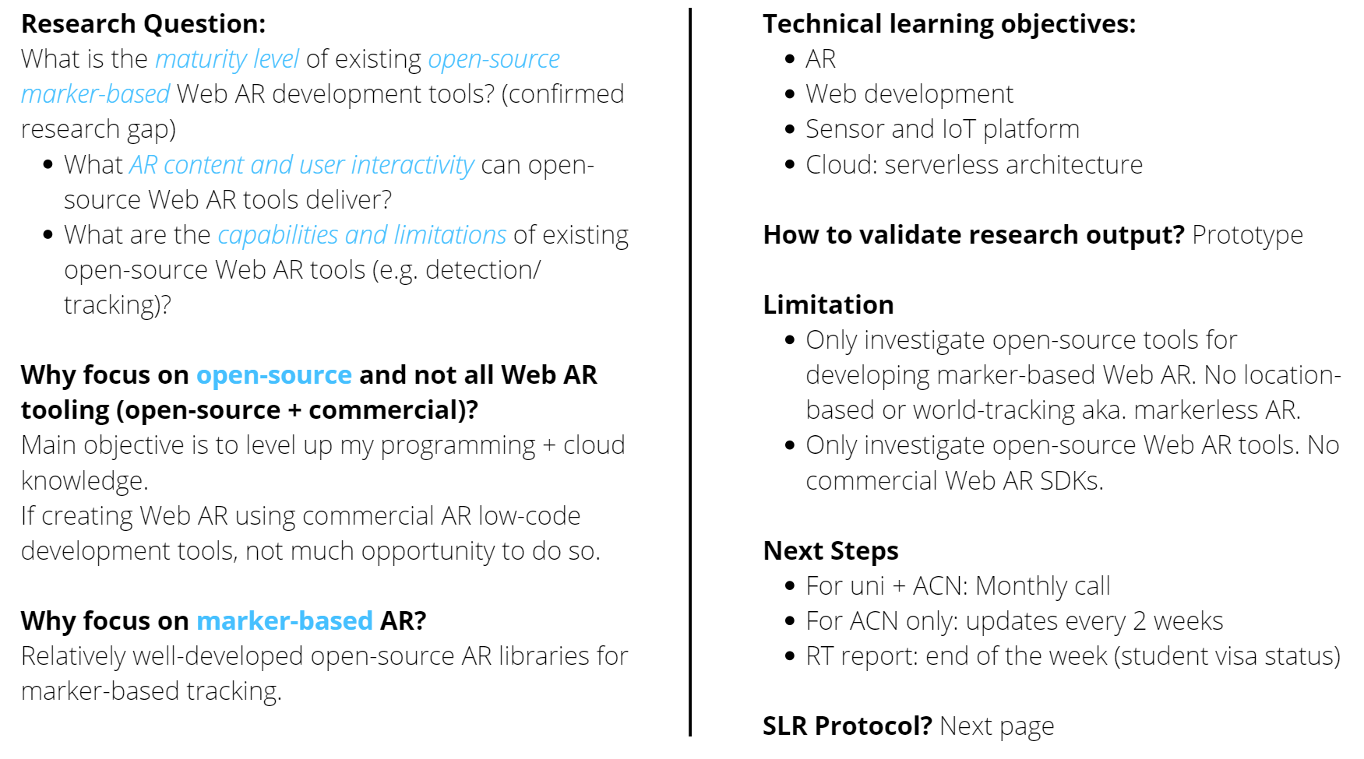
RQ: 2nd iteration of RQ for AR use case – Meet with UT + ACN

Slide 98
Thesis Update on a Page: Research Methodology – v2
To-do: get UT approval for RQs + submit RT paper
Problem Statement
Augmented Reality (AR) presents an exciting medium to consume and interact with info. Existing research features primarily proof-of-concept (PoC), small-scale native mobile AR app while little attention has been paid to web AR, a feasible and appealing alternative.
Solution/ Thesis Scope
Create a solution template for rapid development and scalable deployment of web AR apps in the cloud.
Research Summary
Research Topics/ Key Enablers: AR, web app development, cloud infrastructure, user experience (UX).
Research Output: A solution template for developing and deploying web AR apps in the cloud.
Research Output Validation: expert interviews, web AR app prototype.
Literature Review
& Research Gaps
Functional requirements
PoC native mobile AR app
PoC web AR app.
Features static AR contents:
e.g., 3D models, 2D images, texts.
Features dynamic AR contents: e.g., IoT sensor readings.
Features artificially-generated AR contents: e.g., AI-generated images.
Non-functional requirements
UX: usability.
Cloud infra for scalable deployment.
Other UX: e.g., user journey, privacy, AR content accuracy
AR content lifecycle management: content creation > storage > usage > retirement.
Research Questions (RQ) Addressing Research Gaps
RQ: What does an implementation framework for web AR applications look like?
The following preliminary questions (PQ) set the scientific foundation for answering the RQ:
PQ#1: What is AR?
PQ#2: How does web AR work?
PQ#3: What factors influence AR adoption?
PQ#4: What is the ecosystem of web AR tooling?
Research Output
The web AR implementation framework provide guidance and reference materials for 3 primary software development lifecycle phases:
Design phase: design steps and considerations
Development phase: catalog of web AR development tools + a reference web AR software architecture
Deployment phase: web AR serverless cloud deployment reference architecture
Expert interviews: validate and fine-tune the framework.
A web AR app prototype: demonstrate how the framework is used in practice and add additional insights to the framework
HIGH
well-researched
LOW
limited research
NONE
no research
HIGH
LOW
HIGH
LOW
NONE
LOW
NONE
NONE
NONE

Slide 99
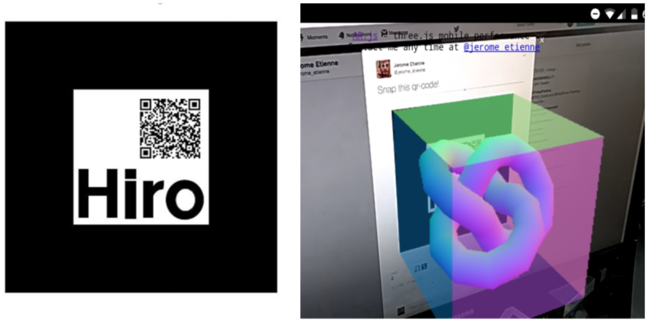
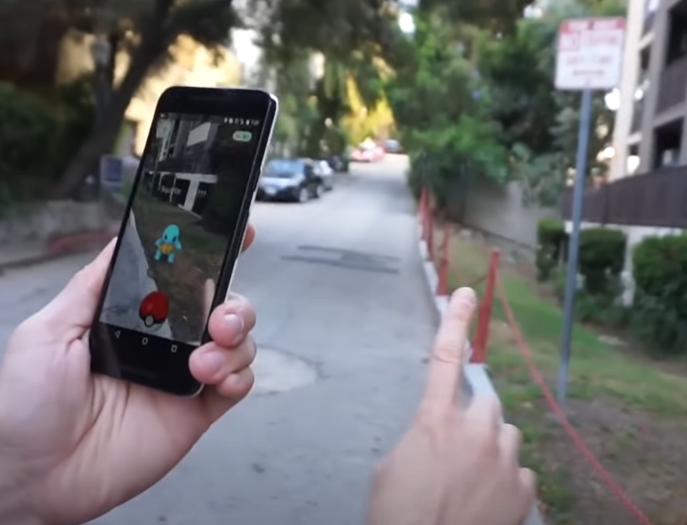
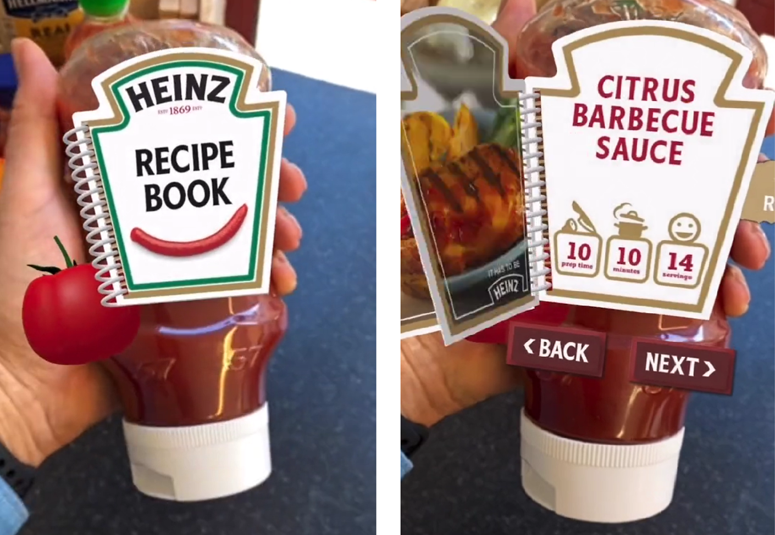

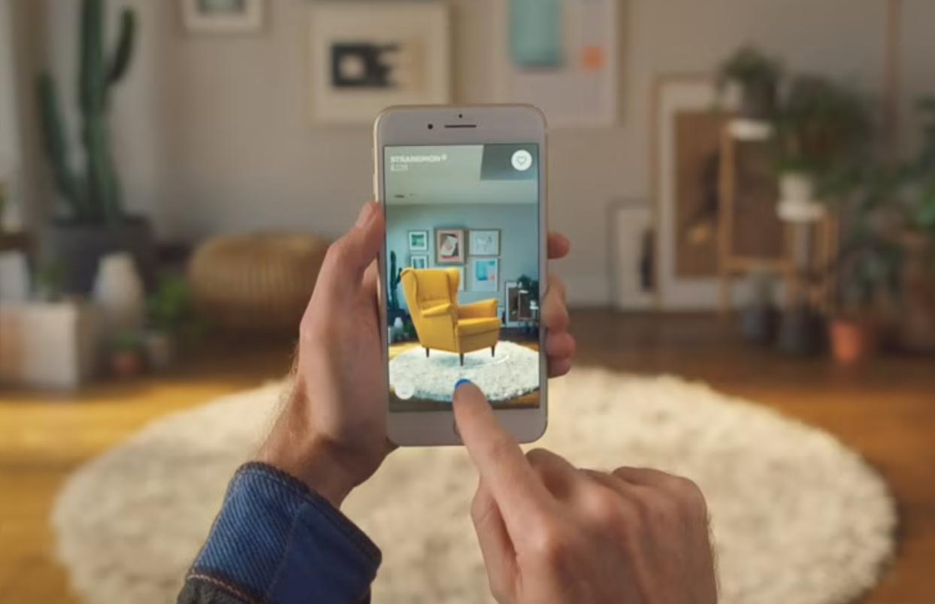
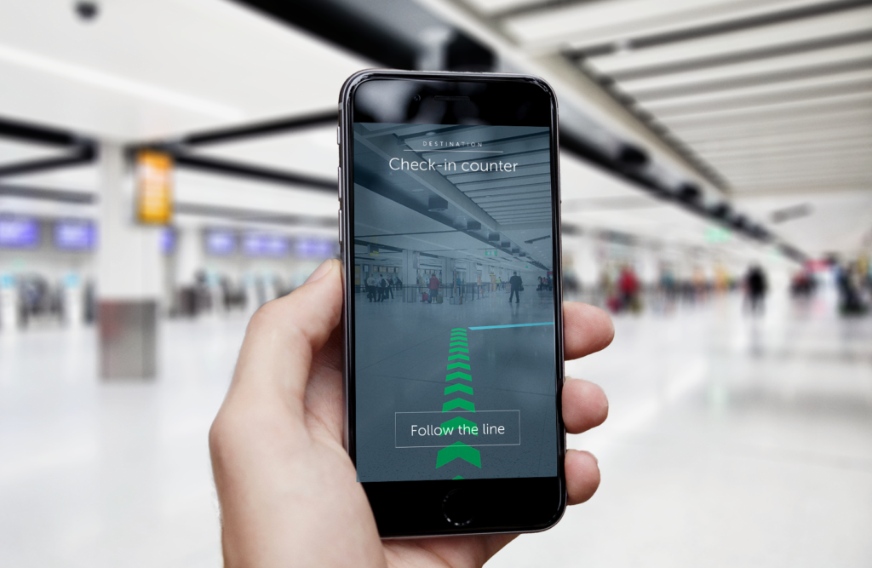
Thesis Update on a Page: Research Methodology – UT call after AR use case finalized
Research Topics: AR, web application development, cloud infrastructure, user experience (UX).
AR by Tracking Techniques
AR by Hardware
(1) Fiduciary marker tracking
(2) Location
AR-dedicated hardware: HoloLens, Oculus, Google Glass
Native mobile app: downloaded from app store;
Web AR app: run in web browser
(3) Image tracking
(4) Face Tracking
(5) World tracking

Slide 100
Thesis Update on a Page: Research Methodology – v1
To-do: get UT approval for RQs + submit RT paper
Problem Statement
Augmented Reality (AR) presents an exciting medium to consume and interact with info. Existing research features primarily proof-of-concept (PoC), small-scale native mobile AR app while little attention has been paid to web AR, a feasible and appealing alternative.
Solution/ Thesis Scope
Create an implementation framework for designing, developing and deploying web AR to the cloud.
Research Summary
Research Topics/ Key Enablers: AR, web app development, sensors and IoT, cloud infrastructure,.
Research Output: web AR implementation framework
Research Output Validation: web AR app prototype, expert interviews.
Literature Review
& Research Gaps
Functional requirements
PoC native mobile AR app
PoC web AR app.
Features static AR contents:
e.g., 3D models, 2D images, texts.
Features dynamic AR contents: e.g., IoT sensor readings.
Features artificially-generated AR contents: e.g., AI-generated images.
Non-functional requirements
UX: usability.
Cloud infra for scalable deployment.
Other UX: e.g., user journey, privacy, AR content accuracy
AR content lifecycle management: content creation > storage > usage > retirement.
Research Questions (RQ) Addressing Research Gaps
RQ#1: What are functional requirements of a web AR app?
1.1 How does a web AR app identify an object to be augmented?
1.2 How does a web AR app retrieve static, dynamic, and artificial AR contents associated with the identified object?
1.3 How does a web AR app render the retrieved AR contents in a web browser?
RQ#2: What does a reference infrastructure look like to securely deploy and scale a web AR app in the cloud?
RQ#3: What are non-functional requirements of a web AR app to enhance user experience?
RQ#4: What does AR content lifecycle management look like?
Research Output
The solution template consists of 4 components corresponding to the RQs.
Web AR software architecture: fulfill functional requirements
Cloud reference architecture: materialize the proposed software architecture with existing cloud solutions
List of non-functional, UX-related requirements
AR content lifecycle mgmt. flowchart
Expert interviews: validate and fine-tune the solution template.
A web AR app prototype: demonstrate how the (non)-functional requirements are implemented.
HIGH
well-researched
LOW
limited research
NONE
no research
HIGH
LOW
HIGH
LOW
NONE
LOW
NONE
NONE
NONE

Slide 101
Research Proposal on a Page: Use Case Pitch to Ilia
Kristen’s strengths: cloud + security + big data architecture; Kristen’s shortcomings: software engineering + ML (minimal exp); XR + IoT (no exp)
# | Required Expertise | Use Case Summary | Problem Statement | Solution | Feasibility 1 = least 3 = most | Comments/ Resources
1 | Software engineering, cloud, industry knowledge | Payment gateway multi-cloud, microservice-based reference architecture | Payment gateway needs to modernize their architecture to handle peak loads | Map business processes + regulatory compliance reqs → microservice + infra reqs. Evaluate reference architecture on multi dimensions: performance, compliance, cost |  | ACN Project Fortuna - Modern Architectures on Azure (2019) What now? Extend to multi-cloud or different payment schemes/ methods (potential duplicate work)
2 | Software engineering + ? | Interactive grocery loyalty app that displays relevant promotions based on shopper’s movement around the store | Hard to plan grocery shopping as new promotions and gratis boodschappen based on points are buried deep in loyalty app | Shopper to open app when entering store. Store camera to track shopper’s movement and show relevant promotions on app e.g., when standing in fresh produce section, show broccoli is on sale. Camera to track coordinate and use it to calculate proximity to different store sections. Pull promotions data based on proximity.
3 | Machine learning | A supervised, regression ML model to predict the remaining nutritional value of fresh produce | Fresh produce has short shelf life. Consumers don’t know how much nutritional value they’re paying for | User to point camera at fresh produce and app to give a predicted remaining nutritional value. ML model to predict ripeness from image and use ripeness as proxy for nutrition calculation
4 | IoT + edge computing | Programmable diving suit that adapts to surrounding water temperature | Requires different suits for different temperature ranges. | Sensor to detect temp drop and actuator to blow up extra air bubbles for insulation
5 | XR + AI | An augmented reality app that allows users to point camera at different landmarks and learn about their history or cultural/ engineering backstory. Think Pokémon Go | Needs a new way to create immersive, engaging experience for tourists/ locals using new technology | Point phone camera at a wildlife crossing and see animations of different types of animals crossing on phone. Or 140-meter long, one-piece bridge in Stockholm. ML model to recognize and pull data about a landmark. XR engine to generate animations based on data
Copyright © 2022 Accenture. All rights reserved.
101

Slide 102
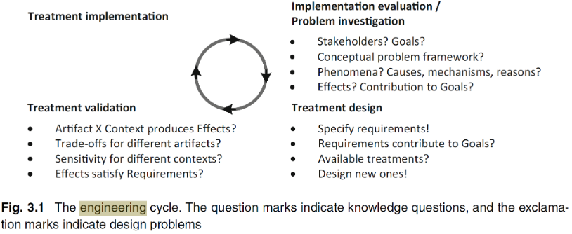
Research Proposal on a Page: 1st meeting with UT before AR use case finalized
Host Institution: Accenture Liquid Studio
Allows clients to experiment with new technology (cloud, VR, BCI – brain computer interface, etc.) through rapid prototyping
Past deliverables: BCI-controlled coffee machine
Research Methodology: Engineering Cycle
Define initial use case:
Discussion with ACN supervisor
Industry research: ACN internal research materials
Validate/ refine use case:
Literature review
Review of existing ACN assets: FORTUNA
Interviews with ACN Cloud/ Banking professionals
The use of a multi-cloud, microservice-based reference architecture [artifact] for implementing a core banking service [context] will enable the service to [stakeholder's goals]:
1) meet peak load demands > higher revenue from payment processing fees,
2) satisfy regulatory compliance: security measures + data governance,
3) provide observability into service performance on several dimensions: SLAs, cost
Research Summary
Key technology enabler: Cloud infrastructure
Industry: TBD – Banking
Industry use case: TBD – payment gateway architecture
Research output: Research questions TBD
Multi-cloud, microservice-based reference architecture for implementing a core banking service
Prototype materialized from the reference architecture to validate architecture design decisions on various dimensions e.g, performance and regulatory compliance
Problem Investigation
Define business processes
Define regulatory compliance reqs: security measures + data governance
Define functional/ non-functional reqs of the reference architecture
Design/ iterate reference architecture
Treatment Design
Research Plan Gantt Chart
Research topic: 7 weeks
Final project: 22,5 weeks
research-plan
Write test cases
Build prototype from the reference architecture
Test prototype using ACN testing frameworks: load testing, security testing, compliance testing
Treatment Validation
Copyright © 2022 Accenture. All rights reserved.
102

Slide 103
Introduction
AR 101
Web AR 101
Prototype
AR Implementation Framework (ARIF)
ARIF: Design
ARIF: Develop
ARIF: Deploy
Key Takeaways
Web AR 101
includes:
silly demo with Ilia head sticking to my forehead: or in presentation invite
uncomment code as I continue to explain how web ar works

Slide 104

Introduction
AR 101
Web AR 101
Prototype
AR Implementation Framework (ARIF)
ARIF: Design
ARIF: Develop
ARIF: Deploy
Key Takeaways
Design: Process Suitability for AR – Use Case Highlights 9/9
Entertainment: Immersive experience with less emphasis on functionalities and more on contents.
Process Characteristics
Content enriching
Navigation
Collaboration
Hard-to-simulate environment
Work instructions
Gesture control
Voice control
Gaze control
Tracking
Fiduciary/ Image
Face
Natural feature
Location
World
Spatial
Design phase
Process suitability for AR
AR platform suitability
AR dev. tool suitability
Notes:
YT video: Coachella and Flume go all in on live concert AR | Spotlight | Unreal Engine
Less emphasis on functionalities: technically easy to implement
More emphasis on contents: focus on composing an engaging story

Slide 105
Introduction
AR 101
Web AR 101
Prototype
AR Implementation Framework (ARIF)
ARIF: Design
ARIF: Develop
ARIF: Deploy
Key Takeaways
Design phase
Design: AR Platform Suitability – Selection Criteria
Decompose AR adoption success factors into AR platform selection criteria categorized into 2 groups.
Process suitability for AR
AR platform suitability
AR dev. tool suitability
Usage Condition-Specific Criteria
Hardware Specification Criteria
Lighting conditions
Network connectivity
Noise
Operating temperature
Operating humidity
Drop-safe
Water-/ dust-proof
Compliance with health/ safety standards
Hand usage
User interactions
E.g., An AR solution deployed in damp, dimly lit, underground mines with no internet connection (criteria #1, 2, 6, 7, 8) for rescue navigation.
E.g., When an AR solution assists a surgeon during a surgery, best that the surgeon can control the AR solution hand-free (criteria #9) > Only AR headsets offer hand-free usage.
E.g., Most AR headsets have built-in functionalities for remote support (criteria #10) including making video calls and streaming live camera feed.
Battery life
Device weight
Connectivity
Camera resolution
Display resolution
Field-of-view
Refresh rate
Storage capacity
Computation capability
Remote rendering
Integration with 3rd party systems
Hardware cost
E.g., HoloLens has limited computation and storage capability (criteria #8, 9) but can rely on Azure Remote Rendering for rendering high-fidelity 3D models.
E.g., Google Glass 2 is one of the lightest AR headsets (criteria #2), causing less head fatigue during usage.
E.g., Vuzix M400 has built-in integration with Zoom and WebEx video conferencing software (criteria #10).

Slide 106
Design: AR Platform Suitability
includes: characteristics + capabilities + limitations of: web AR, native AR, AR on specialized hardware
types of interactivities
gesture command: Researchers look to add augmented reality to miners’ helmets
voice command: Augmented Reality for Enabling Smart Nuclear Infrastructure
gaze command: Microsoft HoloLens: Gaze Input
remote collaboration: example of Dutch police use augmented reality to investigate crime scenes
success factors for AR adoption: instead of getting in the weeds by reading up technical specs of individual tools, go straight to the end users
1. working conditions requirements: 1) light, 2) internet connection, 3) noise, 4) temperature, 5) weather, 6) rugged conditions > drop safe, 7) hand usage 8) User interaction
2. hardware requirements: battery lifetime, weight, camera and display resolution, storage capacity, compliance with safety standards, processing speed, sensor accuracy, hardware cost
3. software requirements: acceptable latency while ensuring adequate tracking + rendering, ease authoring systems, integration with enterprise systems
acceptable latency while ensuring adequate tracking + rendering
azure remote rendering supports only hololens + windows pc
then reference to: AR dev tool suitability
industry-wide standardizations of solutions: research tried-and-tested use cases > not relevant here
external support: rely on in-house or external vendor to guide the implementation > not relevant here
implementation cost: design, develop, deploy, maintain > not relevant here
easy authoring systems > not relevant here: include in AR dev tool suitability
integration with enterprise systems + authorized data access and data updates > not relevant here: include in Develop + Deploy phase
4. user experience requirements: these success factors can be measured during user journey + prototype iterations
user experience: distractions + mental overload, head fatigue from wearing headset, eye fatigue
adequate training: perhaps translate to intuitive UI and interactivity
intuitive interactivity: gesture + voice + gaze + collab
info accuracy + timeliness: perhaps use AR risk assessment framework about AR failure > perception > comprehension > decision making (paper: Safe-AR: Reducing Risk While Augmenting Reality)
ergonomics: movement restrictions, field of view, weight, portability, suitability, for outdoors use, for specific working conditions
psychological risks: fear of losing jobs, over-reliance on technology, making wrong decisions, fear of perceived competence loss, etc.
regulations – privacy and data protection: human face, medical records, employee surveillance, etc.
regulations – compliance with safety standards

Slide 107
Design: AR Development Tool Suitability
includes: dimensions to benchmark different tools
cost: open-source y/n
tracking capabilities
fiduciary marker
image marker
face
location: gps
natural feature
spatial mapping
world tracking aka. markerless
custom tracking: location indoors, electromagnetic sensor tracking, etc.
rendering capabilities
hololens: has azure remote rendering YT video: Reimagine bridge inspection with Azure Remote Rendering and HoloLens
interactivity: gives example of:
gesture command
voice command
gaze command
remote collaboration
ease of development
graphical design interface
simulator testing
easy authoring system: success factors for AR adoption

Slide 108
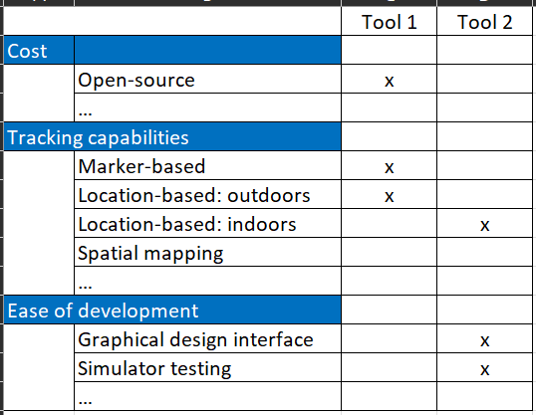
Web AR Implementation Framework
Design
Develop
Deploy
Process suitability for AR
Web AR suitability
Web AR tools suitability
Prototype serverless architecture
A list of factors which determine if AR can help improve a process:
Example:
1) Equipment inspection and maintenance
Distill a list of web AR characteristics, capabilities, and limitations to help determine if web AR is a suitable AR platform for chosen use case.
Example:
1) Working conditions: web AR requires stable internet connection
2) Hand usage: one hand occupied (surgeon example)
3) Interactivity: web AR does not support gaze control
Provide a vendor landscape to speed up the selection of Web AR tools for chosen use case.

Slide 109
AR Implementation Framework Overview
includes:
3 phases and research output:
design:
3 questions: 1) process suitability for AR 2) AR platform suitability 3) AR dev tool suitability
develop:
experience using web ar tools feed into 1) AR dev tool suitability 2) AR platform suitability
service-orientated architecture (SOA)
Agile development
CI/CD for rapid release > address a success factor for AR adoption: implementation cost: design, develop, deploy, maintain
deploy:
security principles: least privilege + zero-trust + IaC + serverless + design decisions > success factor: integration with enterprise systems: authorized data access and data updates
Design for cost optimization > address a success factor for AR adoption: implementation cost: design, develop, deploy, maintain

Slide 110
Introduction
AR 101
Web AR 101
Prototype
AR Implementation Framework (ARIF)
ARIF: Design
ARIF: Develop
ARIF: Deploy
Key Takeaways
37 use cases
reviewed
Design: Determine Process Suitability for AR Based on 2 Dimensions
Process Characteristics
User Interactivity
Below are characteristics which make a process an ideal candidate for AR.
Below are possible interactivities in AR. Determine they are appropriate for the process.
1. CONTENT ENRICHING
1. GESTURE CONTROL
A process is enhanced when provided intuitive ways to access, publish, and interact with contents.
User uses hand gesture to control and modify 3D contents.
2. WORK INSTRUCTIONS
2. VOICE CONTROL
Worker productivity is enhanced when provided step-by-step work instructions.
User uses voice to control and modify 3D contents.
3. NAVIGATION
3. GAZE CONTROL
Process is enhanced when provided real-time navigation.
User uses eye movements to control and modify 3D contents.
4. COLLABORATION
4. COLLABORATION
Decision making is enhanced when provided real-time collaboration.
Multiple users interact with 3D contents in real-time.
5. HARD-TO-SIMULATE ENVIRONMENT
Process requires workers to work in hard-to-simulate environment.

Slide 111
Design: Process Suitability for AR
Have not discussed different types of interactivities yet
# | Process char | Use case highlights | Tracking | Interactivity | Industry
1 | Info enriching + collab + hard to simulate | Design and Implementation of “AugMedicine: Lung Cases,” an Augmented Reality Application for the Medical Curriculum on the Presentation of Dyspnea: video here YT video: A hospital revolution: VSI HoloMedicine® | World tracking | Collab + Voice | Medicals
2 | Info enriching + navigation | Identification of Living Human Objects from Collapsed Architecture Debris to Improve the Disaster Rescue Operations Using IoT and Augmented Reality (no screenshot; no video) Augmented Reality for Fire & Emergency Services (no screenshot, no video) + YT video: Augmented reality could be a game-changer for firefighters + Nice AR interface: airport wayfinding | Natural feature, World tracking, Location | Collab | Rescue
3 | Info enriching + navigation + hard to simulate | Future of First Response: Vision for Police YT video: Microsoft HoloLens: Partner Spotlight with Black Marble (policing work) | Location, World tracking, Spatial | Collab + gesture | Police
4 | Info enriching + hard to simulate | YT video: Microsoft HoloLens 2: Partner Spotlight with VisualLive and NOX Innovations YT video: Microsoft HoloLens: Design spaces in real-world context with Microsoft Layout (floorplan design) | Spatial | Collab + gesture | Construction
5 | Info enriching + work instructions + remote colab | YT video: More detailed demo of Manifest's AR work instructions solution + how to author a new work instruction/ training | Spatial | Collab + gesture | Industrials
6 | Hard to simulate | YT video: Programming a Robotic Arm Using Augmented Reality & Spatial Computing | PTC Reality Lab | Spatial | N/A | Robotics
7 | Info enriching | YT video: Coachella and Flume go all in on live concert AR | Spotlight | Unreal Engine | Location | N/A | Entertainment
8 | Info enriching | Covid dashboard in AR with gaze control https://www.linkedin.com/posts/matthew-hallberg-49645292_technology-tech-augmentedreality-activity-6650174999191781376-0UKA?trk=public_profile_like_view | World tracking | Gaze
174
use cases
reviewed

Slide 112
Introduction
AR 101
Web AR 101
Prototype
AR Implementation Framework (ARIF)
ARIF: Design
ARIF: Develop
ARIF: Deploy
Key Takeaways
Design: Determine Process Suitability for AR – Use Case Highlights
Medicals: Medical Training + Surgery Planning and Patient Care
Process Characteristics
Info enriching
Navigation
Collaboration
Hard-to-simulate environment
Work instructions
User Interactivity
Gesture
Voice
Gaze
Collabo-ration
Tracking
Fiduciary/ Image
Face
Natural feature
Location
World
Spatial
Notes:
Design and Implementation of “AugMedicine: Lung Cases,” an Augmented Reality Application for the Medical Curriculum on the Presentation of Dyspnea: video here
Multiple students together view a 3d model of lung and listen to the sound it makes for different lung conditions
YT video: A hospital revolution: VSI HoloMedicine®
Construct a 3d model of patient’s organs and tumors from 2d MRI/ CT scan images.
Examine the 3D model to plan for surgery and determine success rate.
Walk patient thru surgery procedural to ease them before the surgery.
View patient data during and post-surgery to assist in decision making.

Slide 113
Introduction
AR 101
Web AR 101
Prototype
AR Implementation Framework (ARIF)
ARIF: Design
ARIF: Develop
ARIF: Deploy
Key Takeaways
Design: Determine Process Suitability for AR – Use Case Highlights
Emergency Services: Firefighter with X-Ray Vision + Using Drones and AR To Look for Buried Victims in Collapsed Buildings
Process Characteristics
Info enriching
Navigation
Collaboration
Hard-to-simulate environment
Work instructions
User Interactivity
Gesture
Voice
Gaze
Collabo-ration
Tracking
Fiduciary/ Image
Face
Natural feature
Location
World
Spatial
Notes:
YT video: Augmented reality could be a game-changer for firefighters
Use thermal camera to highlight the contour of a room and objects inside that room in neon colors > enable fire fighters to see in a smoke-filled room
Identification of Living Human Objects from Collapsed Architecture Debris to Improve the Disaster Rescue Operations Using IoT and Augmented Reality:
(no screenshot; no video):
use drones to detect signals from wearable devices and locate buried victims in collapsed buildings
prioritize victims based on age, heart rate, etc.
navigate firefighters to the victim’s location
Augmented Reality for Fire & Emergency Services:
view building blueprint,
stream live video to control center,
receive navigation instructions,
mark an area as search complete,
voice memo of the patient condition and first aid performed.

Slide 114
Introduction
AR 101
Web AR 101
Prototype
AR Implementation Framework (ARIF)
ARIF: Design
ARIF: Develop
ARIF: Deploy
Key Takeaways
Design: Determine Process Suitability for AR – Use Case Highlights
Policing: Crime Scene 3D Mesh + Live Data Stream + Location Tracking To Avoid Friendly Fire
Process Characteristics
Info enriching
Navigation
Collaboration
Hard-to-simulate environment
Work instructions
User Interactivity
Gesture
Voice
Gaze
Collabo-ration
Tracking
Fiduciary/ Image
Face
Natural feature
Location
World
Spatial
Notes:
YT video: Microsoft HoloLens: Partner Spotlight with Black Marble (policing work)
3d mesh of crime scene + live stream data to command center
Based on live stream video, remote forensics specialists can guide on-site police officers (e.g., bagging a special piece of evidence) and avoid overcrowding the crime scene and potentially contaminate the scene
View reports + crime scene back in station: detectives to retrace the steps of the murder to solve the case
Future of First Response: Vision for Police
Track live location of fellow officers to avoid friendly fire
View live camera from drone to see where the suspect is and how to best approach
Receive navigation instructions from remote officers

Slide 115
Introduction
AR 101
Web AR 101
Prototype
AR Implementation Framework (ARIF)
ARIF: Design
ARIF: Develop
ARIF: Deploy
Key Takeaways
Design: Determine Process Suitability for AR – Use Case Highlights
Constructions: Fabrication Planning and Progress Monitoring + Layout Planning
Process Characteristics
Info enriching
Navigation
Collaboration
Hard-to-simulate environment
Work instructions
User Interactivity
Gesture
Voice
Gaze
Collabo-ration
Tracking
Fiduciary/ Image
Face
Natural feature
Location
World
Spatial
Notes:
YT video: Microsoft HoloLens 2: Partner Spotlight with VisualLive and NOX Innovations
Used for the construction of a Microsoft data center
Review structure to be built before actual build
Persistently anchor 3d model of the structures in physical space
Visually inspect and track the progress: e.g., pull data from construction monitoring platform and label the virtual structure with “behind schedule”, “on schedule”, or “ahead of schedule”
YT video: Microsoft HoloLens: Design spaces in real-world context with Microsoft Layout (floorplan design)
Microsoft Layout is a specialized solution for designing floorplan layout
Construct a new layout using existing 3d models
Review layout with colleagues.

Slide 116
Introduction
AR 101
Web AR 101
Prototype
AR Implementation Framework (ARIF)
ARIF: Design
ARIF: Develop
ARIF: Deploy
Key Takeaways
Design: Determine Process Suitability for AR – Use Case Highlights
Industrials: Easy Authoring of Step-by-step Work Instructions
Process Characteristics
Info enriching
Navigation
Collaboration
Hard-to-simulate environment
Work instructions
User Interactivity
Gesture
Voice
Gaze
Collabo-ration
Tracking
Fiduciary/ Image
Face
Natural feature
Location
World
Spatial
Notes:
YT video: More detailed demo of Manifest's AR work instructions solution + how to author a new work instruction/ training
Business users can create new work instructions without having to write a single line of code

Slide 117
Introduction
AR 101
Web AR 101
Prototype
AR Implementation Framework (ARIF)
ARIF: Design
ARIF: Develop
ARIF: Deploy
Key Takeaways
Design: Determine Process Suitability for AR – Use Case Highlights
Airport Navigation
Process Characteristics
Info enriching
Navigation
Collaboration
Hard-to-simulate environment
Work instructions
Interactivity
Gesture
Voice
Gaze
Collabo-ration
Tracking
Fiduciary/ Image
Face
Natural feature
Location
World
Spatial
Source: https://www.resonai.com/blog/smart-buildings-101

Slide 118
Introduction
AR 101
Web AR 101
Prototype
AR Implementation Framework (ARIF)
ARIF: Design
ARIF: Develop
ARIF: Deploy
Key Takeaways
Design: Determine Process Suitability for AR – Use Case Highlights
Robotics: Program a Robotic Arm using AR
Process Characteristics
Info enriching
Navigation
Collaboration
Hard-to-simulate environment
Work instructions
User Interactivity
Gesture
Voice
Gaze
Collabo-ration
Tracking
Fiduciary/ Image
Face
Natural feature
Location
World
Spatial
Notes:
YT video: Programming a Robotic Arm Using Augmented Reality & Spatial Computing | PTC Reality Lab
Intuitively program a robotic arm using spatial tracking.

Slide 119
Introduction
AR 101
Web AR 101
Prototype
AR Implementation Framework (ARIF)
ARIF: Design
ARIF: Develop
ARIF: Deploy
Key Takeaways
Design: Determine Process Suitability for AR – Use Case Highlights
Entertainment: Immersive Experience with Less Emphasis on Functionalities and More on Contents
Process Characteristics
Info enriching
Navigation
Collaboration
Hard-to-simulate environment
Work instructions
User Interactivity
Gesture
Voice
Gaze
Collabo-ration
Tracking
Fiduciary/ Image
Face
Natural feature
Location
World
Spatial
Notes:
YT video: Coachella and Flume go all in on live concert AR | Spotlight | Unreal Engine
Less emphasis on functionalities: technically easy to implement
More emphasis on contents: focus on composing an engaging story

Slide 120
WAIF:
once use case defined that AR is a suitable solution, now decide the medium: web ar vs. native ar vs. ar headsets based on (1) and (2)
how to embed (1) and (2) in WAIF;
add the following as an immediate between [Research Questions] > [Research Ouput] AND move [Research Output Validation] in parallel to this immediate.
(1) web ar key characteristics:
one-hand occupied
stable internet connection
no app download
faster development
financials: device cost (no ar hardware), licensing (for Vuforia+unity), app store fee (native ar)
open-source js library has no graphical tool for design AR contents as in Unity
hardware: no heavy headset like HMD;
unity project can be exported to arcore, arkit, or hololens, but no webar yet (think unity can be exported to webgl but only for VR content since Vuforia tracking engine does not support web ar yet) (source 14.35)
(2) web ar capabilities & limitations: only for open-source tools
what types of AR contents?
what types of user interactivity? – voice control, hand control, etc.
any tracking techniques available in mobile ar and ar headsets but not for web ar (e.g., natural feature tracking)?
possible to use multiple markers?
which tracking for which use case?
possible to use multiple tracking techniques?
capabilities and limitations of web ar tracking engines
ar.js location-based tracking: only for (lat,lon), not for indoor positioning system (IPS); perhaps IPS is possible for web ar but need to write plug-ins
unity: have simulator mode for testing AR experience (source 14.12)
possible to use custom UI by web frameworks like Angular (e.g., Angular Material)
multi-user interacting with the same AR scene?
no remote collaboration e.g., phone call with remote exports as for hololens
random ideas:
criteria for selecting AR tracking engine
type of tracking
tracking robustness: https://ieeexplore.ieee.org/document/8281493 > collect these technical reqs while doing user journey
luminosity = lighting conditions
tracking distance
marker type: fiduciary, qr code, etc.
occlusion: testing ARToolkit’s robustness based on occulusion https://ieeexplore.ieee.org/document/5685477
cross-platform support : e.g., ios, android, headsets like hololens, web ar
wikitude supports ios, android, windows, smart glasses hololens + Epson Moverio + vuzix
rich built-in capabilities = faster development time + more flexible use cases
paper https://ieeexplore.ieee.org/document/6947744 implements its own speech command functionality when building AR for HMD with Mixed Reality Toolkit (MRTK)
Process selection + AR suitability + AR platform suitability
research common use cases in the industry as a starting point for brainstorming
choose a process
choose performance measure for the process
break down process into 1) cognitive task 2) perceptual task = requirements
collect more reqs:
based on success factors + technical/user-based issues
what tracking techniques
conduct user journey test to validate AR + AR platform suitability + impact on user and work process

Slide 121
Attribute | Yes | No | Total | High-Level Findings/ Research Gaps
The paper discusses web AR | 8 | 24 | 32 | Limited literature about web AR exists compared to that of native mobile AR applications.
The paper includes an implementation of an AR application prototype. | 19 | 13 | 32 | 19 out of 32 papers discusses an implementation an AR application prototype. 4 out of 19 are web AR prototypes 16 out of 19 are native mobile AR prototypes. Most AR contents used in prototypes are static while only a small portion is dynamic. None of the prototypes use artificial AR contents. This research gap is addressed in RQ#1. 15 out of 19 prototypes augment static AR contents such as 3D models, 2D images, text, and audio. 4 out of 19 prototypes augment dynamic AR contents such as social media posts and sensor readings. 0 out of 19 prototypes augment artificial AR contents such as images created by machine learning models.
The paper discusses the software architecture of the implemented web AR app prototype. | 2 | 30 | 32 | Out of 19 papers which implement an AR application prototypes, only 2 of them discuss the prototype’s software architecture. This research gap is addressed in RQ#1.
The paper mentions the use of cloud infrastructure for deploying the prototype. | 6 | 26 | 32 | Out of 19 papers which implement an AR application prototypes, 6 of them uses cloud resources for deploying the prototype. Cloud resources range from full app hosting environments (e.g., Google Firebase, AWS GameSparks), virtual machines (e.g., AWS EC2), storage solutions (e.g., Google Cloud Storage), and cloud-based IoT platforms. While the discussed use of cloud resources fulfills the requirements for deploying the prototype, none of the papers discuss the scalability of the prototype in the cloud and relevant topics such as security in the cloud. This research gap is addressed in RQ#2.1.
The paper evaluates the implemented prototype. | 3 | 29 | 32 | Out of 19 papers which implements an AR application prototype, only 3 papers evaluate the implemented prototype and measure only the usability of the AR app i.e., how user-friendly, and informative the AR apps are. This points to a research gap where little attention has been paid to non-functional requirements such as privacy of AR apps to enhance user experience. This research gap is addressed in RQ#3.
The paper discusses how AR content lifecycle should be managed | 0 | 32 | 32 | No full lifecycle management. This research gap is addressed in RQ#4.

Slide 122
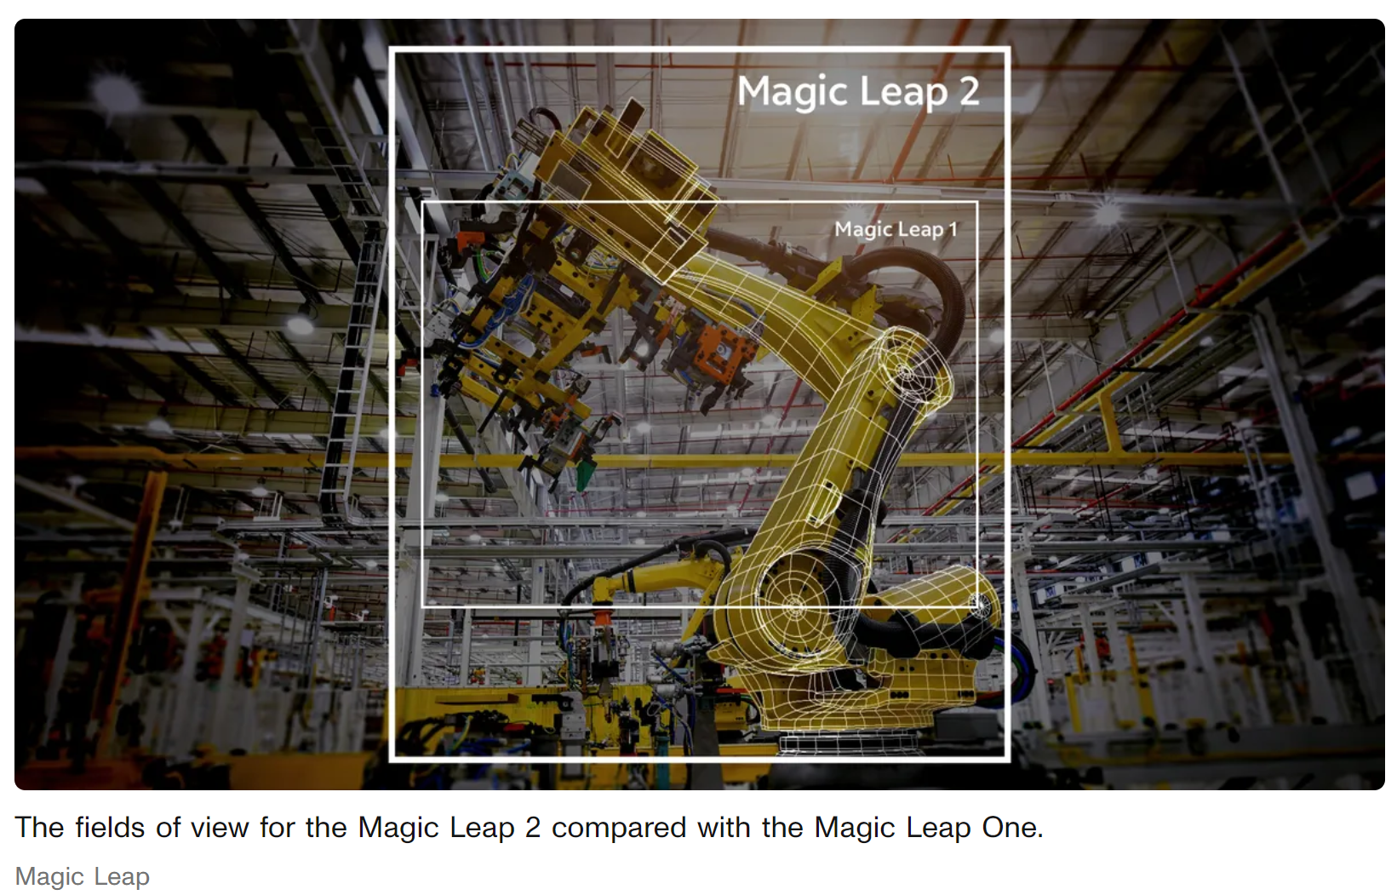
https://www.cnet.com/tech/computing/magic-leap-2-aims-to-bring-ar-to-business-customers-with-no-bs-this-time-around/
AR by tracking techniques
Marker-based: ls run (using QR code)
Image-based: ketchup recipe Heinz
Face tracking: snapchats
Location-based: ikea
AR by hardware
AR headset: Hololens, google glass
Native mobile app
Web AR in browser
HIGH
MED
LOW

